Slide 1
Science Connections
Yr 9 Bushfire and Ice resource
scienceconnections.edu.au

Slide 2
L1 Launch
Exploring bushfires

Slide 3
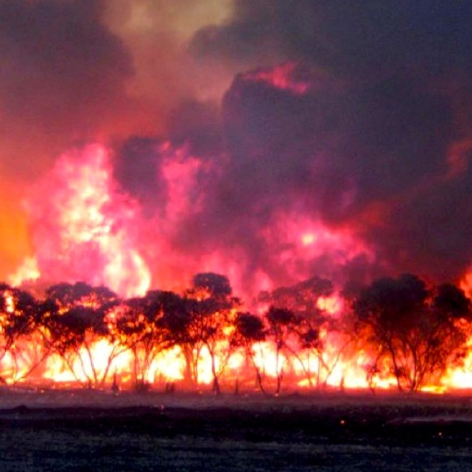
Think
What are people thinking about?
Feel
What emotions are people describing or showing?
Say
How do people describe what has happened?
Do
How are people moving and acting?
Notes:
Bushfire photo: Photographer: Mark Modra., CC BY-SA 4.0, via Wikimedia Commons

Slide 4
What do you know about bushfires?
Has Australia always had bushfires?
Why are we so worried about bushfires now?
What makes a fire a bushfire?
Is a fire in grassland called a bushfire? Why? Why not?
Do bushfires occur in all parts of Australia?
What different types of environments occur across Australia?
Do you think a fire behaves the same in all environments? Why do you think that?

Slide 5
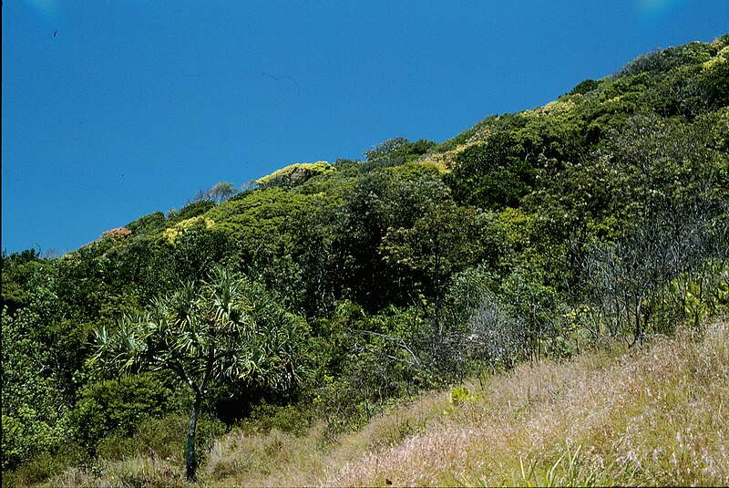
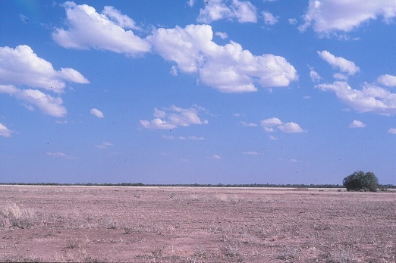
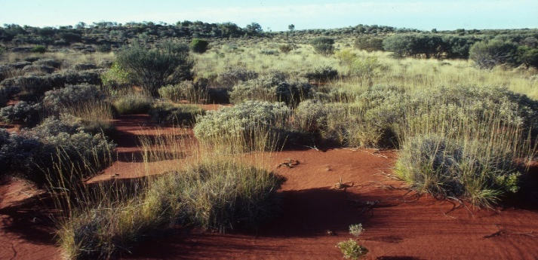
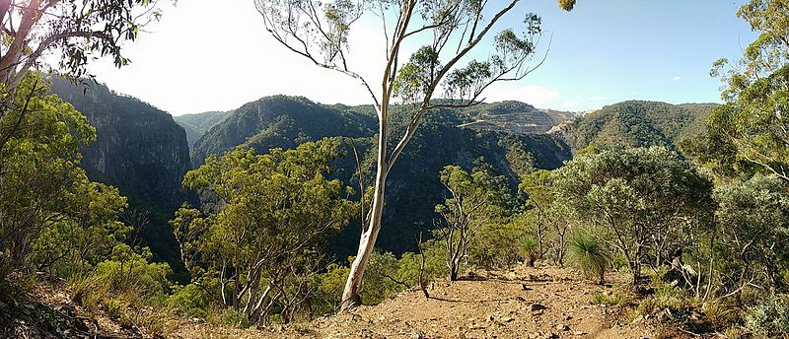
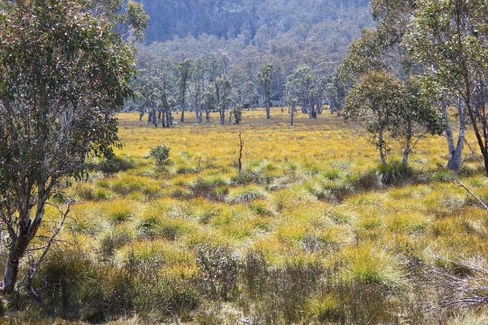
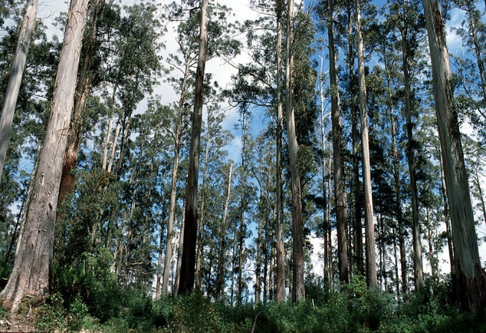
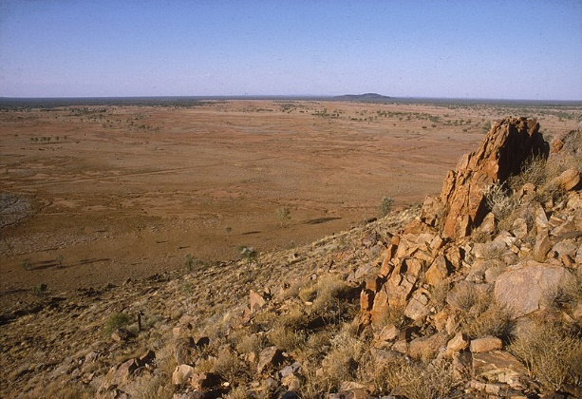
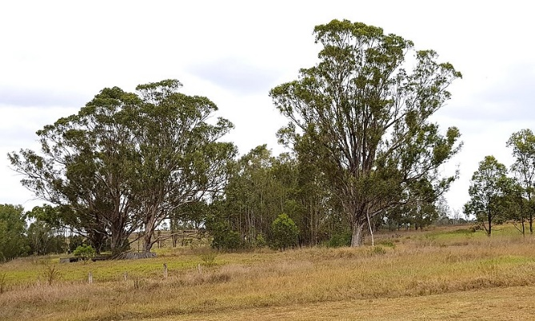
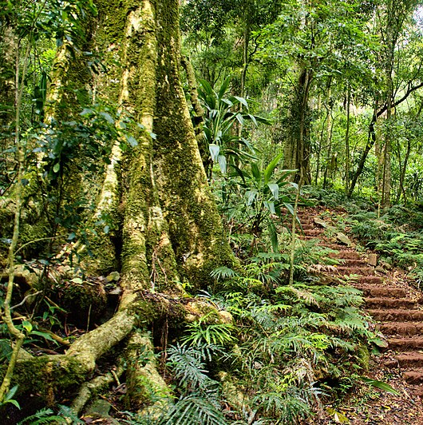
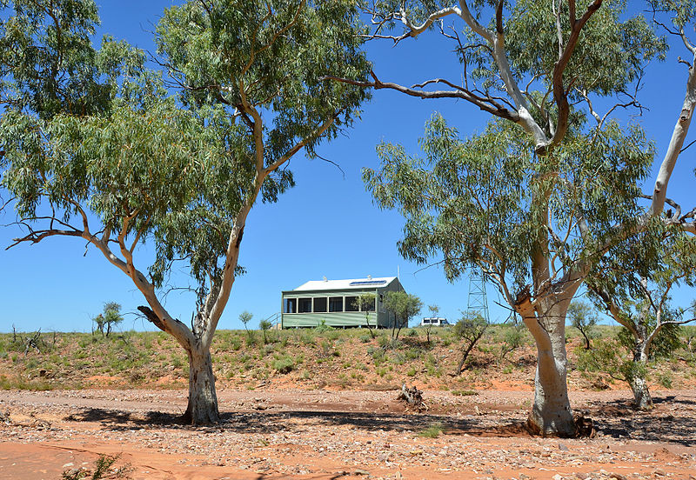
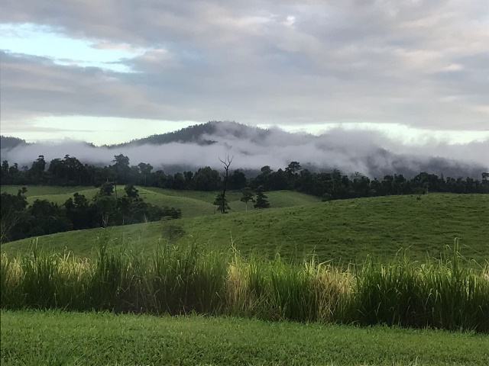
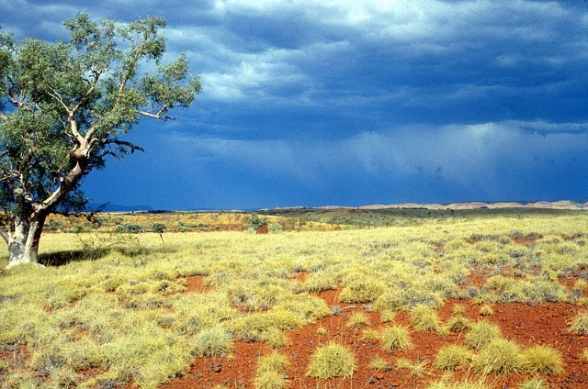
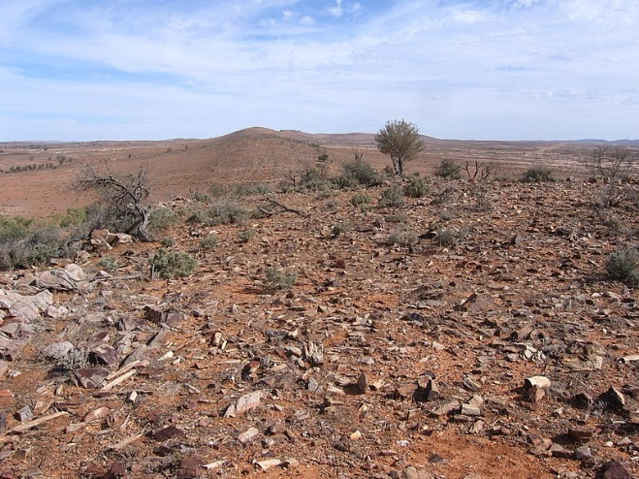
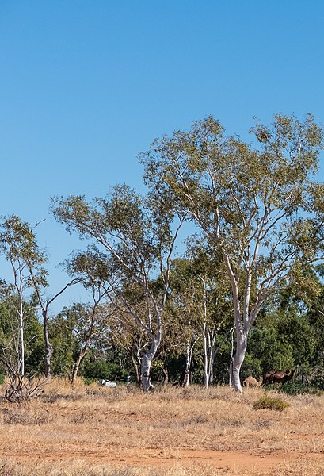
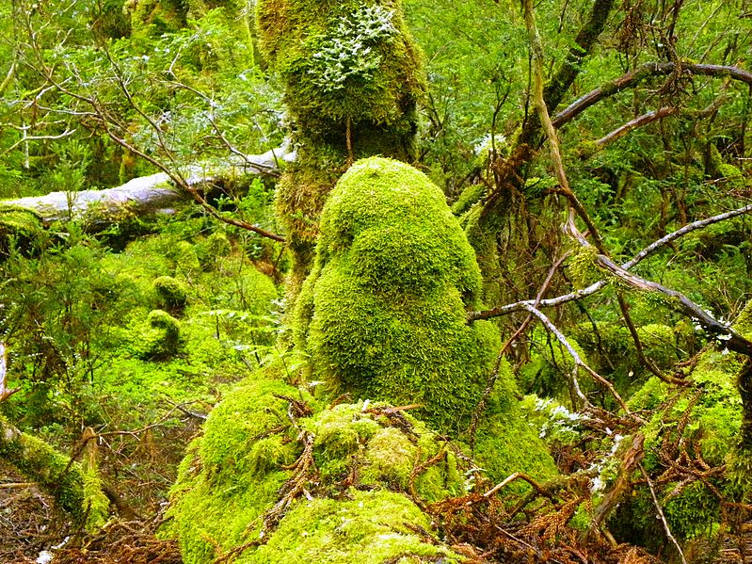
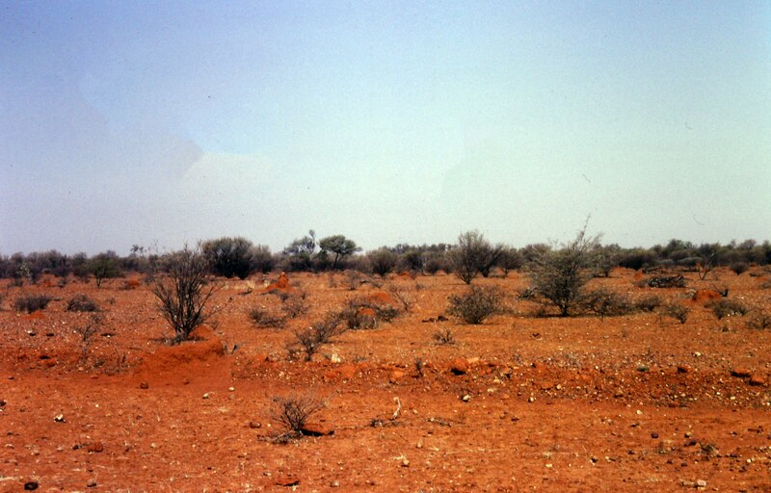
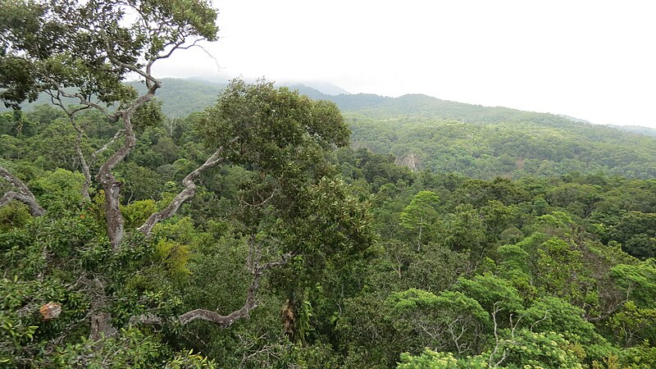
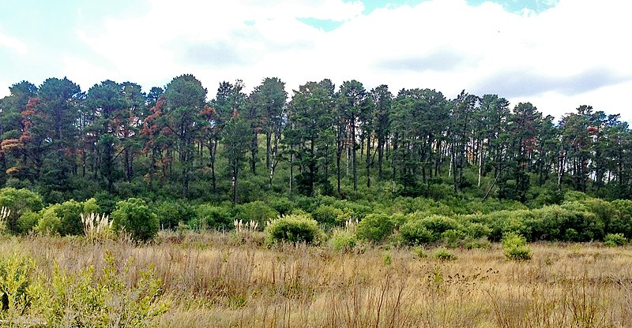
Australian environments

Slide 6
Discussion
How did your group decide the categories?
How did the categories vary between each group of students? What was similar and what was different?
Is there one environmental category that would be most at risk of bushfire?
What evidence would you need to support your claim?

Slide 7
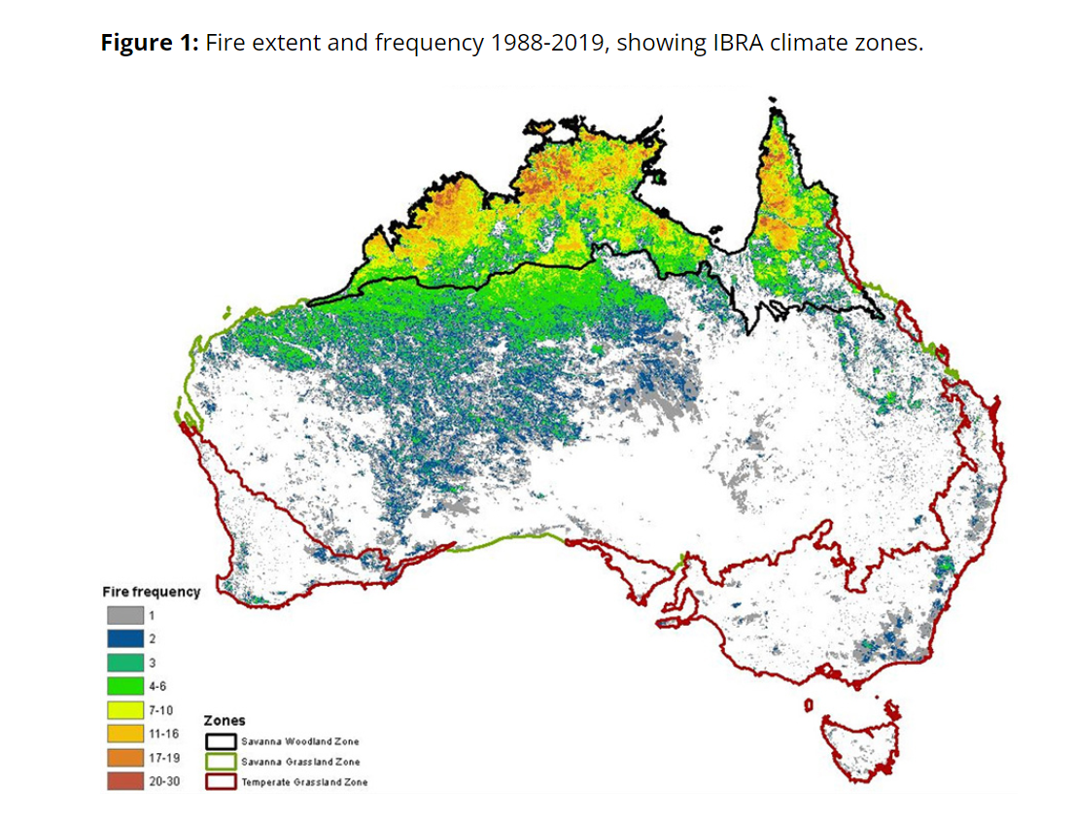
Fire extent and frequency 1988-2019, showing IBRA climate zones
Savanna woodland zone: scattered trees and shrubs forming a light canopy
Savanna grassland zone: little to no trees or shrubs
Temperate grassland zone: hot summers and cold winters produce grassland with occasional eucalyptus
https://www.dcceew.gov.au/climate-change/publications/estimating-greenhouse-gas-emissions-from-bushfires-in-australias-temperate-forests-focus-on-2019-20

Slide 8
What do you know or want to know?
What (in the pictures) will burn in a bushfire?
What makes a bushfire more dangerous in our environment?
How do bushfires spread?
What makes a bushfire spread faster?
Have we always had bushfires in our area?
Are bushfires occurring more often?
What causes most bushfires?

Slide 9
What is the main cause of bushfires?
Claim: Lightning is the main cause of bushfires.
Claim: People are the main cause of bushfires.

Slide 10
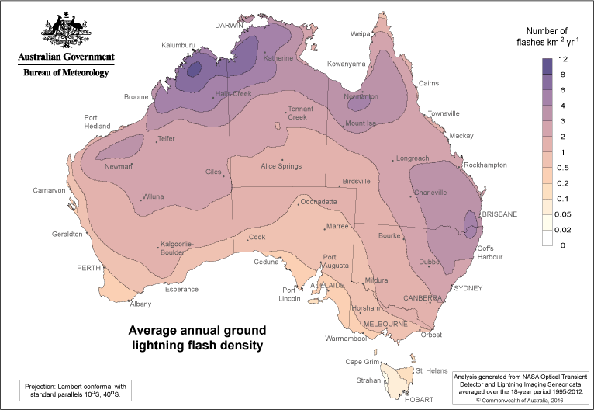
A/Prof Andrew Dowdy, Principal Research Fellow in the School of Geography, Earth and Atmospheric Sciences, University of Melbourne, Victoria

Slide 11
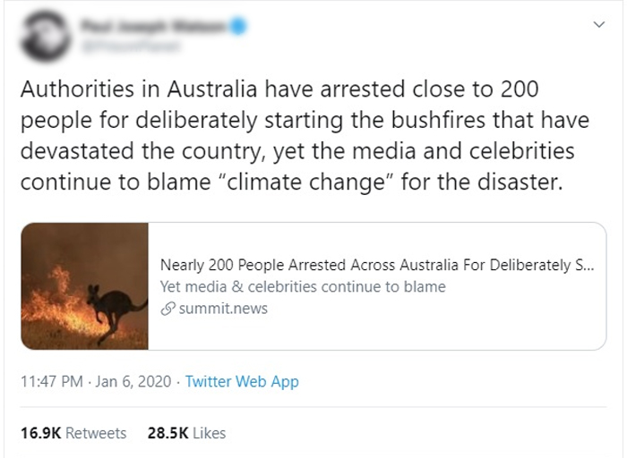
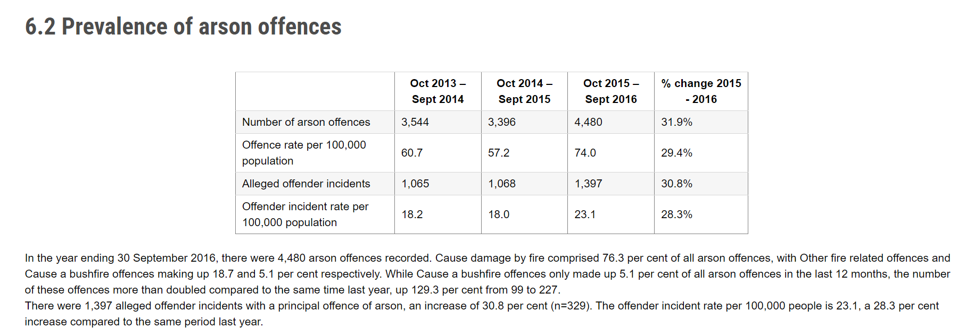
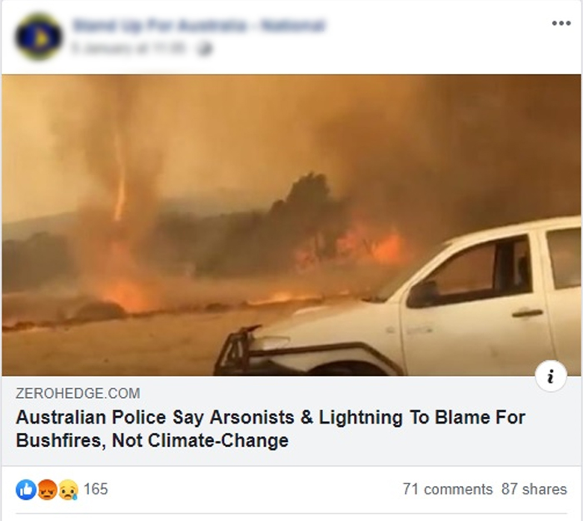
What is reliable evidence?
Blog
Victorian Government
United Nations Office for Disaster Risk Reduction
Blog

Slide 12
Main cause of bushfires: Make your argument
Reasoning:
How does the evidence link to your claim?
Evidence: What evidence are you using to support your claim?
Claim:
Make a claim about the biggest cause of bushfires.

Slide 13
Victorian Government Crime Statistics
https://www.crimestatistics.vic.gov.au/crime-statistics/download-crime-data/year-ending-30-september-2016/spotlight-arson-offences#:~:text=6.2%20Prevalence%20of%20arson%20offences&text=There%20were%201%2C397%20alleged%20offender,the%20same%20period%20last%20year.

Slide 14
United Nations Office for Disaster Risk Reduction
Chart source: https://www.preventionweb.net/news/open-data-shows-lightning-not-arson-was-likely-cause-most-victorian-bushfires-last-summer
Data source: Victoria Department of Environment, Land, Water and Planning

Slide 15
Argumentation
Evidence: Over 2 years, 41% of bushfires were started by thunderstorms.
United Nations Office for Disaster Risk Reduction
Claim: Most bushfires are caused by lightning
Reasoning: This is higher than other causes of bushfires including 17% arson, 34% accidents and 7% hazard reduction
United Nations Office for Disaster Risk Reduction
Evidence:
17% Arson
34% accidents
7% hazard reduction
Claim: Most bushfires are caused by people
Reasoning: People cause arson, accidents and hazard reduction
Victorian Government

Slide 16
My fire watch
https://myfirewatch.landgate.wa.gov.au/map.html

Slide 17
Our community
Who in our community would be affected by a bushfire? | How would they be affected?

Slide 18
L2 - Inquire
Fire and combustion reactions

Slide 19
What does a fire need?
I, MarcusObal, CC BY-SA 3.0 - via Wikimedia Commons

Slide 20
Combustion reaction
Heat source
reactant + reactant → product + product

Slide 21
Combustion reaction
Heat source
Fuel + reactant → product + product

Slide 22
What claims can you make?
Claim:
Air is needed for combustion
Reasoning:
The jar prevented air being replaced
Evidence:
The flame went out when a jar was put over the top.

Slide 23
Discussion
What can we tell from each activity and what can we not tell from the activity?
What is an assumption?
What assumptions would it be easy to make with one of these activities?
What makes an experiment valid?
What key things are needed to start a combustion reaction?
What types of substances could be a fuel?

Slide 24
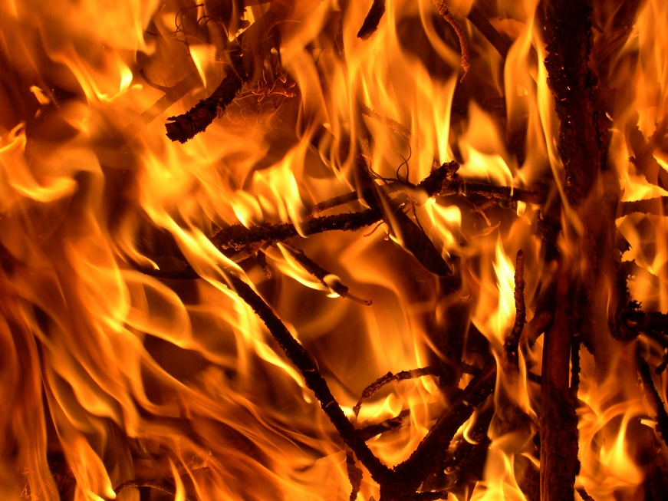
Fire triangle
Oxygen
Heat
Fuel

Slide 25
Combustion reaction
Heat source
Fuel + Oxygen → Carbon Dioxide + Water

Slide 26
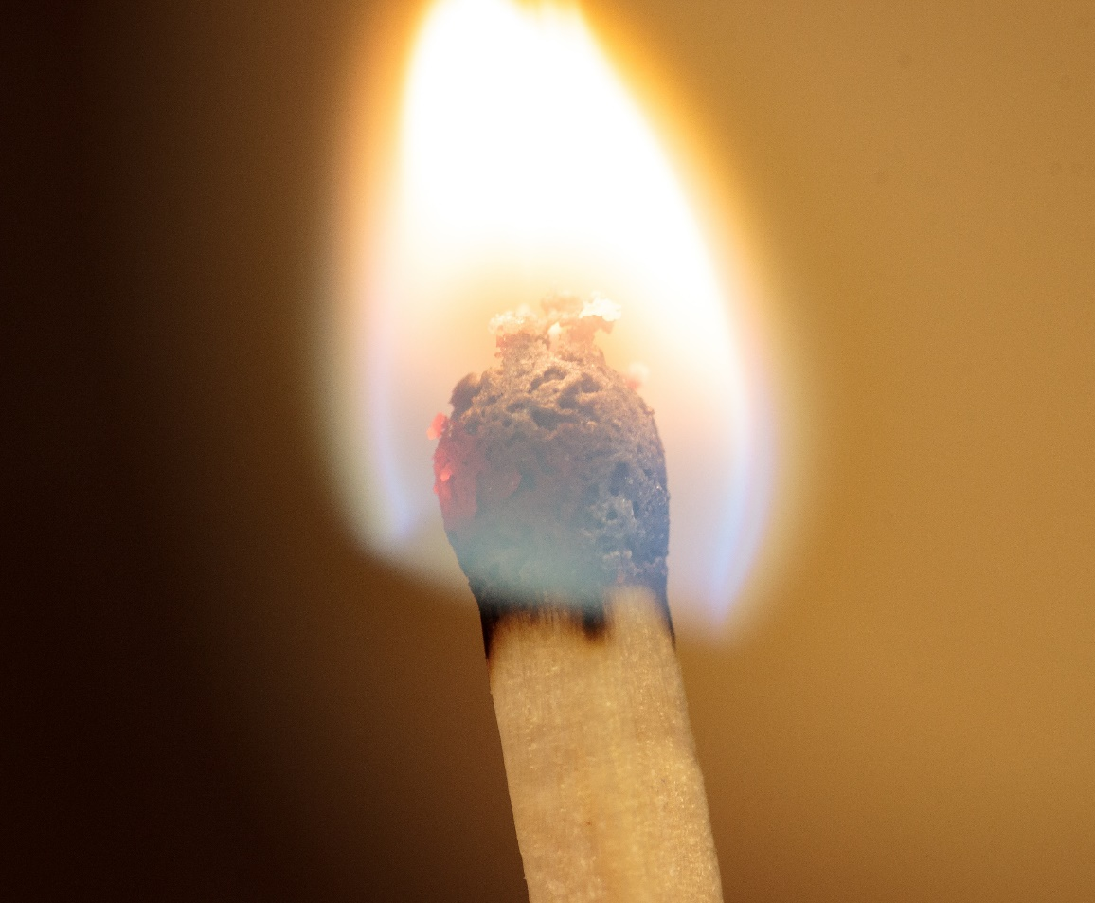
Can combustion occur in space?
Claim 2: No
Reason: There is no oxygen in space.
Claim 1: No Reason: There is no air in space.
Claim 3: No
Reason: There is no force of gravity in space.
Francesco Schiavone, CC BY 4.0, via Wikimedia Commons

Slide 27
L3 - Inquire
Carbon dioxide and the carbon cycle

Slide 28
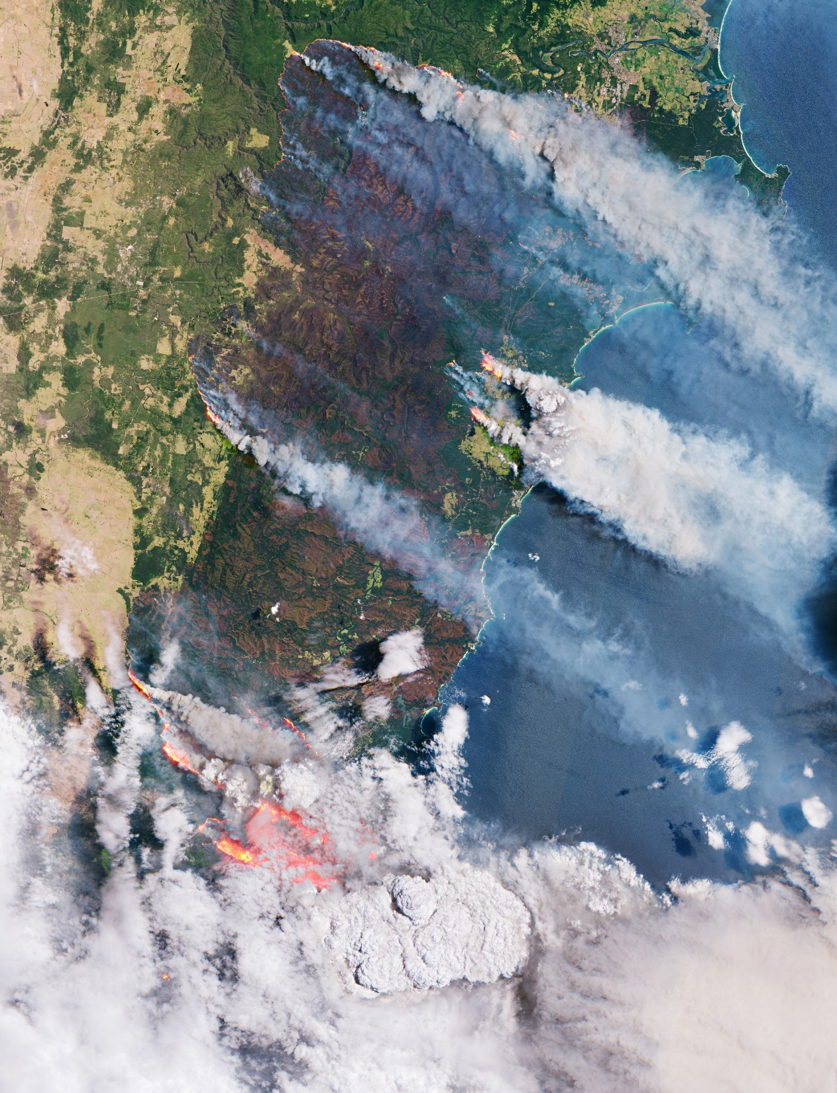
European Space Agency photo of 2020 bushfires
CC BY-SA 3.0 IGO

Slide 29
Bushfire smoke
What makes up the smoke shown in the picture?
What is carbon?
What does carbon look like?
What molecules in the process of combustion of fuel contain carbon?
What other molecules contain carbon?
Where do we find carbon dioxide?
Where else might we find carbon?

Slide 30
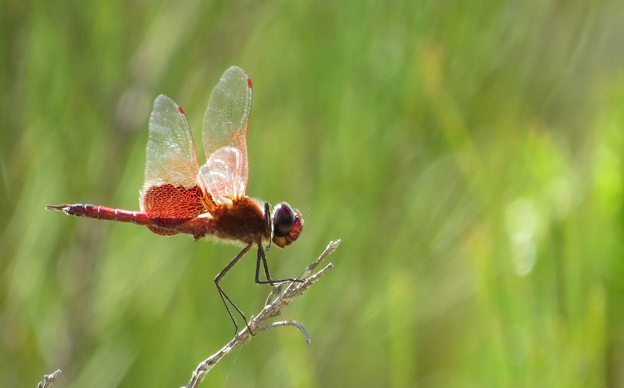
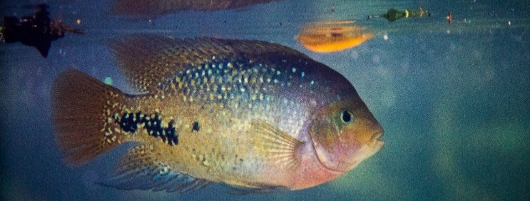
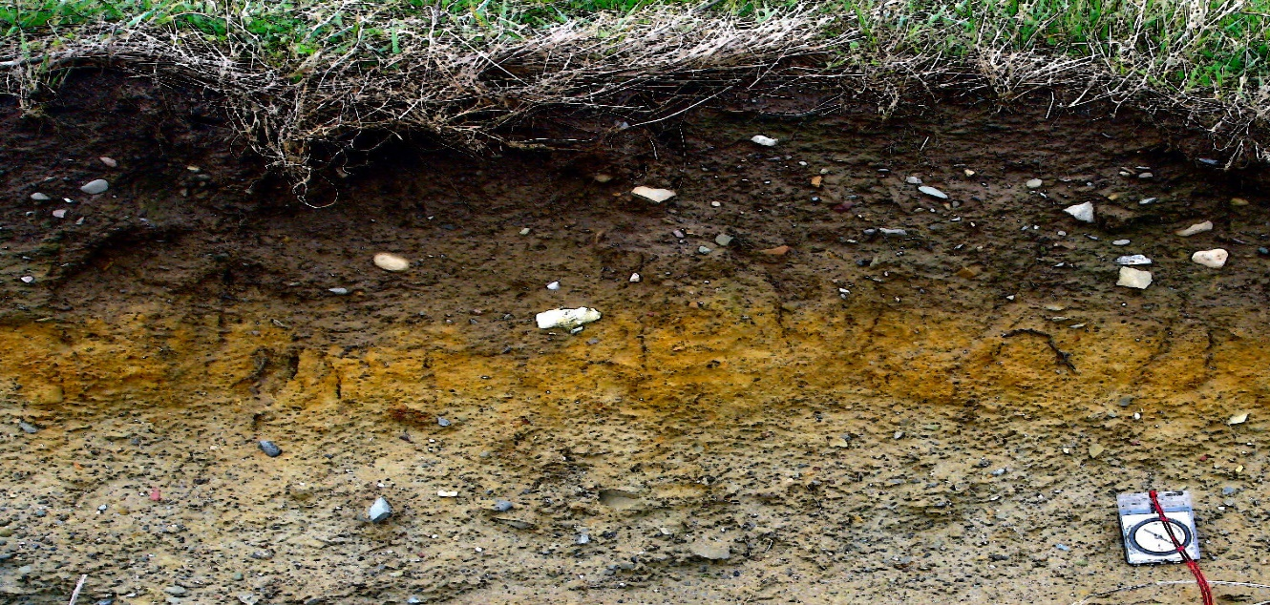
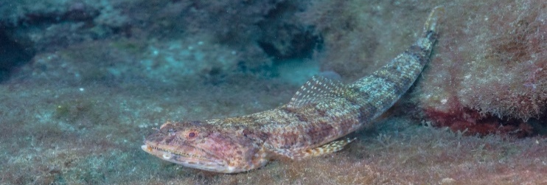
The carbon cycle game
CO₂
Methane
CH₄
Chitin
Glucose
C₆H₁₂O₆
Organic carbon
CO₂
Organic carbon
CO₂
Organic carbon
Coal, calcium carbonate, limestone

Slide 31
Earth’s spheres
CK-12 Foundation, CC BY-SA 3.0, via Wikimedia Commons

Slide 32
Carbon cycle game discussion
Did anyone become ‘stuck’ at any part of the carbon cycle?
Did some parts of the carbon cycle move faster than others?
Did some parts of the carbon cycle move slower than other parts?
How effective would this model be in predicting the levels of carbon in the different spheres?
What are some of the limitations of using modelling to test a science concept?
How could a more accurate model be made?

Slide 33
Draw the carbon cycle (example)
Atmosphere
Hydrosphere (Ocean surface)
Biosphere (Animals)
Biosphere (Plants)
Hydrosphere (Deep ocean)
Geosphere (Soil)
Geosphere (Fossil Fuel)

Slide 34
L4 - Inquire
Storing carbon in the biosphere

Slide 35
Biosphere carbon
Where do plants get their carbon from?
What carbon molecules are there in the plants?
How could we measure the amount of carbon material that there is in a tree?
What could we measure on a tree that would tell us how big it is?

Slide 36
Measuring biomass
Circumference (cm)
1.3 m
Bungonia Gorge and the limestone quarry
Life Adventures, CC BY-SA 4.0, via Wikimedia Commons

Slide 37
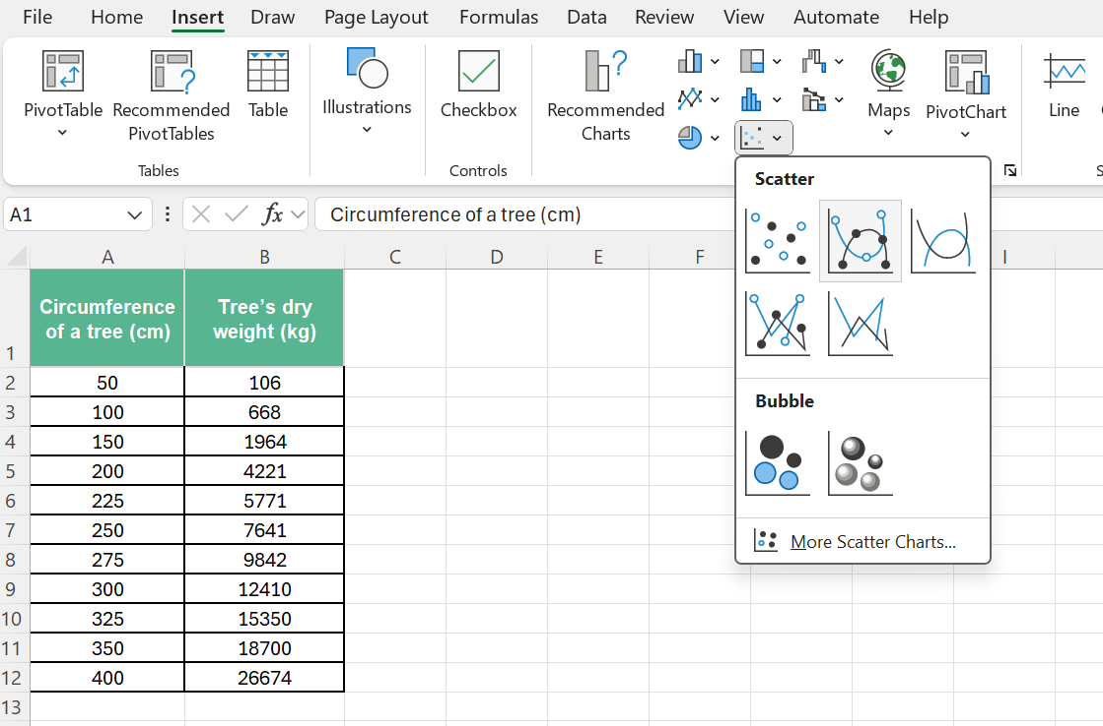
Calculating biomass of a tree (>50 cm)

Slide 38
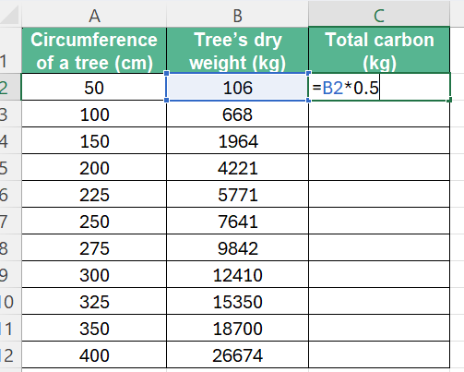
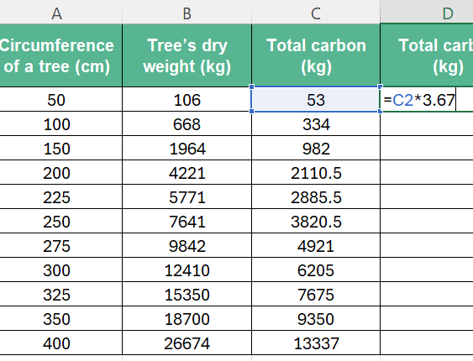
Calculating carbon
Carbon in the tree (kg)
Carbon dioxide absorbed (kg)

Slide 39
Discussion
Why was the circumference of the tree measured 3 times and averaged? How does this affect the accuracy of the results?
How could we check that the tape measure was accurate? How would it affect our calculations if it was not accurate?
What would be the largest tree we could measure using this result? Would our results be just as accurate if we used the graph to measure the carbon in a tree larger than 400 cm? Why or why not?
What assumptions have we made about this method? How do we know it is a valid test?

Slide 40
How does biomass affect a bushfire?
Why is biomass important in bushfires?
Why do bushfires add to the carbon dioxide levels in the atmosphere in the short-term?
Why might increasing carbon dioxide levels be a bad thing?

Slide 41
L5 - Inquire
Carbon dioxide levels and bushfires

Slide 42
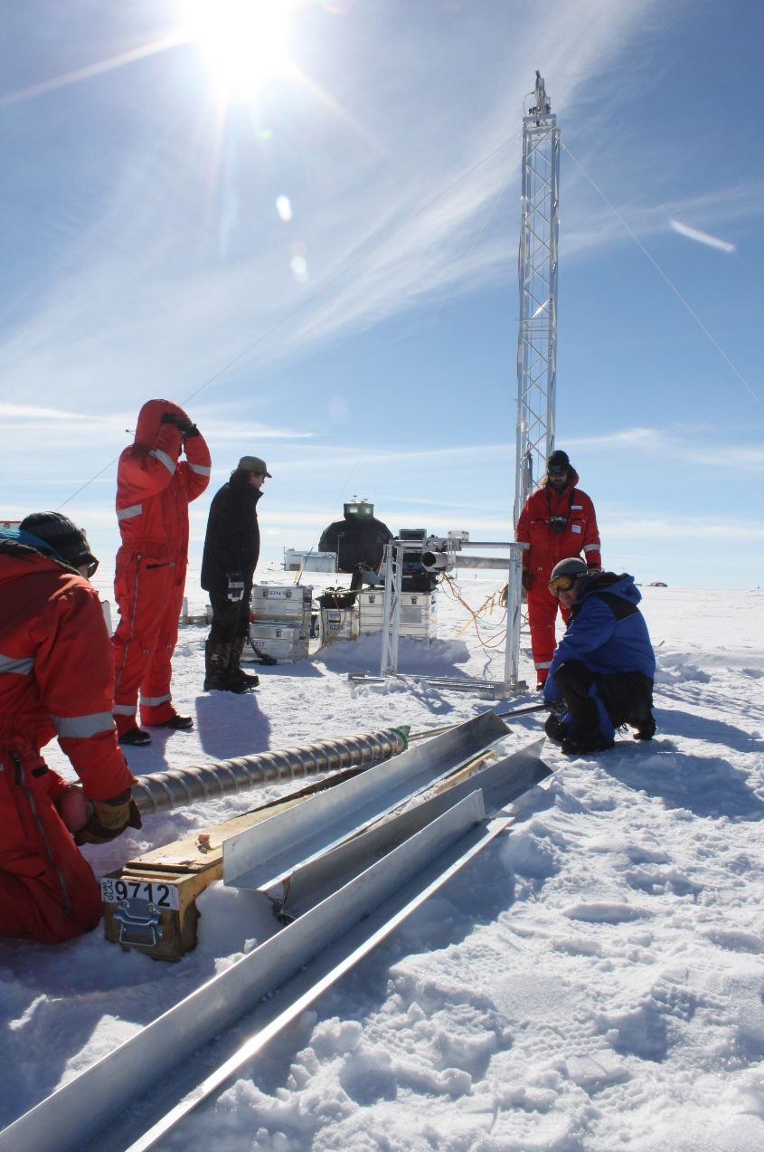
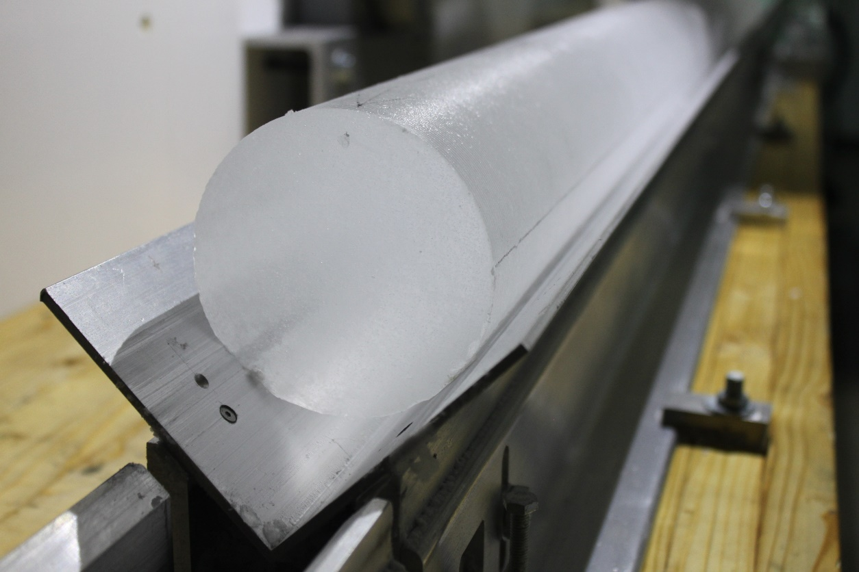
Ice cores can be used to track carbon dioxide levels
Helle Astrid Kjær, CC BY 4.0, via Wikimedia Commons

Slide 43
Making an ice core
Depth of the sample | Relative age of gas (years prior to 1950) | Age of the gas | Concentration in parts per million Volume [ppmv]
m | cm from top of paper | Years prior to 1950 | CO2 concentration
129.75 | 8.65 | 1060 | 279.1
365.5 | 24.37 | 13,356 | 236.2
544.7 | 36.31 | 29,063 | 188.5
1,023.50 | 68.23 | 65,939 | 194.9
1,575.20 | 105.01 | 107,579 | 238.2
1,870 | 124.67 | 128,372 | 287.1
1,947 | 129.80 | 132,492 | 223.5
2,231.05 | 148.74 | 162,228 | 190.1
2,475 | 165.00 | 193,481 | 220.0
2,644.41 | 176.29 | 214,459 | 251.7
2,693.61 | 179.57 | 224,923 | 215.7
2,747.61 | 183.17 | 237,868 | 239.1
2,773.51 | 184.90 | 242,007 | 279.0
2,797.51 | 186.50 | 245,441 | 219.4
2,887.51 | 192.50 | 271,256 | 184.7
3,027.51 | 201.83 | 310,168 | 233.2
3,123.51 | 208.23 | 332,919 | 298.6
3,156.51 | 210.43 | 340,456 | 200.7

Slide 44
What do we know about ice cores?
What does the model ice core tell us about the levels of carbon dioxide over time?
What could affect the amount of ice that forms each decade/century?
How effective is this model in representing the carbon dioxide levels over time?
What are the limitations of such a model?

Slide 45
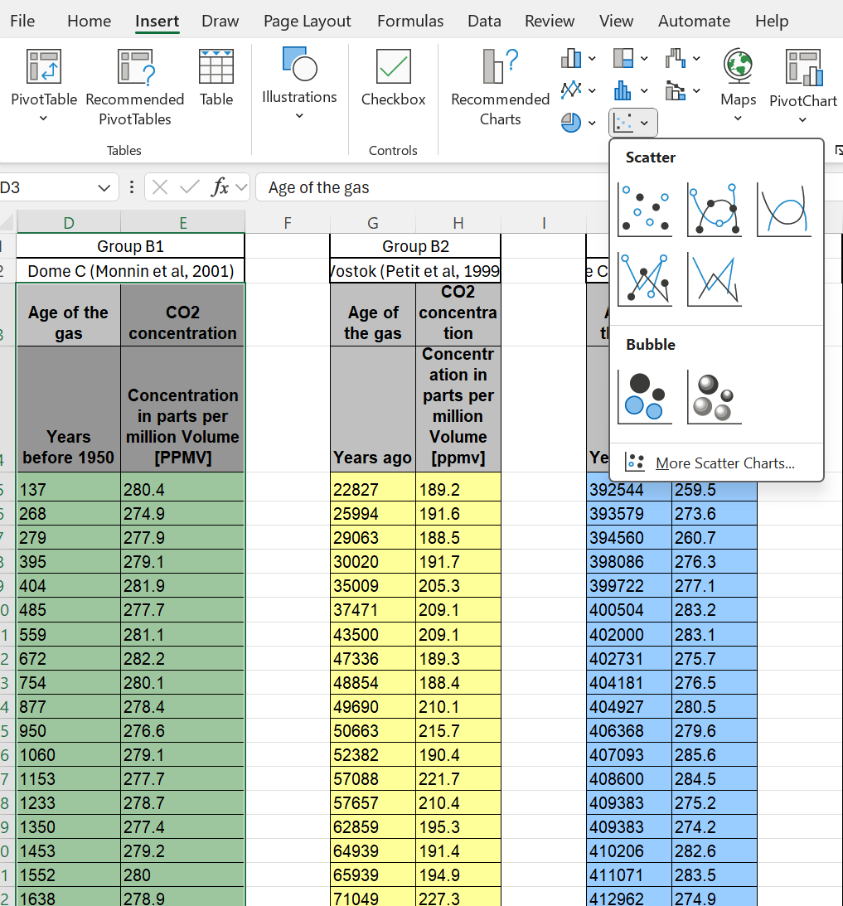
Graphing the ice core data
Select the numbers in the two columns you want to graph.
Select ‘Insert’ and ‘Scatter’ to create a graph from the data.
Select ‘Chart design’ from the LHS top ribbon.
Add a title for the graph and axis labels.

Slide 46
Discussion
Which group has the most recent data set (fewest years ago)?
Which group has the oldest data set (most years ago)?
Is the data consistent (do they show the same pattern)?
Why do scientists need to review the data with their peers?

Slide 47
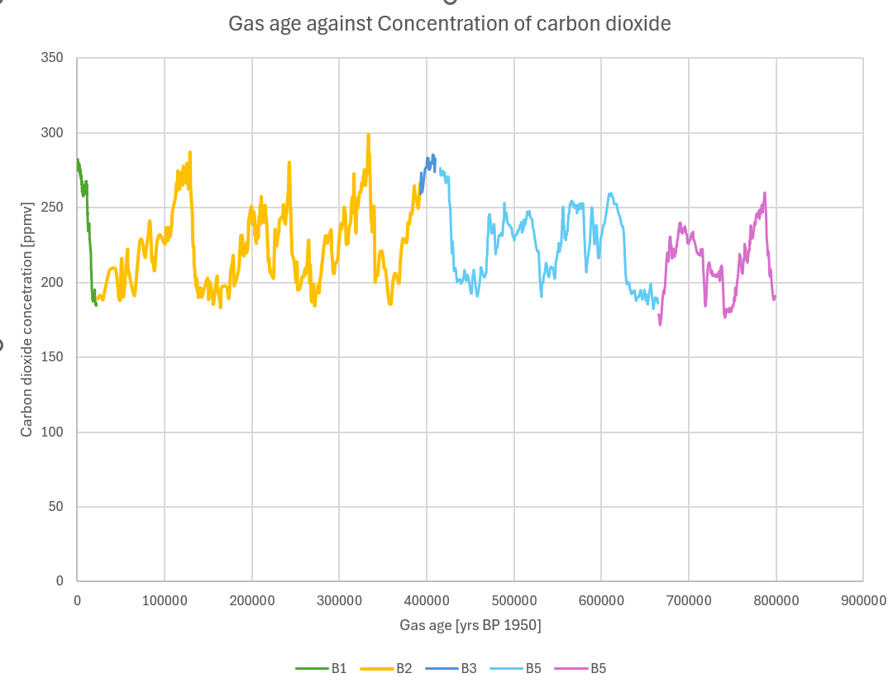
Peer review of data

Slide 48
European Space Agency photo of 2020 bushfires
CC BY-SA 3.0 IGO

Slide 49
Bushfires and carbon dioxide levels
Bushfires increase global warming.
Bushfires increase the amount of carbon dioxide in the air.
Plants grow back fast after a bushfire and remove the carbon dioxide from the air.

Slide 50
L5A – Optional Inquire
Correlation between carbon dioxide levels and global temperature

Slide 51
What do we know about Earth’s temperature?
Has the temperature of the Earth always been the same?
When was the last ice age?
What do you think caused the increase and decrease in temperature in the past?

Slide 52
Correlation vs causation
Carbon dioxide level
Temperature difference

Slide 53
Correlation vs causation
What is the difference between correlation and causation?
Can you give an example of correlation that is not causation?
How do we know when one event causes another event?
This graph stops at 1950. Can we extrapolate the graph? Why or why not?

Slide 54
Is this global warming like other warming events?
From the graph, how many years did not of the previous global warming events occur?
Is this amount of time consistent for all of the increases or just a few?
What was the date of the most recent values on our ice-core data? Was this value within the normal carbon dioxide range?
How quickly has the current average global temperature increased?

Slide 55
What will be the impact of global warming?
Brainstorm…

Slide 56
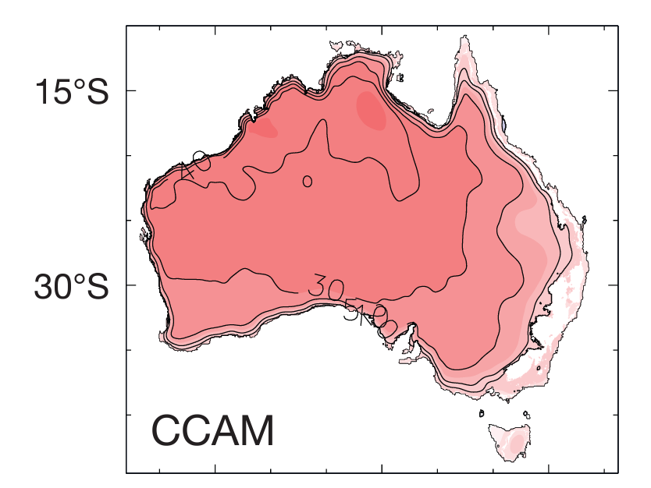
Modelling of fire danger days in 2060
https://nespclimate.com.au/wp-content/uploads/2021/05/ESCC_Fire-Generated-Thunderstorms_Brochure.pdf

Slide 57
Computer models
What is a computer model?
What data would need to be put into a computer model of bushfires?
How does the type and amount of data affect the effectiveness of a computer model?

Slide 58
L6 - Inquire
What affects bushfire rate and intensity?

Slide 59
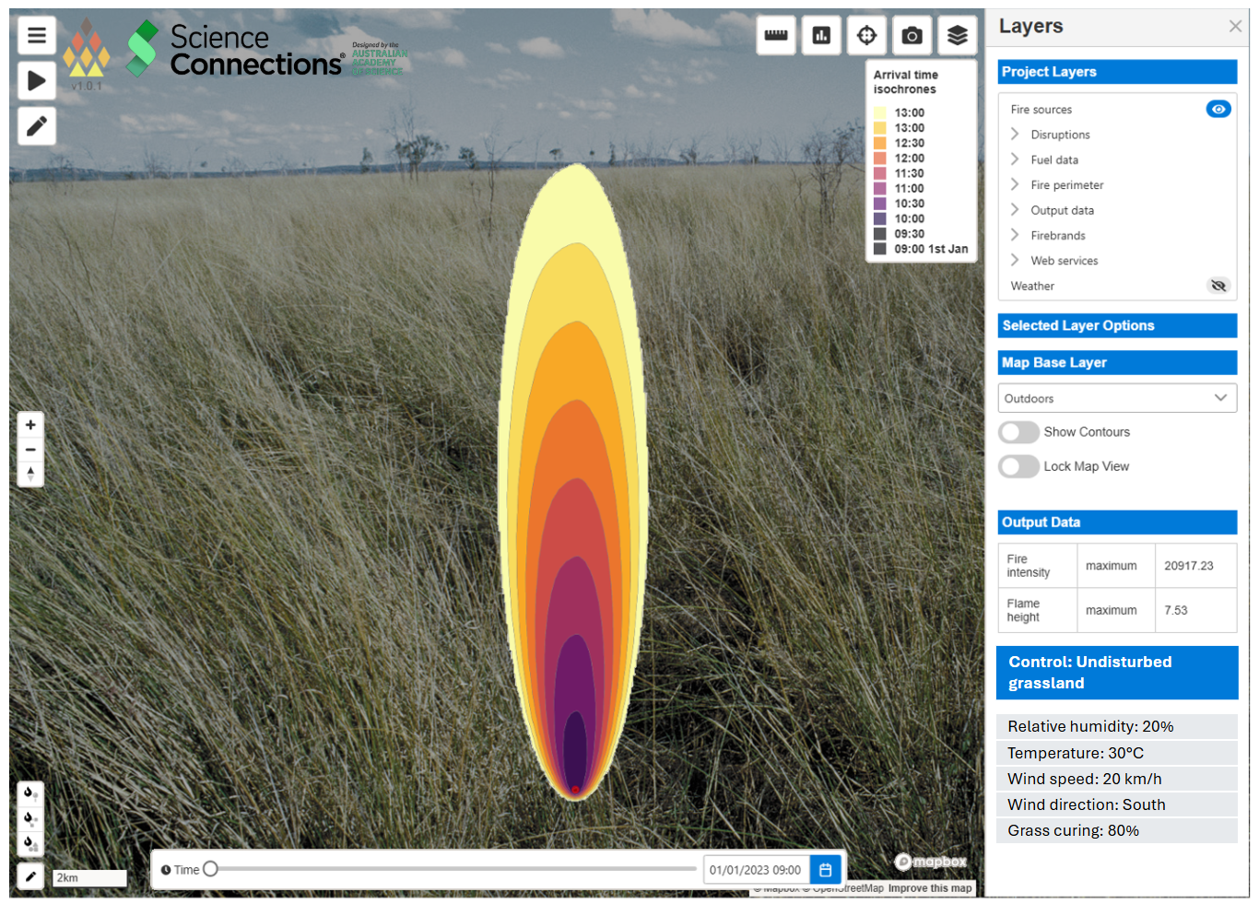
Modelling fire behaviour
Use a ruler to measure the distances between modelled fire front edges (30 minutes).
Use a ruler to measure the length of the map scale.
Use ratios to determine the actual distance the fire travelled.
The distance fire travels in 30 minutes
North
Fire ignition point
Scale of map

Slide 60
Using CSIRO Spark data
What do you think the different lines on the graph represent?
How could we measure how far the fire has spread from the ignition point in the first hour?
How could we measure how far the fire has spread in the second hour?
How could we convert the distance measurement into a speed (km/hr)?
How could we work out the direction of the fire spread?

Slide 61
Results discussion
There were only two types of controls (undisturbed grassland and undisturbed bushland). How did the measurements different groups make compare?
Why might there be some slight differences between the measurements of the same set of data?
What could we use to be more accurate?
Why might scientists run a model multiple times for the same settings?

Slide 62
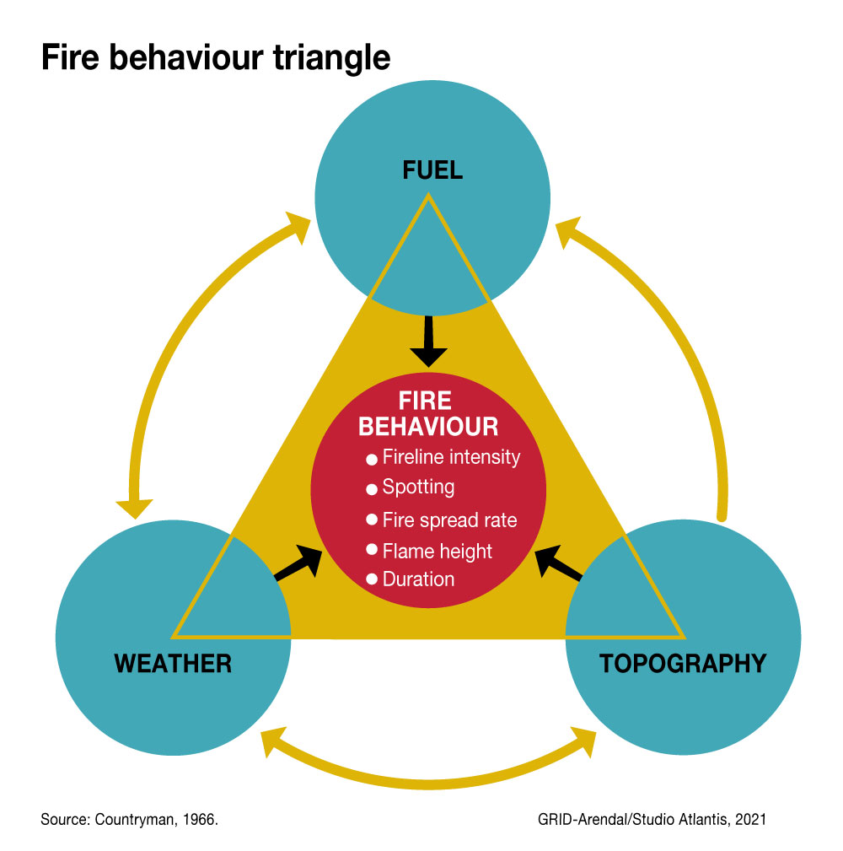
Fire behaviour triangle

Slide 63
Fire behaviour discussion
How does the topography (downhill or uphill) affect a fire?
How does weather (humidity or wind) affect a fire?
How does the amount of fuel affect a fire?
How does having a previous fire affect the next fire?

Slide 64
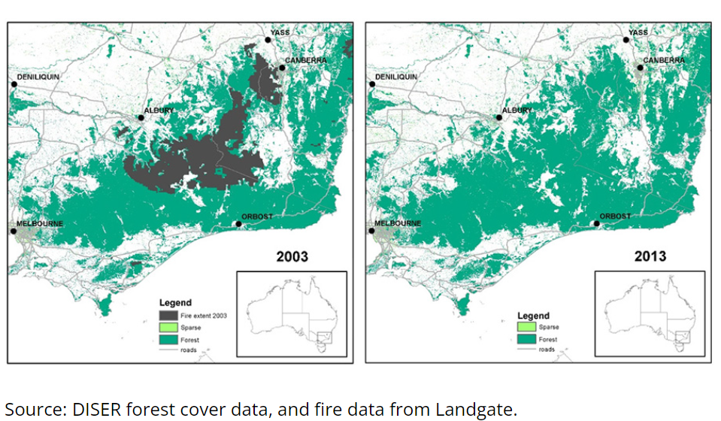
Regrowth following 2002-2003 bushfires

Slide 65
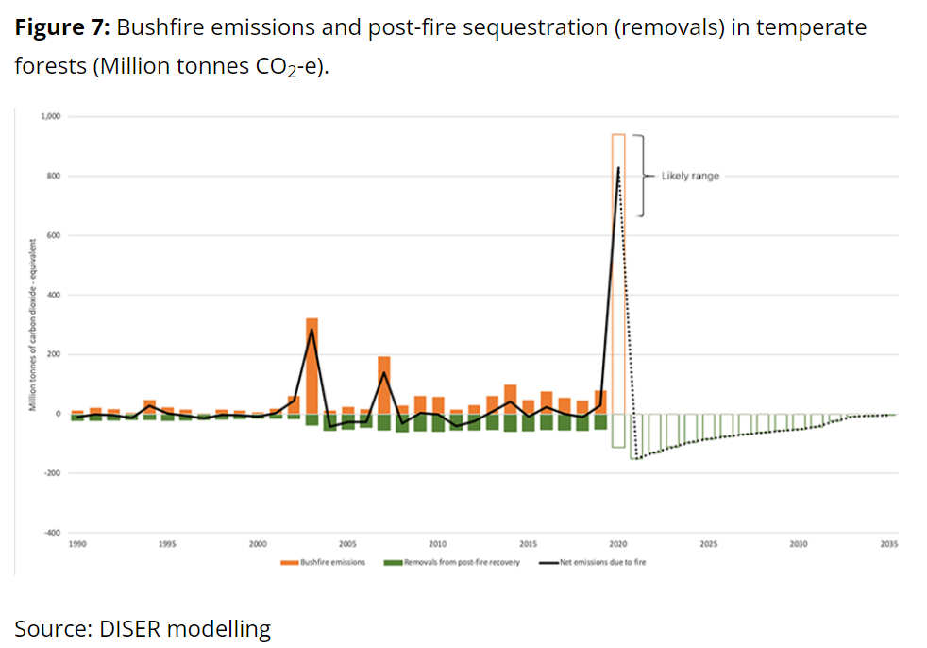
Modelling bushfire carbon emissions
https://www.dcceew.gov.au/climate-change/publications/estimating-greenhouse-gas-emissions-from-bushfires-in-australias-temperate-forests-focus-on-2019-20

Slide 66
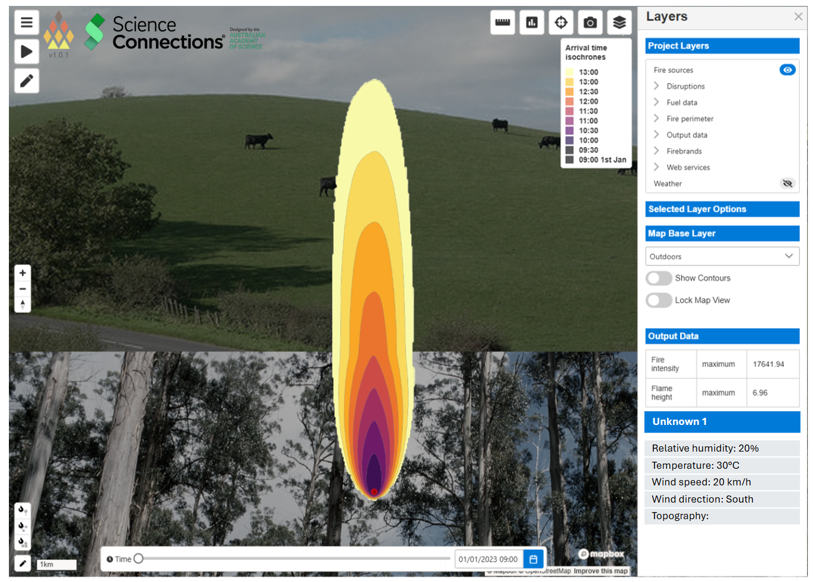
Can you describe what is happening?
To be provided by CSIRO Spark2

Slide 67
“As we’re burning Country, we’re healing it”
Warren Foster, Elder and Knowledge Holder for the Yuin Nation
Notes:
Uncle Warren Foster

Slide 68
Cultural burning discussion
How does the Tiwi islands’ environment compare to the local environment in your area? (Focus on the differences.)
What does it mean to say the Tiwi Islanders treat fire as a gift instead of a threat?
Why might it be good for the environment for the burns to happen less often?
What do you think happens to the good bacteria and fungi in the soil during a fire?
How many different First Nations Peoples’ communities are there across Australia?
Can we extrapolate what we know from the Tiwi Islanders to the rest of Australia?
Does this cultural burning practice apply to all parts of Australia?
Why would scientists want to work with First Nations Peoples when researching bushfires?

Slide 69
L7 - Act
Design to survive

