Slide 1
Science Connections
Yr 9 Breeding for balance

Slide 2
Lesson 1
Cute enough to save

Slide 3
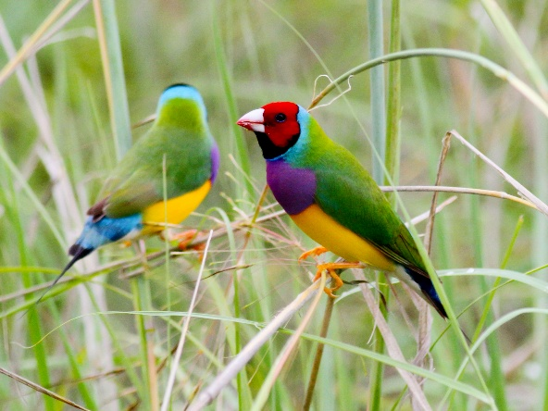
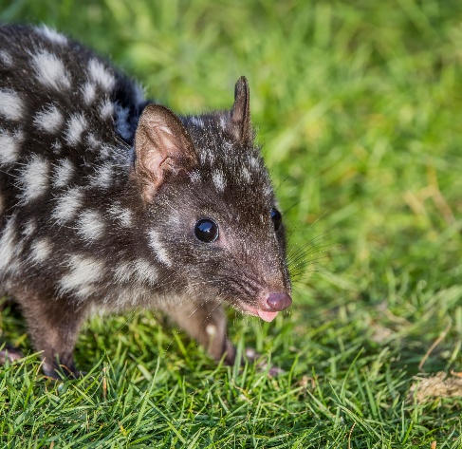
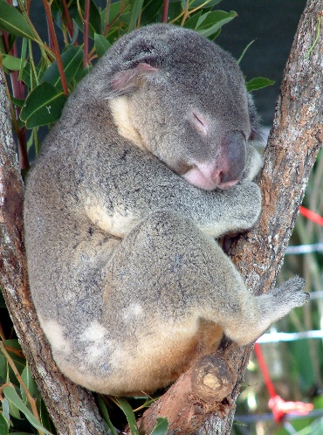
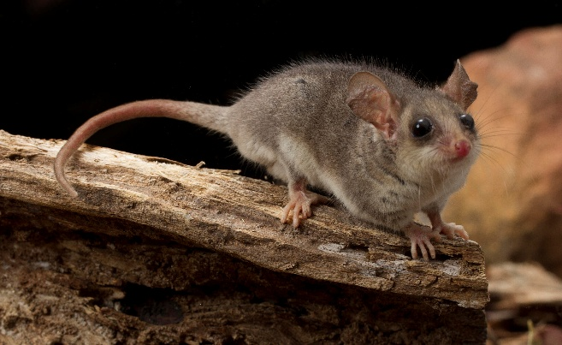
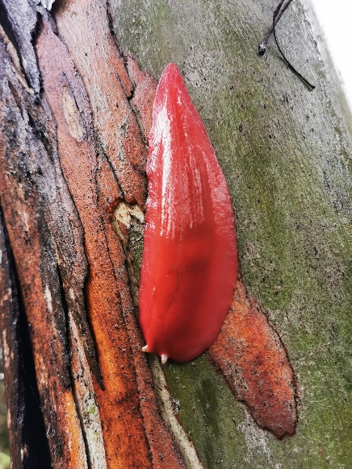
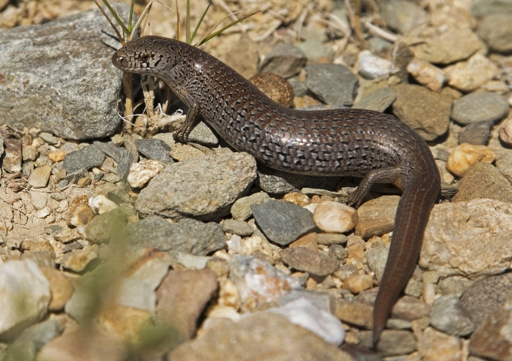
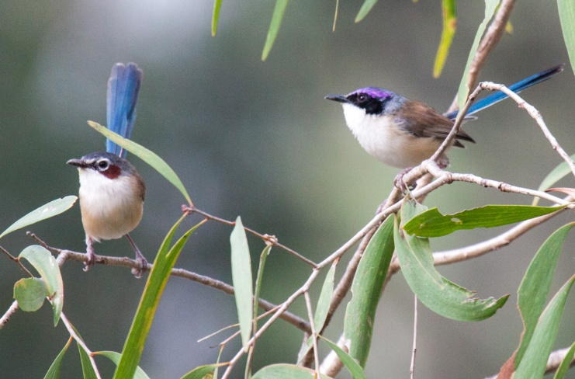
Endangered animals
Eastern pygmy possum
Gouldian finch (NT)
Eastern quoll
Koala
Alpine she-oak skink
Purple crowned fairy wren
Giant pink slug

Slide 4
Define
Extinct
Endangered
Vulnerable
Threatened

Slide 5
What do you need to start a breeding program?
What is meant by ‘breeding’? How is it similar or different to ‘reproduction’?
What is a breeding program?
What is the purpose of a breeding program?
Why are breeding programs important?

Slide 6
How do you decide which animal or plant you sponsor?

Slide 7
Sponsored animals
How many animals were mammals? Insects? Reptiles? Amphibians?
Why do you think some groups were represented more than others? Are they the ones that are most endangered?
Does cuteness play a role in which animal is most likely to be sponsored or have a breeding program in a zoo?

Slide 8
Lesson 2
Strategic survival

Slide 9
How does the way an animal reproduces affect the survival of
- the parents? - the offspring? - the population?

Slide 10
Population growth simulation
Table 1: Population growth in species that have few offspring (flip a counter)
Table 2: Population growth in species that have many offspring (toss a die)
Generation | Number of offspring born to each member of the population | Population total in each generation
1
2
3
4
Generation | Number of offspring born to each member of the population | Population total in each generation
1
2
3
4

Slide 11
Discussion
Describe the shape of the population graph for animals that have few offspring.
Describe the shape of the population graph for animals that have many offspring.
Predict how the size of the populations could change if each reproductive strategy was continued.
Describe the possible impacts on the habitat if a population continued to produce many offspring each generation.
Compare the challenges of animal parents caring for many offspring versus few offspring.
Three assumptions are made in this simulation. Select one assumption and predict how the results could change if the assumption was incorrect.

Slide 12
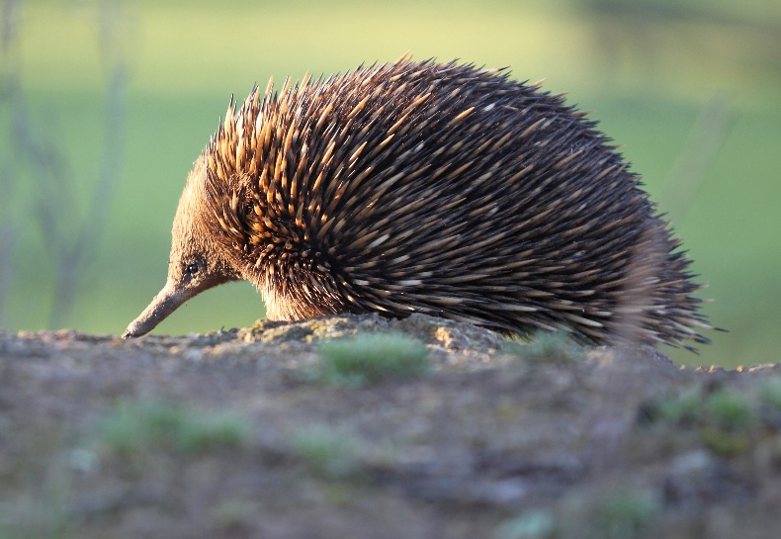
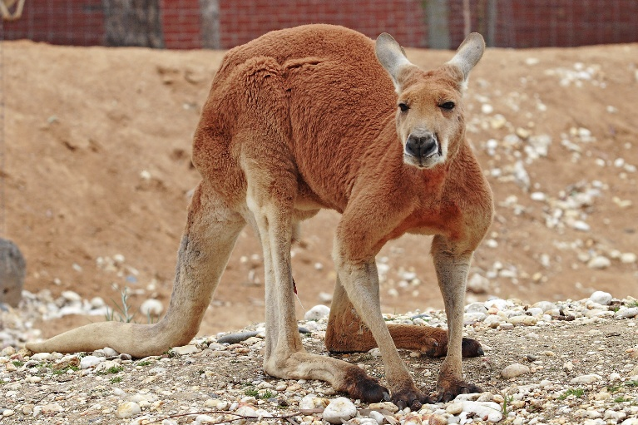
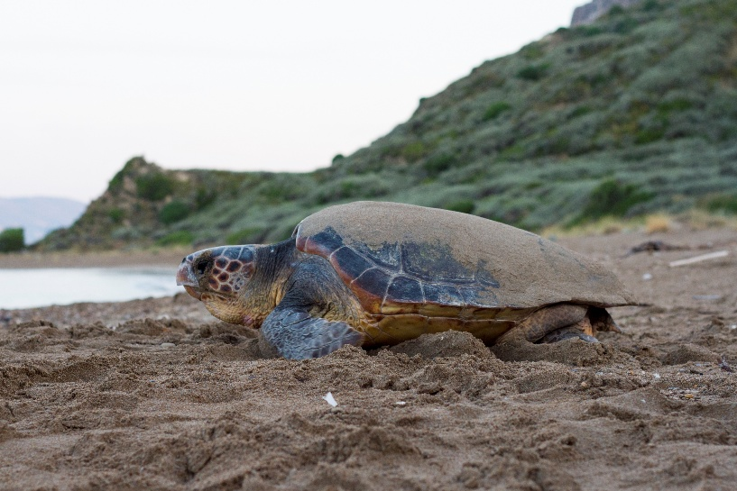
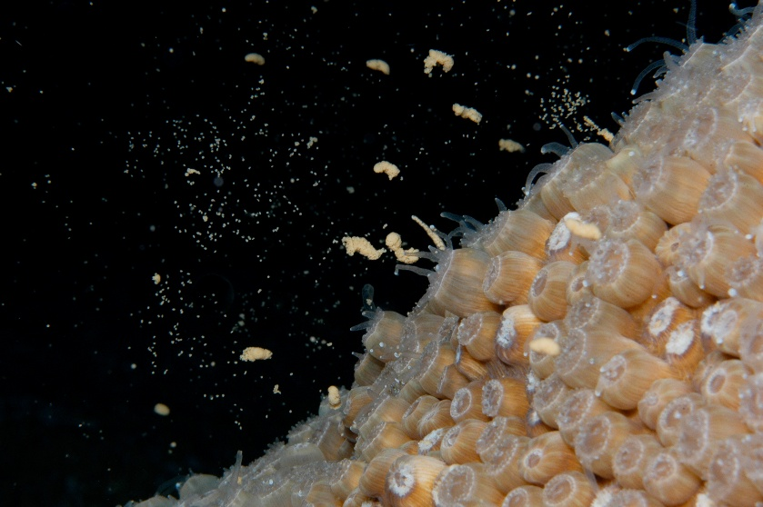
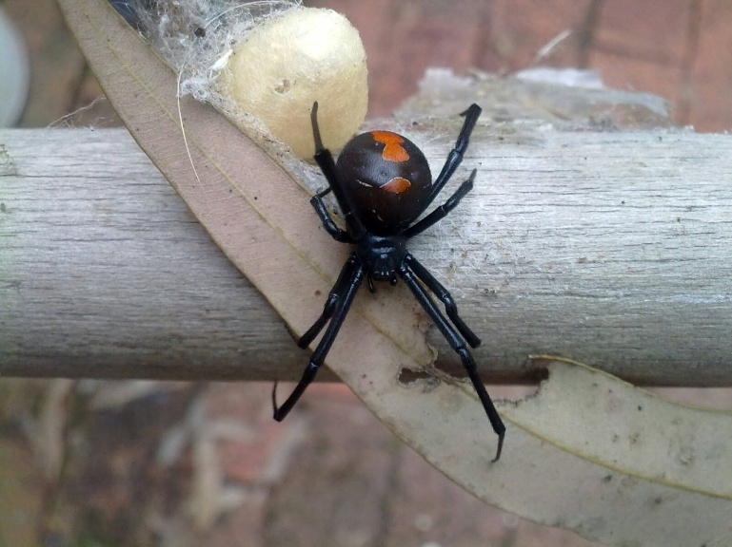
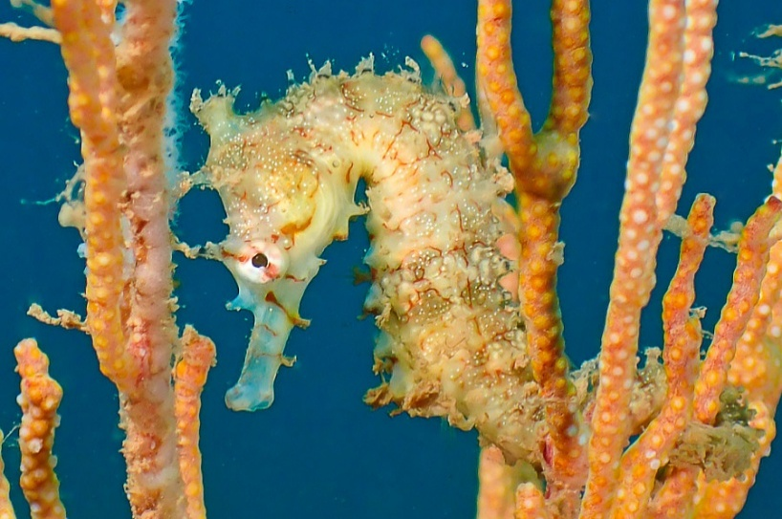
Animal information cards

Slide 13
Surviving siblings
Scenario 1
Prowling predator
r-strategy
Roll numbers 5-6
The offspring hide.
(Survive)
Roll numbers 1-4
Predator eats 10 offspring.
K-strategy
Roll numbers 1-4
Parent fights predator.
(Survive)
Roll numbers 5-6
Parent cannot fight predator.
(Lose 1 offspring)
Scenario 3
Hungry offspring
r-strategy
Roll odd numbers
The offspring find food.
(Survive)
Roll even numbers
The offspring find food.
(Lose 15 offspring)
K-strategy
Roll numbers 1-4
Parent brings food.
(Survive)
Roll numbers 5-6
Parent can’t find food.
(Lose 1 offspring)
Scenario 2
Not see parents all day
r-strategy
Roll numbers 1-2
The offspring survive alone.
(Survive)
Roll numbers 3-6
The offspring run into trouble.
(Lose 20 offspring)
K-strategy
Roll numbers 5-6
Parent returns.
(Survive)
Roll numbers 1-4
Parent doesn’t return.
(Lose 2 offspring)

Slide 14
Discussion
Which strategy was most likely to produce surviving offspring? Why do you think that?
How quickly would offspring need to ‘grow up/mature’ if their parents used the r-strategy?
How would this be different to the offspring that used the K-strategy?
What would happen if a population was able to grow unchecked (no predators, plenty of food etc.)?

Slide 15
What if an assumption were incorrect?
Assumptions:
each parent is fertile
each individual finds a mate outside the population
each individual only reproduces once each season

Slide 16
What reproductive strategy would be most affected by climate change?

Slide 17
Lesson 3
Who killed the bogong moth?

Slide 18
Bogong moth migration
With the permission of Prof Eric Warrant
Notes:
https://www.researchgate.net/figure/Map-of-Bogong-moth-migratory-routes-showing-the-names-of-the-major-rivers-in-New-South_fig1_360992093
Wallace, J. R., Maleszka, R., & Warrant, E. J. (2022). Large-scale whole-genome sequencing of migratory Bogong moths Agrotis infusa reveals genetic variants associated with migratory direction in a panmictic population. bioRxiv, 2022-05.

Slide 19
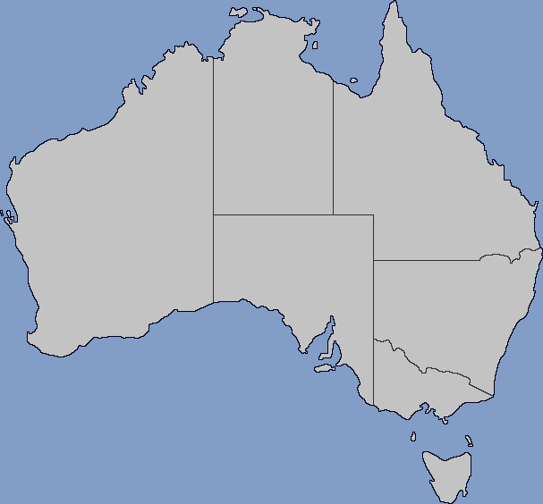
Relative abundance of bogong moths each season
3 ‘Good’ abundance
2 ‘Normal-poor’ abundance
1 ‘Bad’ abundance
Green, K., Caley, P., Baker, M., Dreyer, D., Wallace, J., & Warrant, E. (2021). Australian Bogong moths Agrotis infusa (Lepidoptera: Noctuidae), 1951–2020: decline and crash. Austral Entomology, 60(1), 66-81.
Updated data provided by Dr Peter Caley (2025)
Notes:
https://commons.wikimedia.org/wiki/File:Blank_Map_of_Australia_With_Subdivisions_(2024).png
Green, K., Caley, P., Baker, M., Dreyer, D., Wallace, J., & Warrant, E. (2021). Australian Bogong moths Agrotis infusa (Lepidoptera: Noctuidae), 1951–2020: decline and crash. Austral Entomology, 60(1), 66-81.
Map of Australia credit: FelixCountryBalls163, CC BY-SA 4.0, via Wikimedia Commons

Slide 20
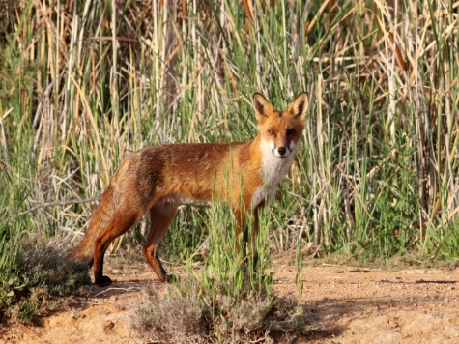
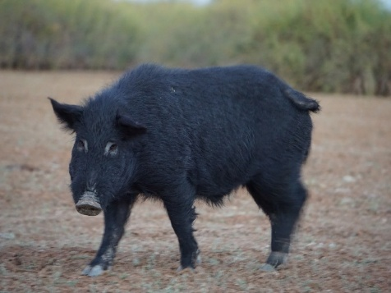
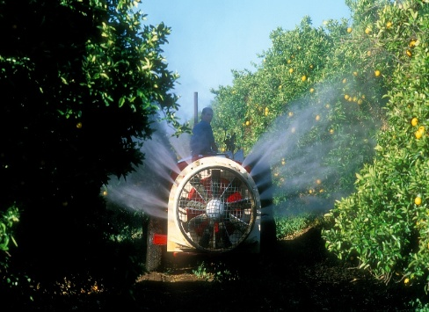
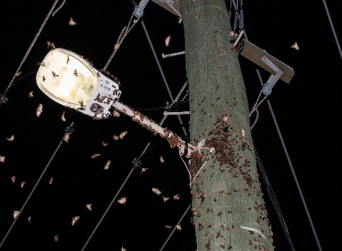
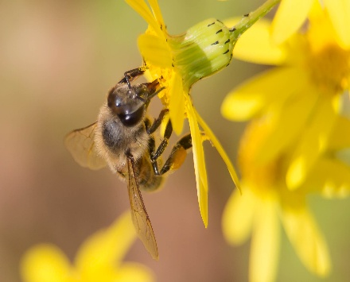
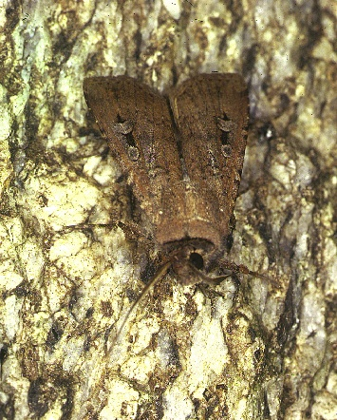
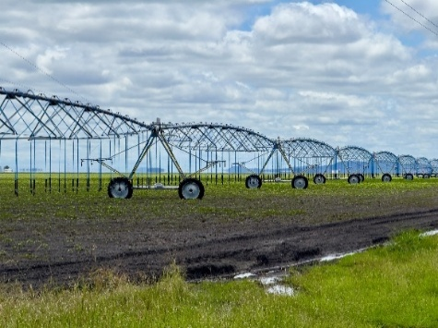
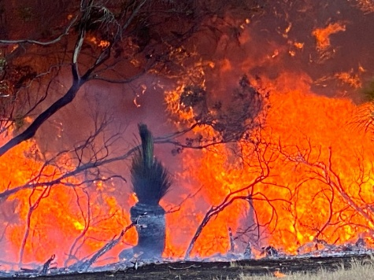
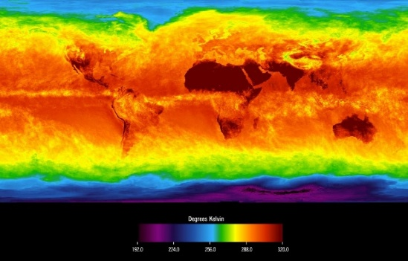
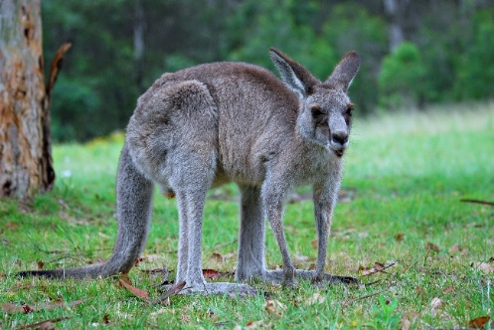
Who done it?
Suspect 1: Vulpes vulpes
(red fox)
Suspect 2: Sus scrofa
(feral pigs)
Suspect 3: Insecticides
Suspect 4: LED street lights
Suspect 5: Honey bees
Suspect 6: Increased land use
Suspect 7: Bushfires
Suspect 8: Increased temperature
Suspect 10: Herbivores
Suspect 9: Pest status

Slide 21
Use argumentation to support your claim
Claim:
Bees are
not guilty
Claim: suspect or ‘not guilty’
Evidence: identify the information that supports your claim
Reasoning: link the evidence to the claim
Qualifier: what conditions might limit your claim? Will your claim always be correct?
Backing: what assumptions or generalisations are you making?
Rebuttals: can you predict what others might say and have a response ready?
Reasoning:
Bees cannot compete for nectar
Evidence:
Bees are
Moved out of the moth migratory path

Slide 22
Bogong moth life cycle
Winter
Larvae
Pupae
Autumn
Eggs
Spring
Lay eggs
Adults
Migrate to breeding grounds
Migrate to mountains
Adult aestivation
Summer

Slide 23
Recovery of bogong moth population
Courtesy of Dr Peter Caley

Slide 24
Lesson 4
Antechinus’ Mother’s Day

Slide 25
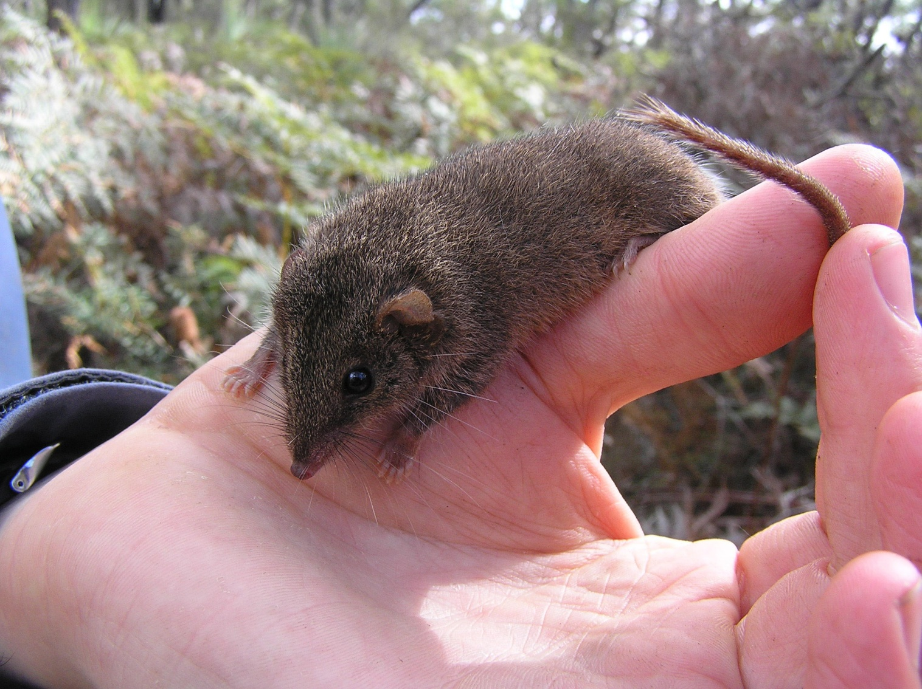
Antechinus agilis

Slide 26
Female Antechinus with young

Slide 27
Does the number of offspring make a difference to the survival of the Antechinus mouse?

Slide 28
Elliott trap

Slide 29
Calculating a population
$$N=\frac{M×n}{m}$$
N = number of individuals in a population
M = number of individuals caught in the first sampling, marked and then released
n = total number of individuals caught in the second sampling
m = number of marked individuals that were recaptured

Slide 30
Beckman, J., & Lill, A. (2016). Space use by female agile antechinus: are teat number and home-range size linked? Wildlife Research, 43(4), 348. https://doi.org/10.1071/wr16001

Slide 31
Beckman, J., & Lill, A. (2016). Space use by female agile antechinus: are teat number and home-range size linked? Wildlife Research, 43(4), 348. https://doi.org/10.1071/wr16001

Slide 32
Claim:
The number of females living in an area did not change much each season.
Claim:
More 6 teat mice live in an area than 10 teat mice.
Reasoning:
The number of mice trapped is an indication of the number living in the area.
Reasoning:
More mice trapped means more live in the area.
Evidence:
More 6 teat mice were trapped each night than 10 teat mice
Evidence:
The number of 6 teat or 10 teat females caught each season did not vary by much.

Slide 33
How many offspring could a female with 6 teats feed? What if they had more or fewer offspring?
How do you think this would affect the mother’s ability to survive?
Would it be easier or more difficult for the mother to survive if they had more offspring? Why or why not?
What other explanations could there be for more females being caught in a trap?
Could the 10T females be travelling further?

Slide 34
Could the 10T females be travelling further to find food?
Beckman, J., & Lill, A. (2016). Space use by female agile antechinus: are teat number and home-range size linked? Wildlife Research, 43(4), 348. https://doi.org/10.1071/wr16001

Slide 35
Which mother (6T or 10T) is more likely to have all her offspring survive?

Slide 36
Which mother is most likely to survive multiple breeding seasons?
The offspring of which mother are most likely to survive?
What are the disadvantages of K-strategy reproduction?
What are the advantages of K-strategy reproduction?
What would happen if the environment of the A. agilis were to change?

Slide 37
Peer review
Why do scientists publish their results/claims in scientific paper?

Slide 38
Lesson 5
Who will you save?

Slide 40
Selection criteria
The current size of the population
How much the population size has decreased in the last 10 years or 3 generations
The limited geographic range of the population
>50% probability of the population becoming extinct in the next 10-100 years

Slide 41
At risk…
What factors put the plant or animal at risk?
Does it produce many or few offspring?
How many offspring does each female produce during its lifetime?
How much do parents care for or teach their offspring?
What are the risks the parents or offspring encounter during their lifetime?
When is the plant or animal most at risk?
How does this affect the survival of the species?

Slide 42
Prioritising principles for selection
Risk of extinction: prioritising species and places under severe and imminent threat
Multiple benefits: prioritising species and places where recovery action will benefit other species
Feasibility and effectiveness: prioritising species and places where action can make a difference and is cost-effective
Importance to people: prioritising species and places of cultural significance
Uniqueness: prioritising species and places that are unlike any other
Representativeness: achieving balance in selected species and places

Slide 43
Develop an argument for why your animal or plant should be a priority.

