Slide 1
Science Connections
Year 7 Forces and sport

Slide 2
Lesson 1
Forces in sport

Slide 3
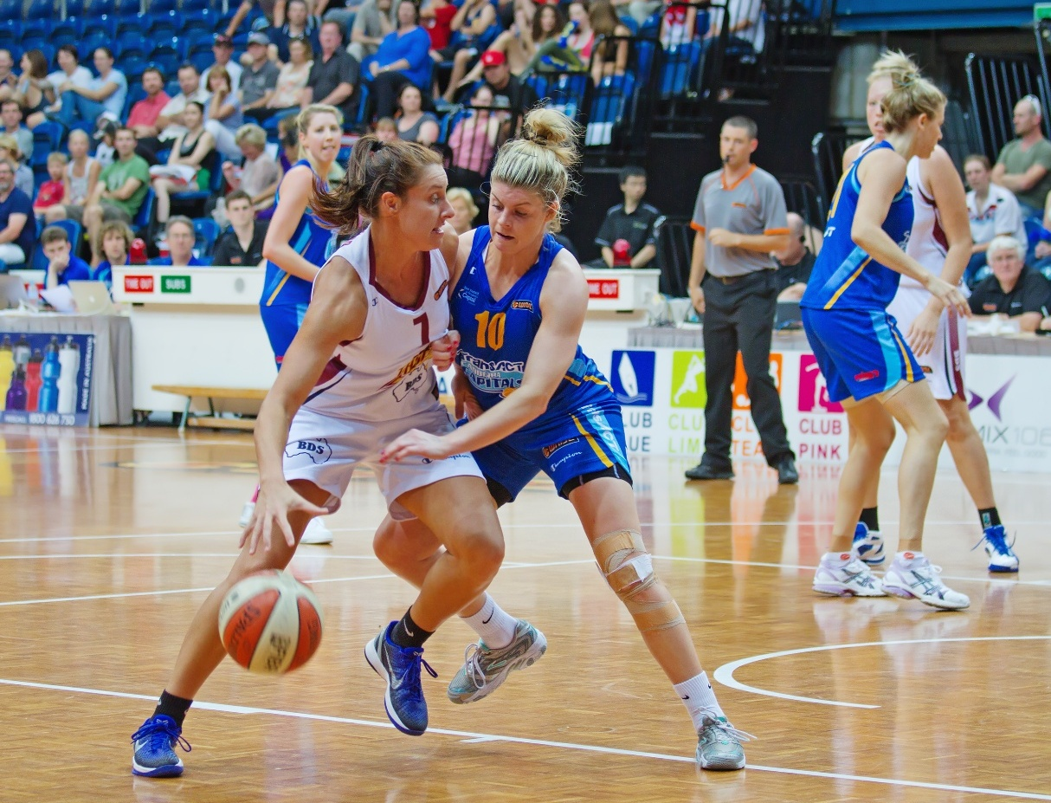
Activity: Forces in sport
What sports or physical activities do we play?
What sports do we like watching?
JJ Harrison (https://www.jjharrison.com.au/), CC BY-SA 3.0, via Wikimedia Commons

Slide 4
Activity: Play Koolchee (‘kool-chee’)
Go to an open area, such as a basketball court, that has a smooth surface and mark out the play area.
Divide players into two teams. Each team lines up along opposite ends of the playing area and faces each other. Each player has a ball (the koolchee).
Place a line of 5 skittles 2-3 m in front of each team at each end.
Players roll their koolchee and attempt to knock down the other team’s skittles lined up on the far end of the play area. Avoid hitting your own skittles directly in front of you but defend your skittles by using the ball to hit away any opposition koolchees.
The winning team is the one who knocks down all of the opponent’s skittles.
Watch this video to see the game being played: Traditional Indigenous games – Koolchee
Koolchees may be recovered from the playing area after everyone has stopped rolling and the playing area is safe.

Slide 5
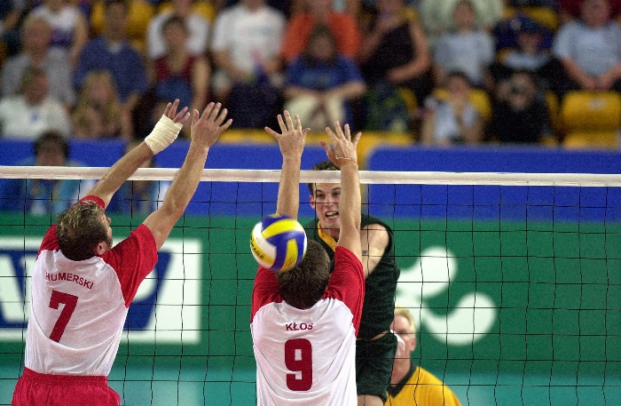
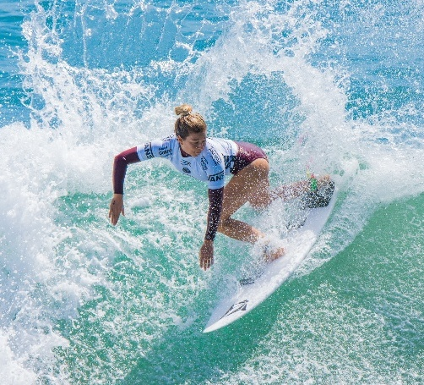
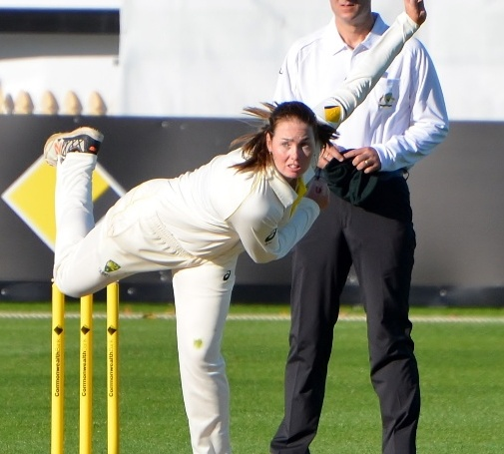
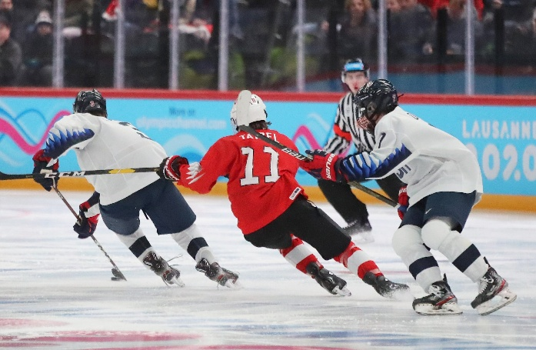
What is important?
How do you play your sport or physical activity?
What important information about what causes changes in movement would you communicate to a new player?
Troy Williams, CC BY 2.0, via Wikimedia Commons, Australian Paralympic Committee, CC BY-SA 3.0, via Wikimedia Commons, Bahnfrend, CC BY-SA 4.0, via Wikimedia Commons, Martin Rulsch, Wikimedia Commons, CC BY-SA 4.0, CC BY-SA 4.0, via Wikimedia Commons

Slide 6
What are forces?
A force is a push or pull that acts on an object when it interacts with another object.
Forces can exert a push or pull through direct contact or from a distance.
Forces always act in pairs because they are in an interaction.
Forces can change the motion of an object; they can make stationary objects move and cause moving objects to speed up, slow down, or stop.
Forces can change the direction an object is moving and can even change its shape.

Slide 7
What forces?
Examples of forces are:
Applied forces – pushes and pulls to move an object away or closer.
Normal force – the force from a surface on an object resting or sliding on it.
Tension force – a pulling force felt through a rope, string or cable.
Gravitational force – a force of attraction acting at a distance.
Frictional force – a force that opposes motion when two surface touch.
Air and water resistance (also called drag) – a type of friction that slows objects down.
Magnetic force – a force between magnets.
Electrostatic force – a force caused by electric charges.

Slide 8
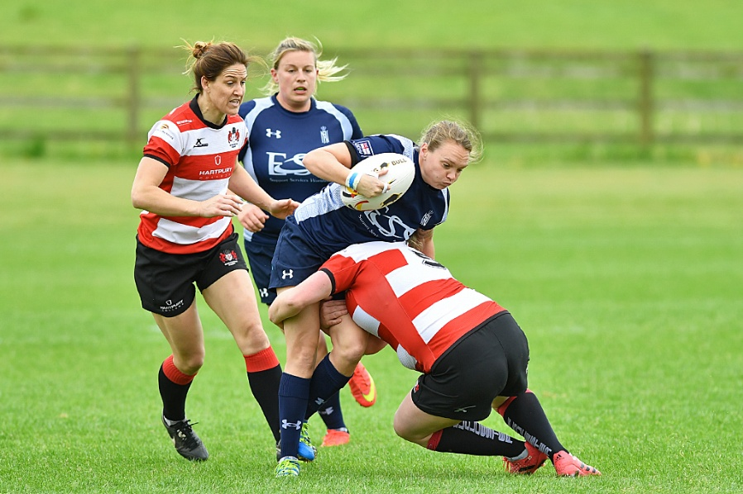
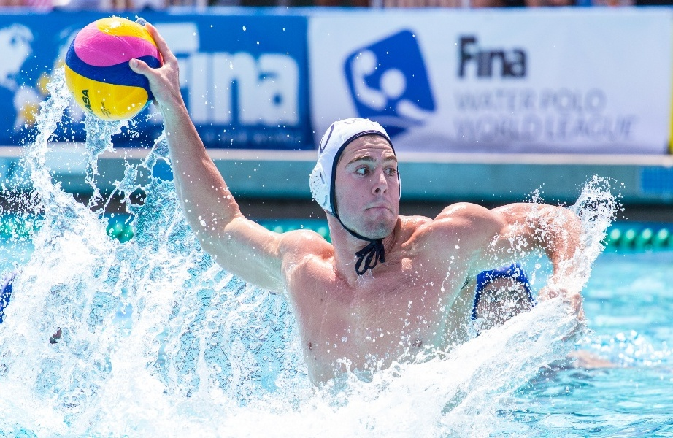
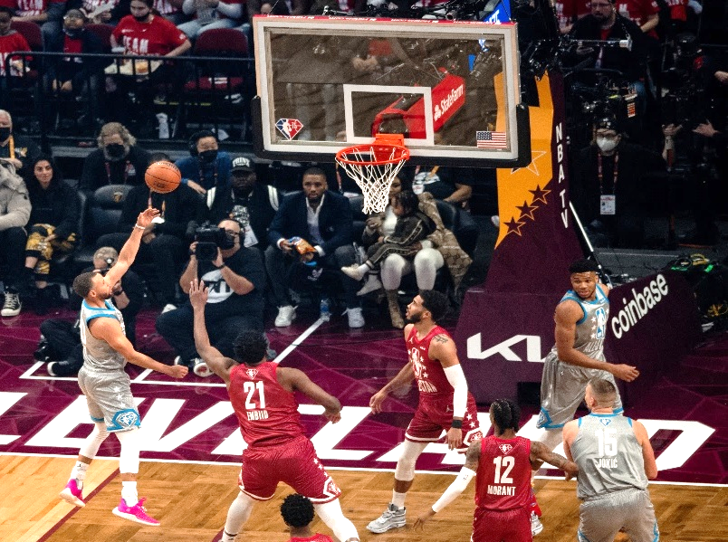
What forces?
John Walton (51) from West Sussex, United Kingdom, CC BY 2.0, via Wikimedia Commons, Jared Gray, CC BY 2.0, via Wikimedia Commons, Erik Drost, CC BY 2.0, via Wikimedia Commons

Slide 9
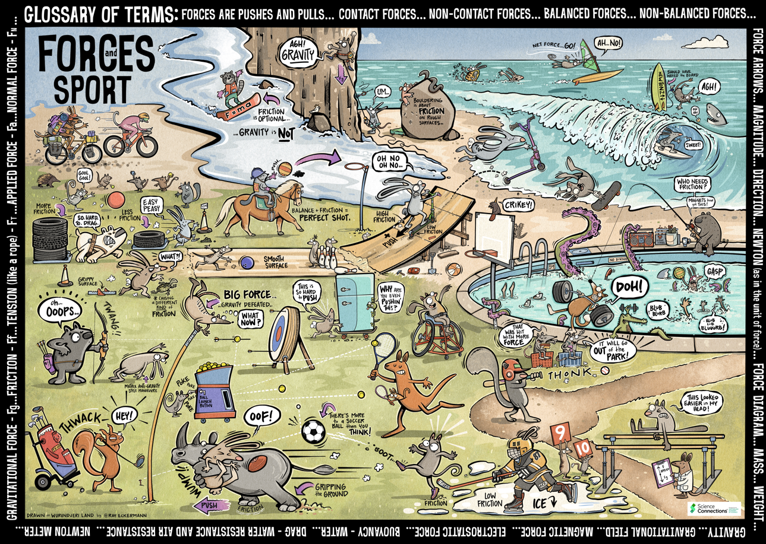
Activity: Find the forces
Identify and record the force/s shown in five sports or physical activities on the poster.
Write a sentence/s using three terms from the word bank.

Slide 10
Lesson 2
Balanced and unbalanced forces

Slide 11
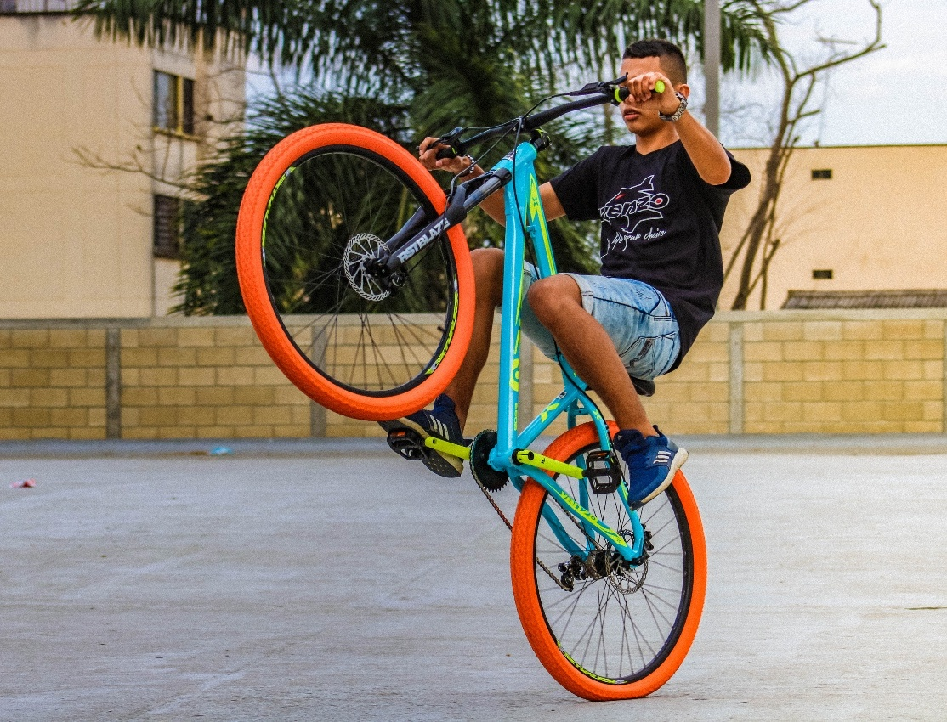
How can we describe forces?
Find examples of these statements about forces in this picture:
A force is a push or pull that acts on an object when it interacts with another object.
Some forces cause movement such as changing direction or speeding up or slowing down.
Other forces are balanced, and the object’s motion remains unchanged.
Sergio Daniel Rivas Rey, CC BY-SA 4.0, via Wikimedia Commons

Slide 12
What happens when forces act in different directions?
Why?

Slide 13
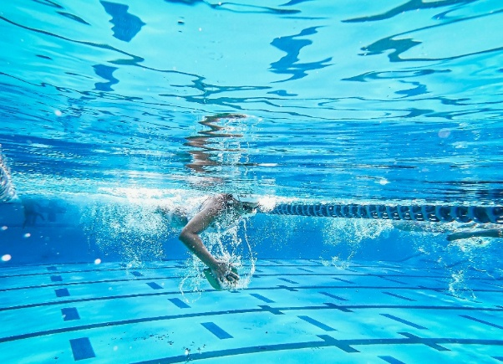
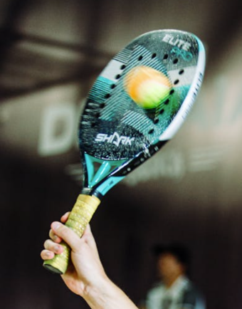
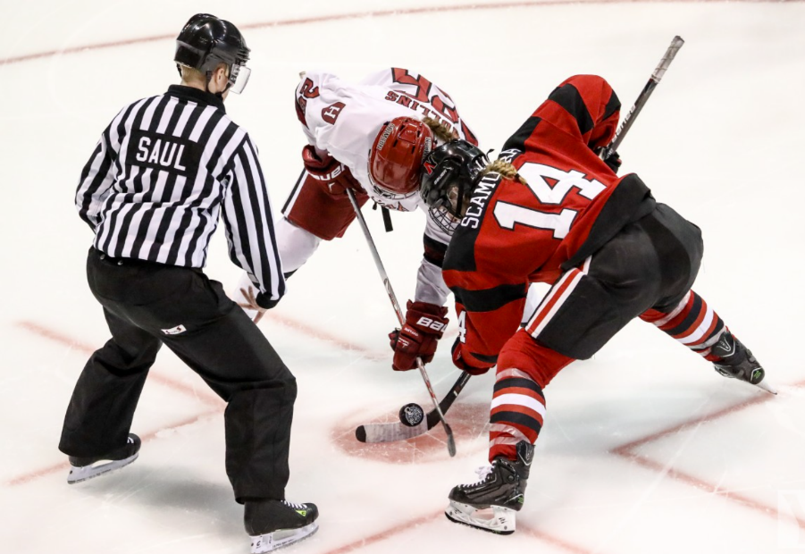
The different directions of forces in sport
Forces act with a certain size (called magnitude) and in a specific direction.
Different forces acting on the same object can:
balance → no change in motion.
be unbalanced → leading to starting or stopping motion or changing speed or direction.
What are the directions of forces in these sports?
Daniel Neves Cotta via Pexels, Kindel Media via Pexels

Slide 14
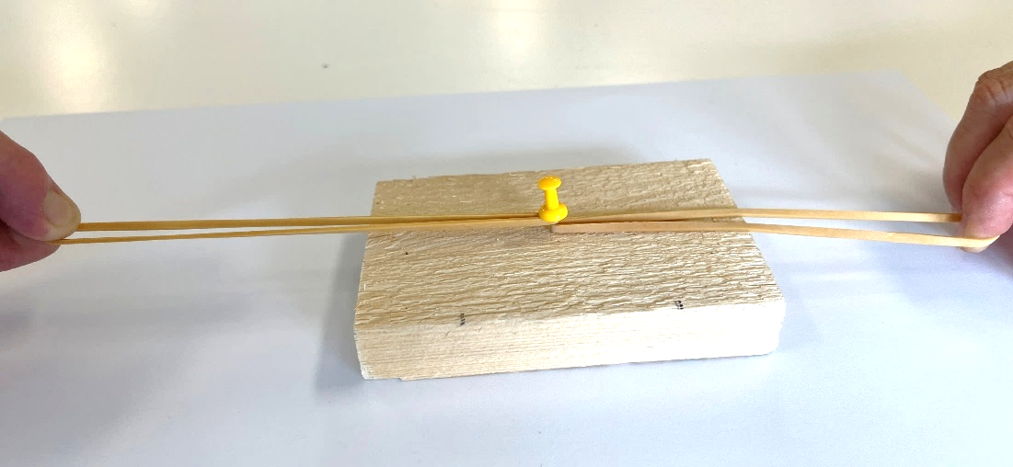
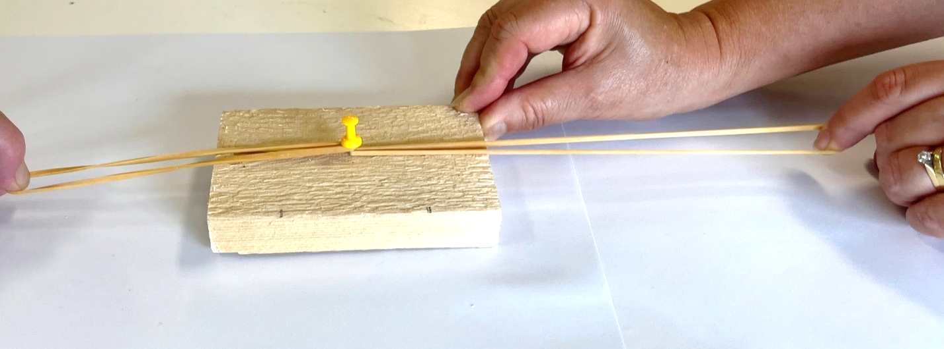
Investigate: Forces in different directions
Rubber bands pulled equal distance each side of the pin.
Equal pull forces on each side of the block = balanced forces
Rubber band on the right pulled a greater distance than the band on the left side.
Unequal pull forces on each side = unbalanced forces

Slide 15
Optional: What happens when forces act in the same direction?
Why?

Slide 16
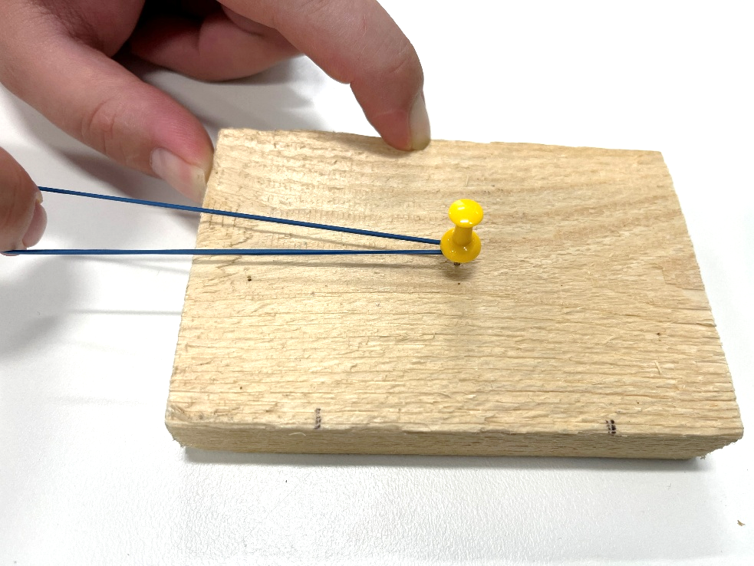
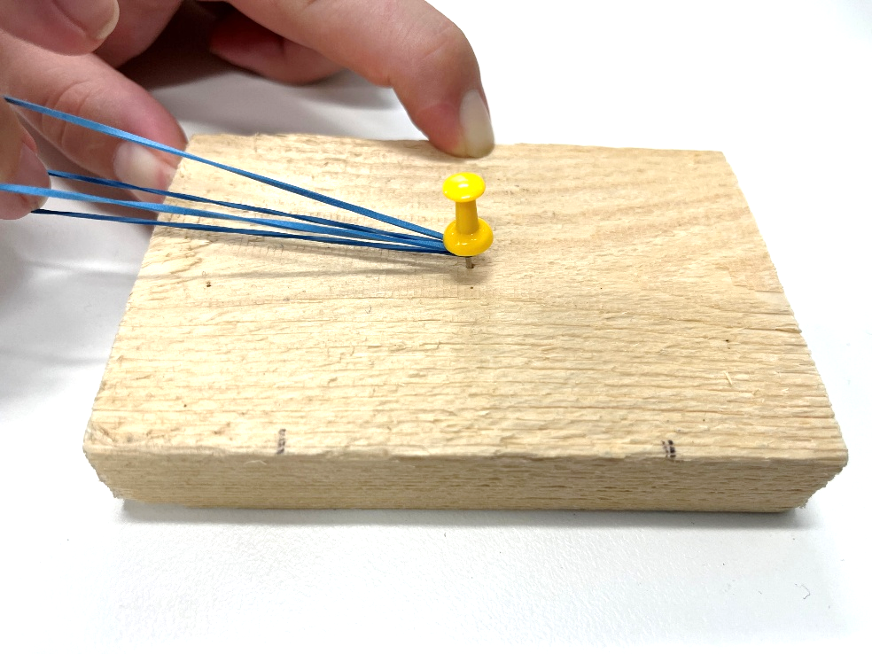
Optional Investigate: Forces in the same direction

Slide 17
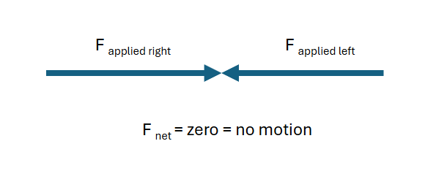
Integrate: Forces in different directions
When forces of the same size (or magnitude) act in different directions, the block did not move as the forces were balanced.
The block did not move because there was a zero net or “final” force acting on it.
The forces subtract from each other when they act in opposite directions and cancel out.

Slide 18

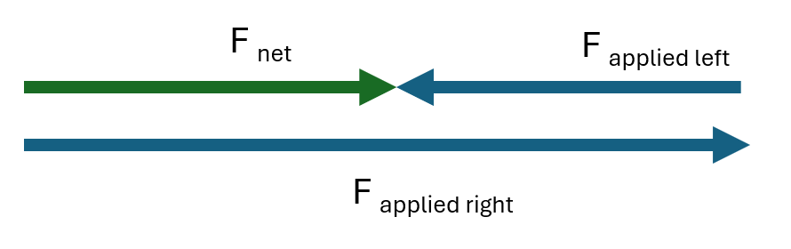
Integrate: Forces in different directions
When forces of different sizes act in different directions, the block moved as the forces were unbalanced.
The block moved because there was a net or “final” force acting on it.
The forces subtract from each other when they act in opposite directions.

Slide 19


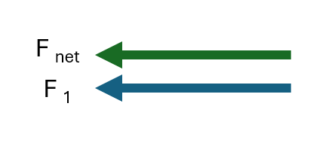
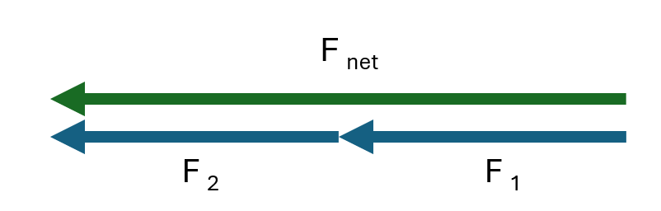
Optional Integrate: Forces in the same direction
When force is applied to the block only in one direction, the block moved as the forces were unbalanced.
The block moved because there was a net or “final” force acting on it.
The forces add to each other when they act in the same direction.

Slide 20
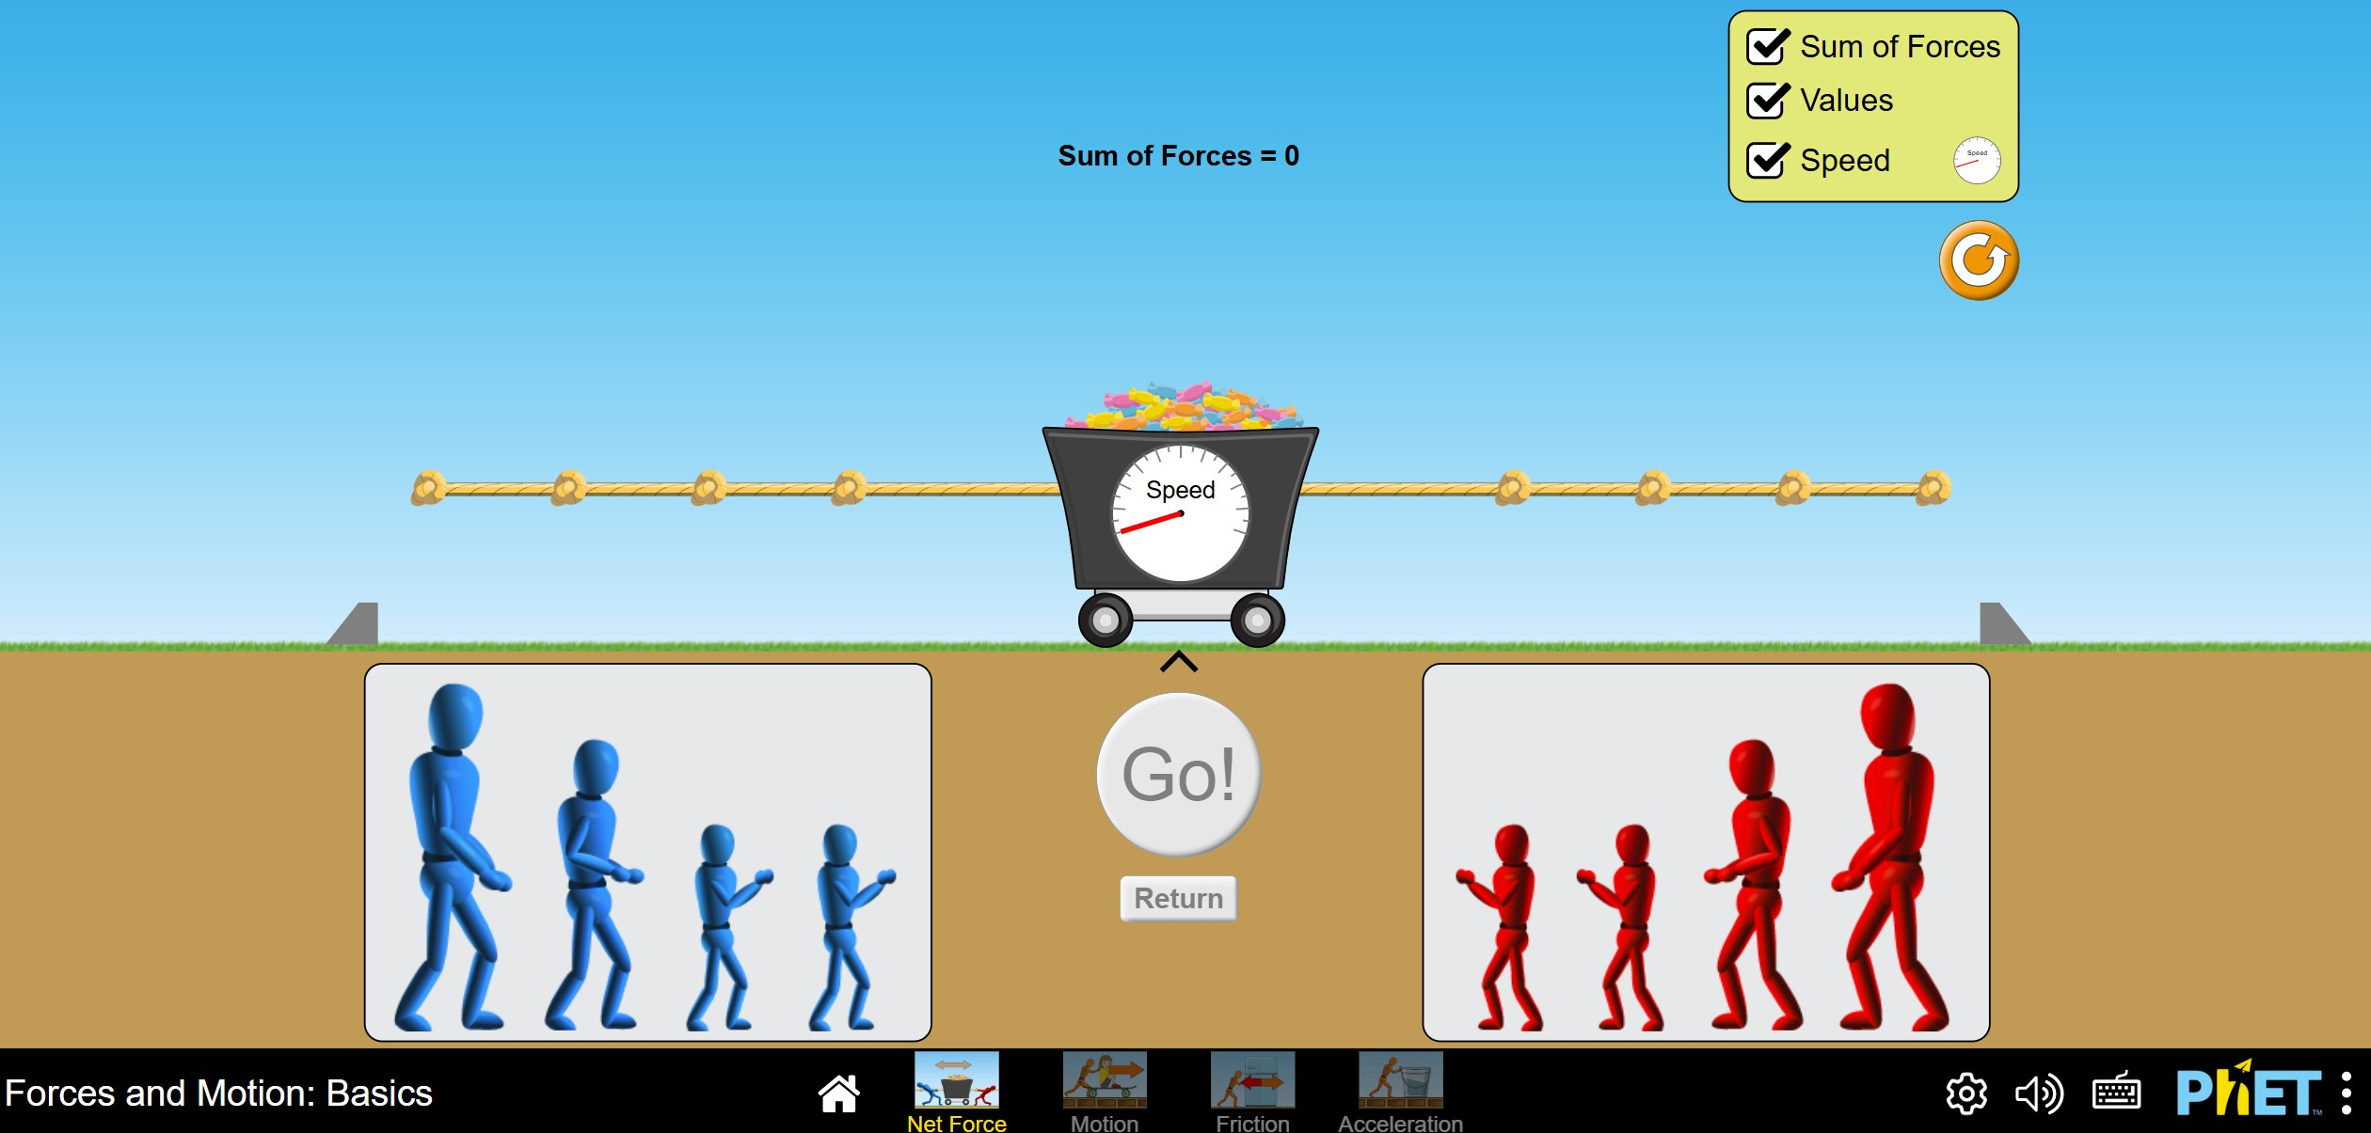
Net force simulation
Go to the PhET simulation ‪‪Forces and Motion: Basics‬‬.

Slide 21
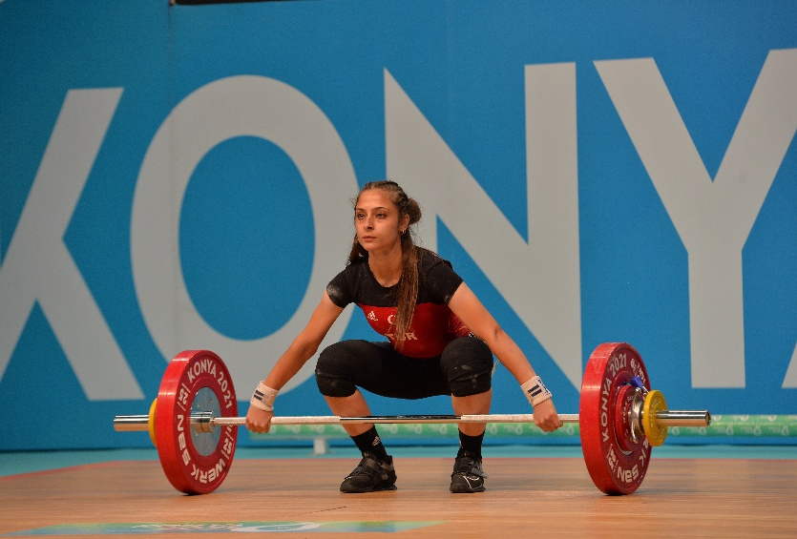
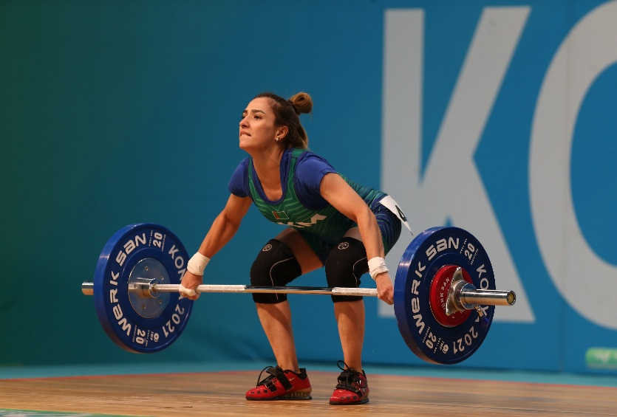
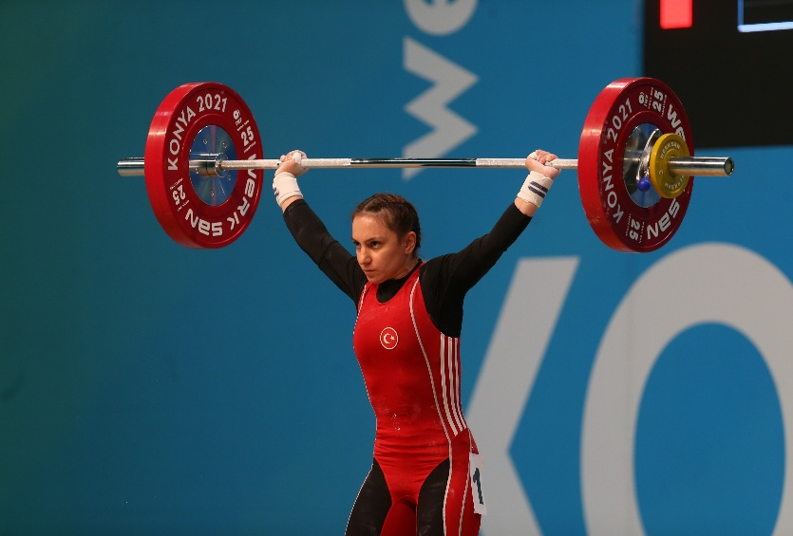
Integrate: Forces in sport
Weightlifting involves balanced and unbalanced forces.
When is the net force zero? Which direction is the net force when the barbell is moving rapidly upwards?
Astro medya Org. Ltd. ŞTİ., CC BY 2.0, via Wikimedia Commons

Slide 22
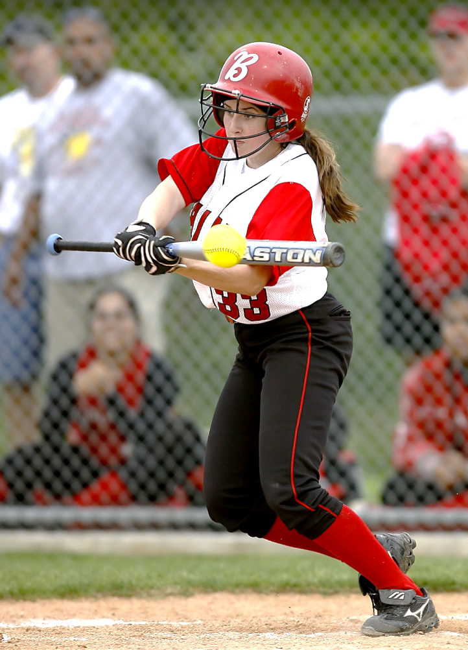
Integrate: Forces in sport
Choose a sport or physical activity.
Identify:
one example of balanced forces.
one example of unbalanced forces.
Explain how these forces affect motion.
CC0 Public Domain.

Slide 23
Lesson 3
Does mass affect motion?

Slide 24
Does mass affect motion?
What adjustments would the weightlifter have to make if the mass on the barbell was increased?
Astro medya Org. Ltd. ŞTİ., CC BY 2.0, via Wikimedia Commons

Slide 25
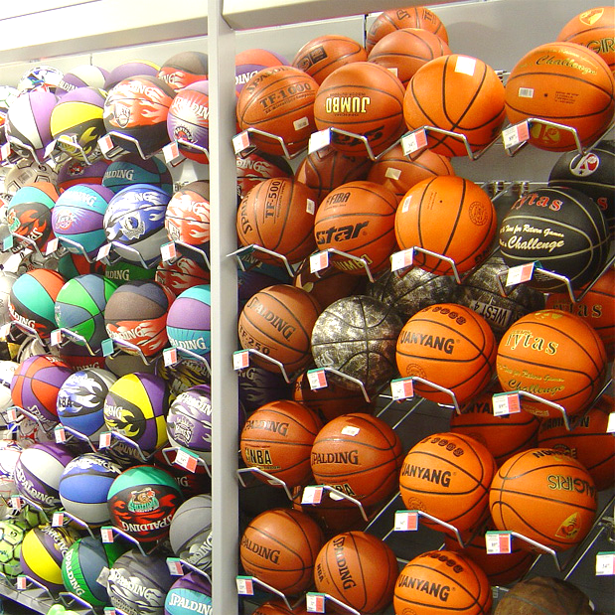
Does mass affect motion?
Using your own experience, how does mass affect movement in sport?
Does mass affect throwing?
Does mass affect hitting with a racket or bat?
Does mass affect catching?
Does mass affect kicking?
Does mass affect pushing?
Wikimedia Commons. CC by 2.5

Slide 26
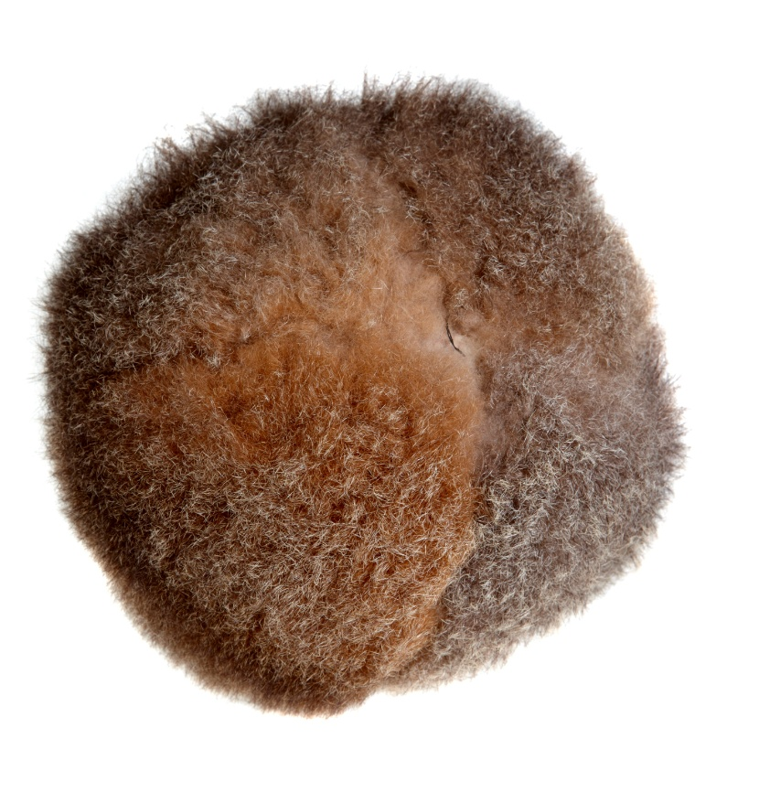
Activity: Play Woggabaliri (“wog-gab-a-lir-i”)
In teams of 4-6:
Players stand in a circle about 2 metres apart.
One player kicks the ball into the air and other players in the circle try to keep the ball in the air by kicking it. No player should kick the ball twice in a row. All “kicks” are made with either the hands or feet. Players must have one foot on the ground when kicking the ball.
Each group attempts to volley the ball (consecutive kicks) in the air as many times as they can within a set time. The group with the greatest number of volleys in the time wins. If the ball touches the ground the count is restarted.
A modern-day ball made of possum skin and stuffed with materials like grass, held by Museums Victoria Source: Museums Victoria

Slide 27
What happens to the speed of an object if its mass is increased?

Slide 28
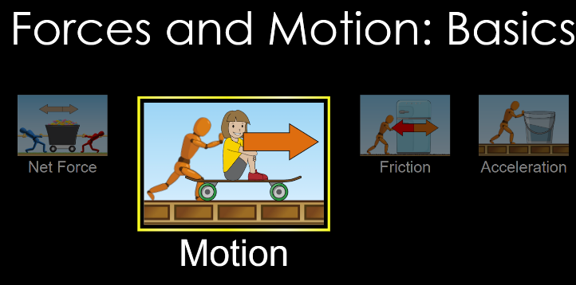
Does mass affect motion?

Slide 29
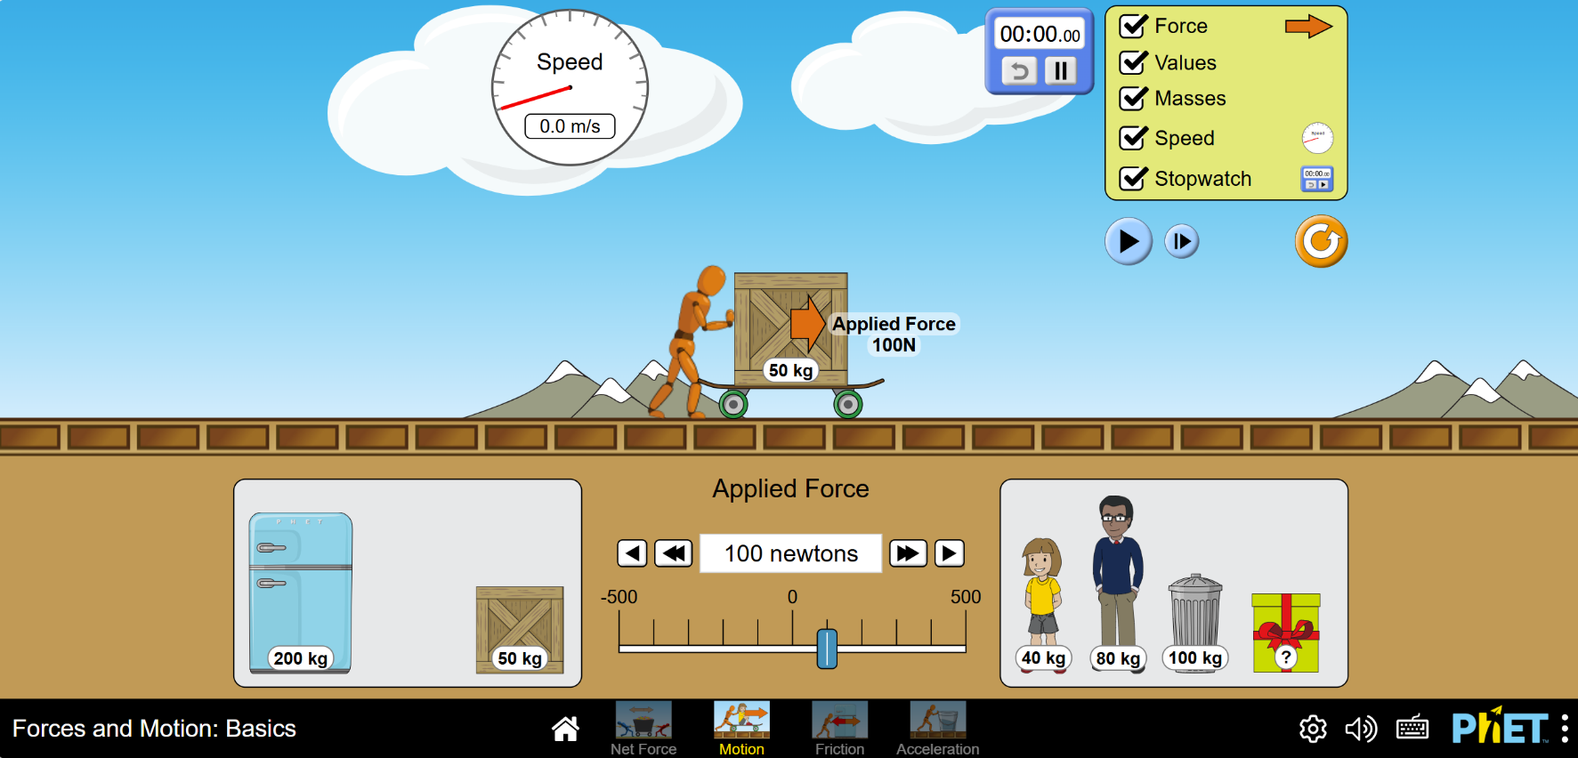
Does mass affect motion?
Experiment 1: Is the speed of the skateboard affected by the mass on the board?
‪Forces and Motion: Basics‬

Slide 30
Does mass affect motion? Making a model
In a direct relationship, as one value gets bigger (↑), the other value also gets bigger (↑).
In an inverse relationship, as one value gets bigger (↑), the other value gets smaller (↓).

Slide 31
Does mass affect motion: Making a model
Using the information about direct and inverse relationships on the previous slide, a student looked at the graph and made a claim:
“The speed of the skateboard has an inverse relationship to the mass on the skateboard.”
Is the student’s claim supported?
Use evidence to support your decision.

Slide 32
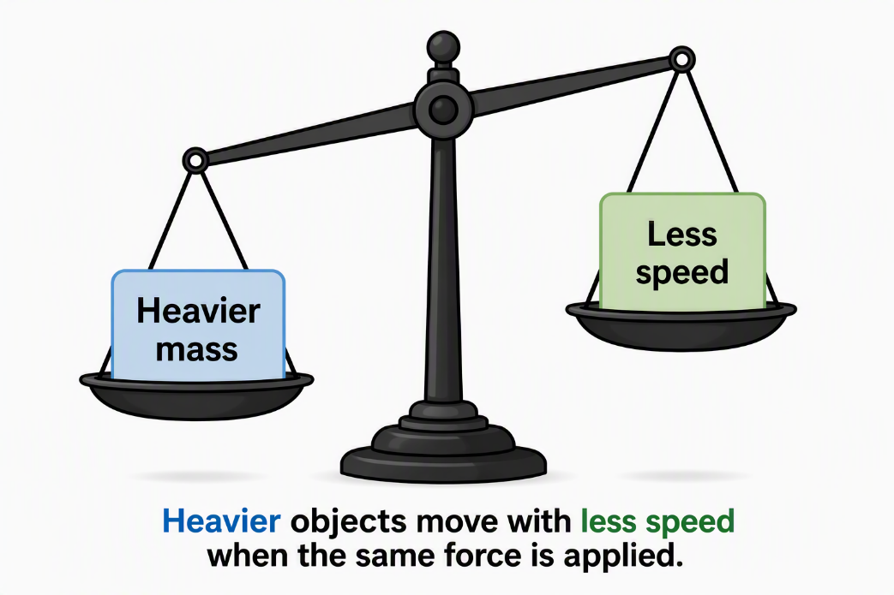
Does mass affect motion: Making a model
A student drew a picture to show the relationship between mass and speed.
Is the diagram a good model?
Why? Why not?

Slide 33
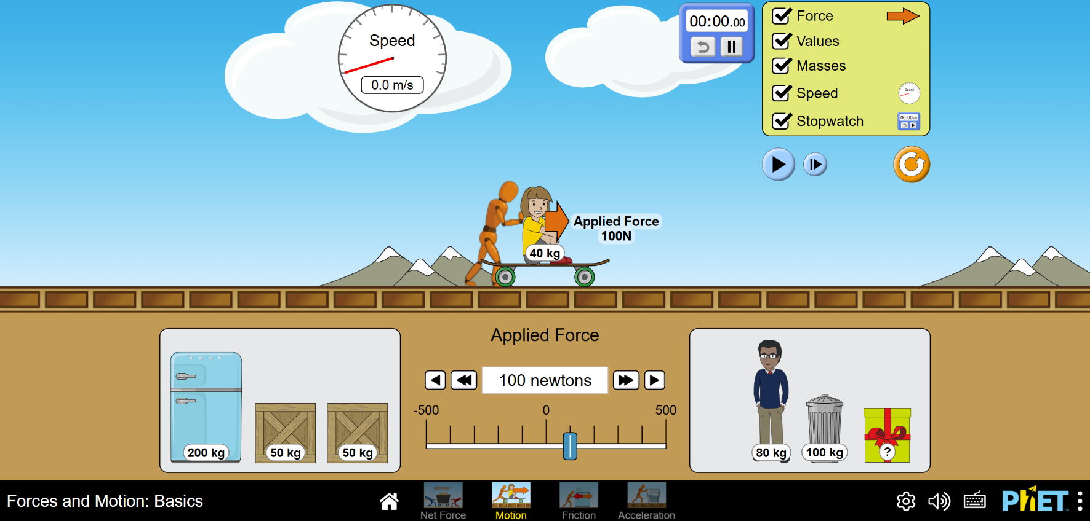
Does mass affect motion: Making predictions
Experiment 2: Can you predict the speed of an object using the scientific model?

Slide 34
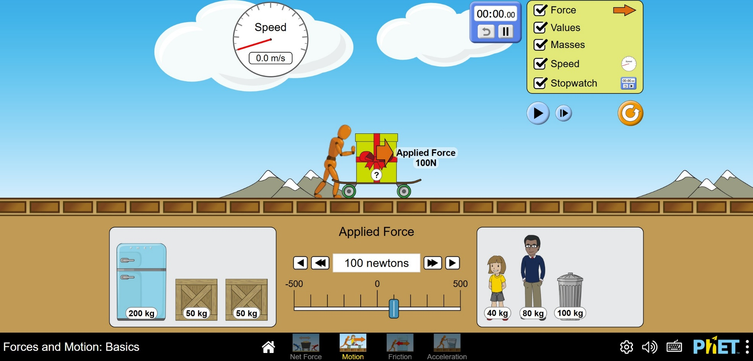
Does mass affect motion?
Experiment 3: What is the mass of the unknown object?

Slide 35
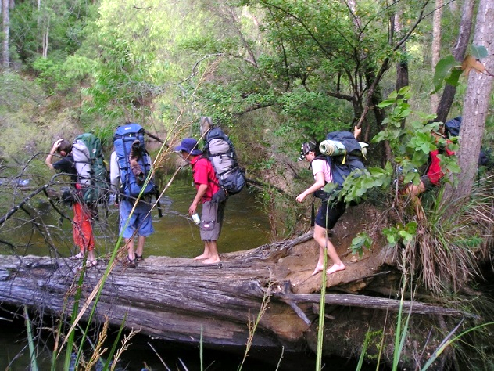
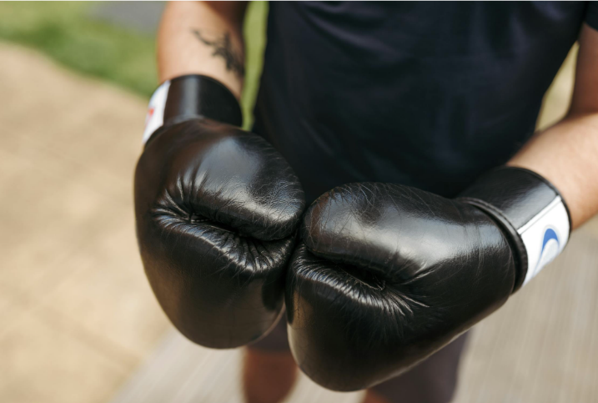
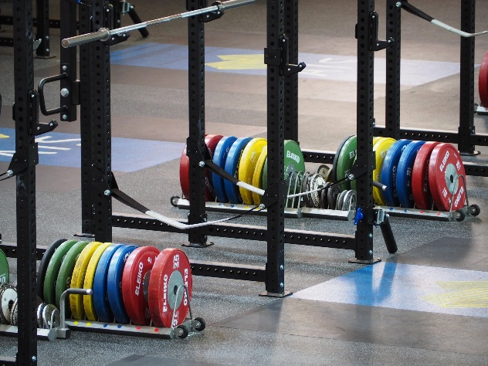
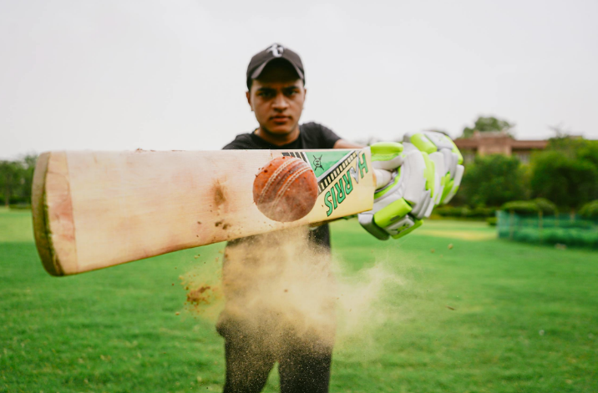
Integrate: Mass and motion in physical activities
How will you show the impact of mass on motion in your sport or physical activity infographic?
Firstac5, CC BY-SA 4.0, via Wikimedia Commons, Photo by KeepActive.com.au, CC BY-SA 4.0, via Wikimedia Commons, Anete Lusina, Yogendra Singh. Via Pexels

Slide 36
Lesson 4
Does the amount of force affect motion?

Slide 37
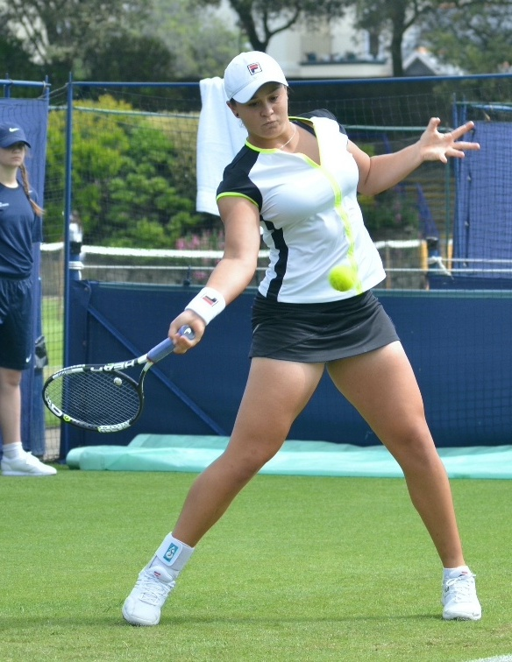
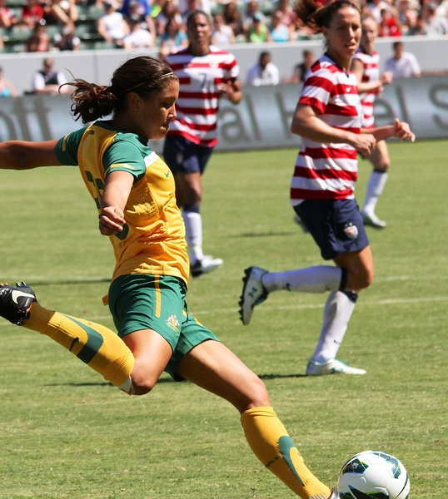
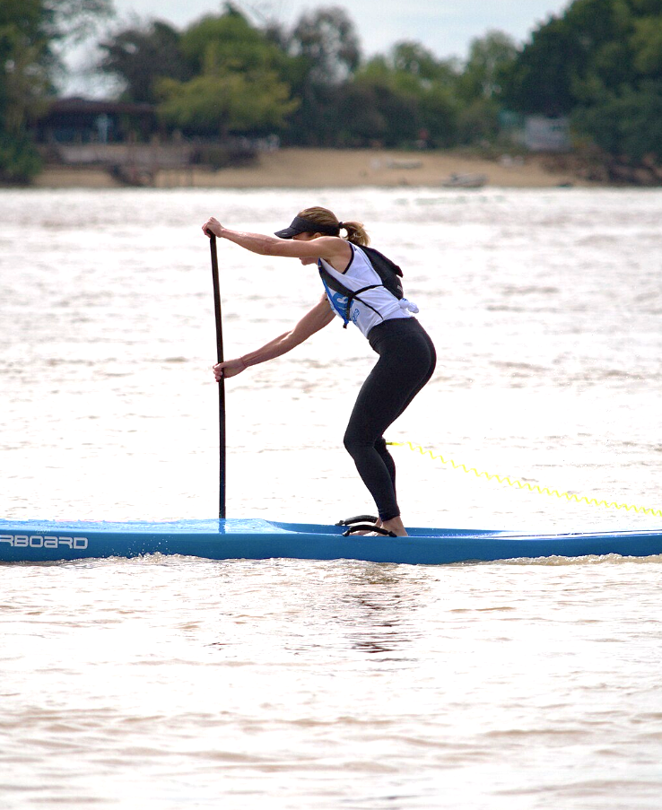
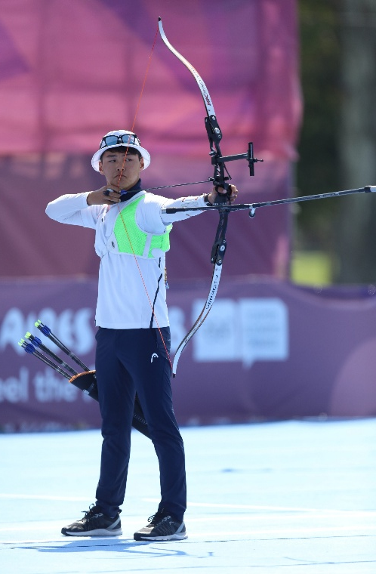
Does force affect motion?
How does increasing the applied force affect motion in these sports?
Martin Rulsch, Wikimedia Commons, CC BY-SA 4.0, CC BY-SA 4.0, via Wikimedia Commons, Peter Menzel, CC BY-SA 2.0, via Wikimedia Commons, Thewomensgame at English Wikipedia, CC BY-SA 3.0, via Wikimedia Commons, Mauricio V. Genta, CC BY-SA 4.0, via Wikimedia Commons

Slide 38
Activity: Play Gorri (“gor-ri”)
Two students are the “rollers”, and the rest of the class or teams are “throwers” who line up along two lines facing each other 10-20 metres apart. The target ball will be rolled across the playing area, parallel to the lines of throwers.
Rollers stand near a marker at the middle of the side of the playing area. Throwers can only throw their tennis balls when the target ball is rolled between these markers.
The throwers call out for the ball to be rolled when they are all ready. The roller calls out “gool-gool” and starts the ball rolling toward the second roller at the other end of the area.
As the target ball rolls towards the marker, the players either throw or roll their tennis balls at the target in an attempt to hit it.
The ball is then rolled from the other end to continue the game. Change around the throwers and rollers after a number of turns.

Slide 39
How does increasing force affect motion?

Slide 40
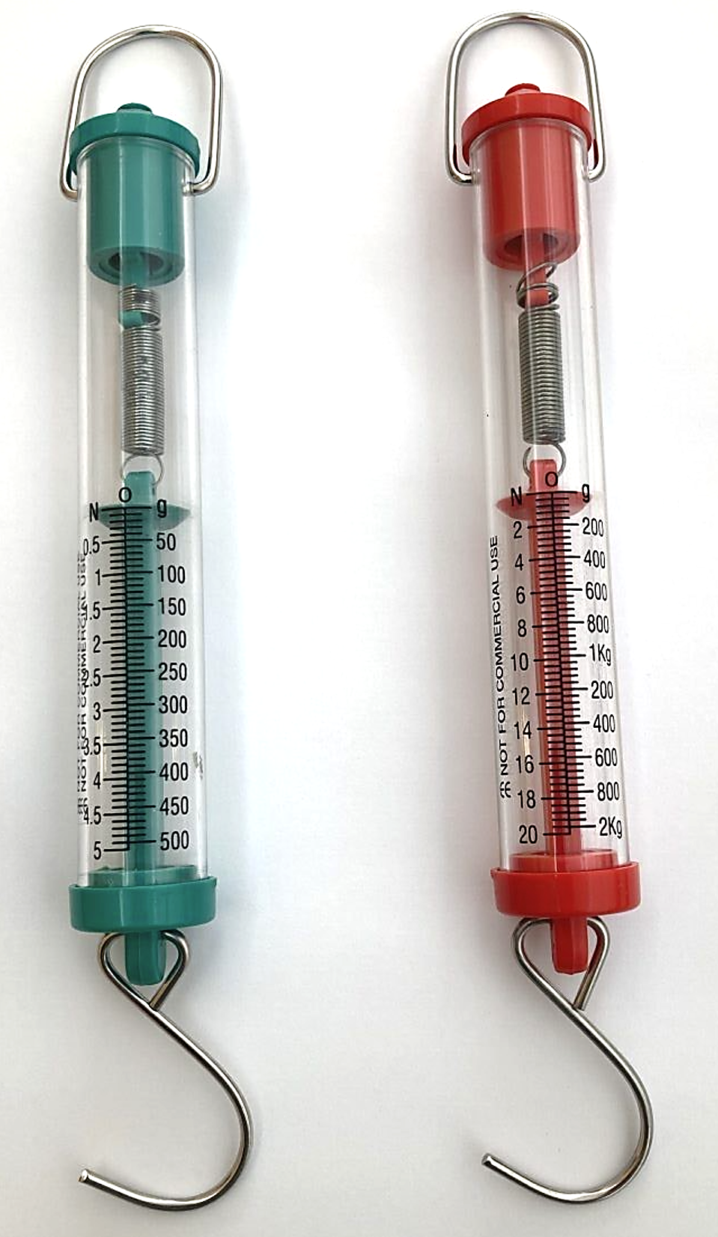
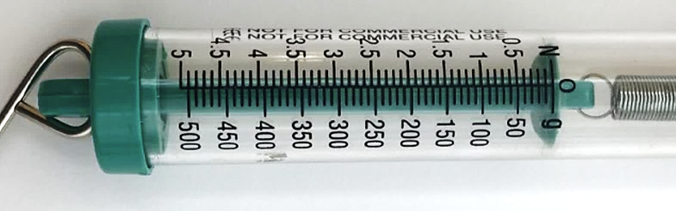
Investigate: Measuring force
Newton meters measure the force to pull or lift an object.
Different Newton meters have different scales. The green meter measures force up to 5 Newtons. The red meter measures force up to 20 Newtons.
There are two scales – one in Newtons and the other in grams.
The internal spring marker should sit at 0 N before starting.

Slide 41
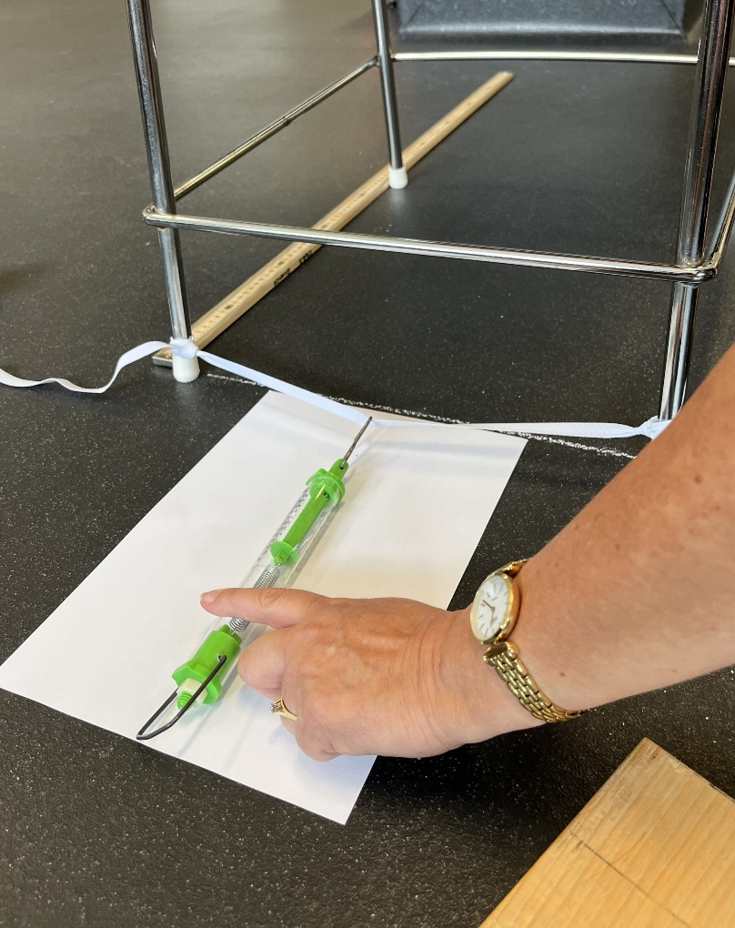
Investigate: Setting up a Newton scale
Tie the sewing elastic between the legs of the chair and attach the hook of the Newton meter to the elastic.
Hold the Newton meter level with surface and pull slowly and evenly until the pointer or marker reaches 1 N.
Read the force value from the scale where the pointer or marker lines up on the scale.
Mark the distance the elastic has been pulled backwards on the paper. Remove the meter from the elastic, and check the marker returns to zero.
Repeat the process to mark 2, 3, 4 and 5 N lines.

Slide 42
What happens to the distance an object travels if more force is applied?

Slide 43
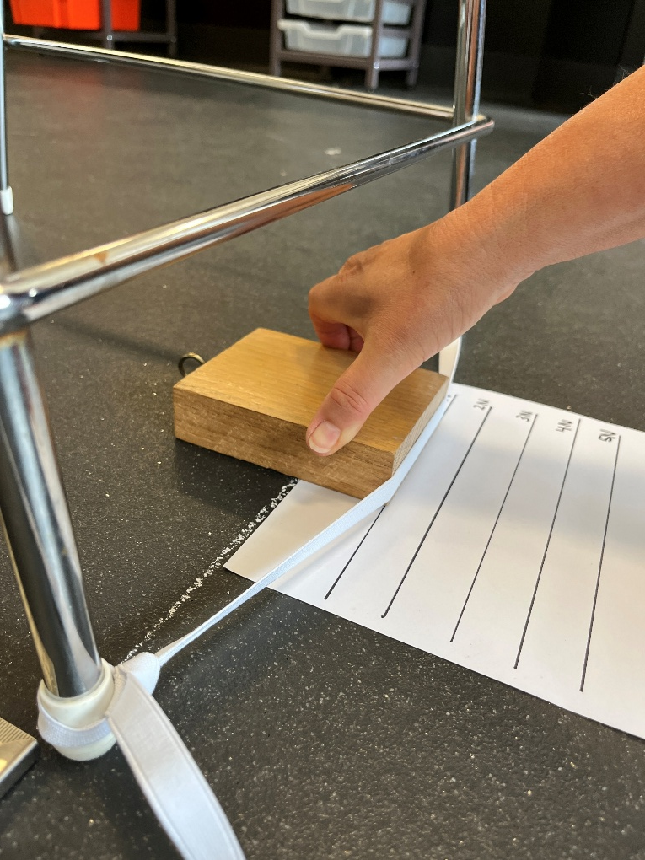
Investigate: Force and motion
Conducting the experiment
Place the block into the force launcher elastic and pull the block and elastic backwards so the edge of the block is lined up with the 1N line.
Release the block and measure the distance the block travels from the chalk line in centimetres. Record this value in the results table. Repeat this process another two times.
Repeat for 2, 3, 4 and 5 Newtons of force.

Slide 44
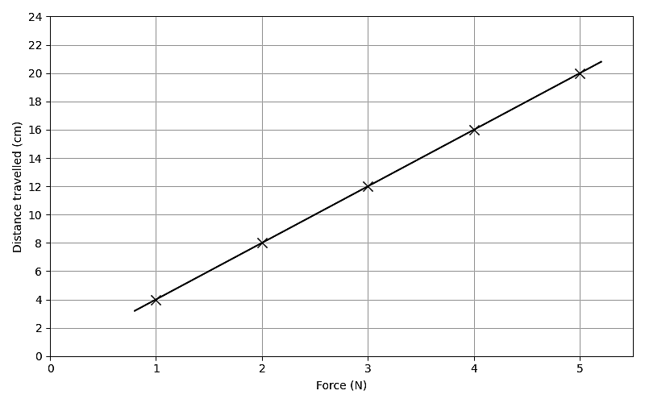
Integrate: Force and motion
What happened to the distance the block travelled as you increased the applied force?
Did you see a similar trend to this student’s graph?

Slide 45
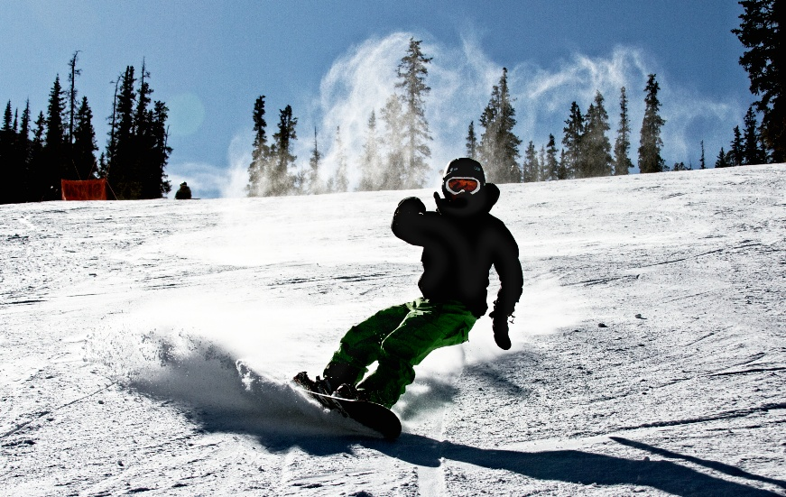
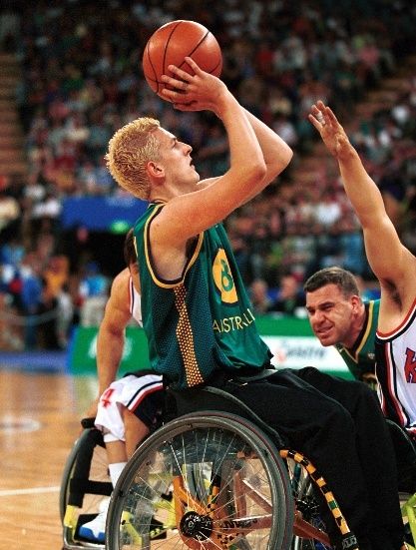
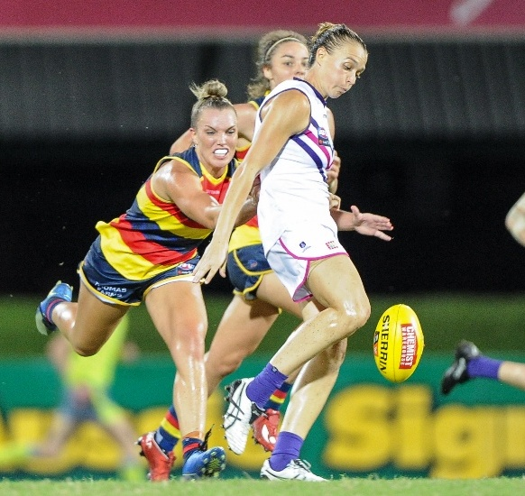
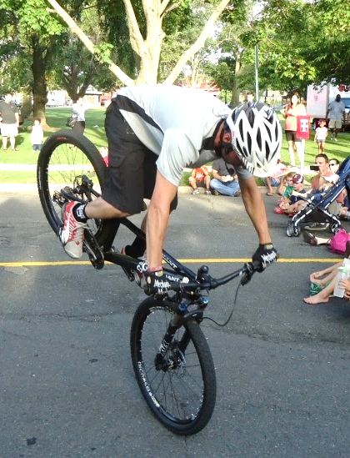
Integrate: Force and sports
Which sports rely on increased force for extra distance or extra speed?
Which sports rely on increased force to stop motion or to suddenly change direction?
Zach Dischner, CC BY 2.0, via Wikimedia Commons, Australian Paralympic Committee, CC BY-SA 3.0, via Wikimedia Commons Flickerd, CC BY-SA 4.0, via Wikimedia Commons, Pierre-Selim Huard, CC BY 4.0, via Wikimedia Commons, Tomwsulcer, CC0, via Wikimedia Commons,

Slide 46




Integrate: Force and sports
How is increased force important in your sport or physical activity?
How will you show this on your infographic?
KeithJJ via Pixabay, CC0, via Wikimedia Commons, Pierre-Selim Huard, CC BY 4.0, via Wikimedia Commons, Australian Paralympic Committee, CC BY-SA 3.0, via Wikimedia Commons.

Slide 47
Lesson 5
Why are surfaces important in sport?

Slide 48




Re-orient
These images show how motion can be affected by changing the force.
How are the ideas shown in the pictures
similar?
different?
Zach Dischner, CC BY 2.0, via Wikimedia Commons, Martin Rulsch, Wikimedia Commons, CC BY-SA 4.0, CC BY-SA 4.0, via Wikimedia Commons, Flickerd, CC BY-SA 4.0, via Wikimedia Commons

Slide 49



Surfaces in sport
Why are surfaces important in cycling?
Crisher P.H via Pexels, Jonathan Cooper via Pexels, Harvey Tan Villarino via Pexels
What about other sports?

Slide 50

Answering a “Why?” question
Why are surfaces important in cycling?
What is the verb? What do I need to include in an answer to an “Why” question?
What do I already know about surfaces and bikes?
What do I already know about the purpose of these surfaces? This will help answer the “explain”.
To finish answering the question, generalise what you have discovered into one sentence.
Jonathan Cooper via Pexels

Slide 51

Why are surfaces important in sport?
Brainstorm examples in sport and physical activities where two surfaces are in contact and:
equipment moving across a surface slows down
equipment in contact with another surface grips
equipment in contact with another surface slides
Photo by Елена from Pexels

Slide 52
Why are surfaces important in sport or physical activities?

Slide 53

Friction
Friction is a contact force that occurs when two surfaces touch and resist slipping or sliding when one surface moves, or tries to move, relative to the other.
Raavimohantydelhi, CC BY-SA 4.0, via Wikimedia Commons

Slide 54


Investigate: Types of surface & friction
Surface
5 N Newton meter
Read the force when the block is moving at a constant speed across the surface.
Block with 500g mass

Slide 55
Integrate: Types of surface & friction
Analysing results
How do your results compare to others in your class? Are there any patterns? Can you group surfaces?
Why do you think the same block experienced different frictional forces depending on the surface?
Conclusion
Summarise the findings of the investigation and the significance of the results. Include a statement referring to the hypothesis.
Discussion
Did the force measured for the trials of a surface vary? Assess the precision of your trials.
Identify one possible error that contributed to this uncertainty and suggest a way to avoid this if the experiment was to be repeated.

Slide 56
Integrate: Frictional forces & surfaces
Why are surfaces important in sport or physical activities?
Surface | Impact on motion | Examples in sport
decreases friction | person or object goes faster | waxing skis or surfboard ball bearings in wheels of bikes and skateboards
increases friction | person or object goes faster or with better control | pushing down on ground to start sprinting or to dodge in touch football the pebbled surface on a basketball for better handling and control
increases friction | person or object goes slower or stops | cyclist braking high-grip soles allow basketballers to stop suddenly on court goal keepers wearing gloves in soccer tennis ball on clay court compared to a grass court

Slide 57






Integrate: Frictional forces & surfaces
How is motion impacted by an increase or decrease in the frictional force between objects?
DoD News, CC BY 2.0, via Wikimedia Commons, Australian Paralympic Committee, CC BY-SA 3.0, via Wikimedia Commons, Steffen Prößdorf, CC BY-SA 4.0, via Wikimedia Commons, Motocross MX Masters Qualifying at Holzgerlingen, Germany Dirk Gently Flickr CC BY-NC-ND 2.0, Pierre-Yves Beaudouin / Wikimedia Commons, Photo by Bono Tsang from Pexels

Slide 58


Integrate: Frictional forces & surfaces
What surface would be best for a starting block, and why?
KeepActive Australia, CC BY-SA 4.0, via Wikimedia Commons, Usain Bolt on the starting blocks | Nick Webb | Flickr CC by 2.0

Slide 59
Integrate: Frictional forces & surfaces
What surface would be best for a starting block, and why?
Claim
A starting block should be covered with…
Reasoning
Evidence

Slide 60
Lesson 6
Controlling the curve

Slide 61
Re-orient
Surface | Impact on motion | Examples in sport
decreases friction | person or object goes faster
increases friction | person or object goes faster or with better control
increases friction | person or object goes slower or stops

Slide 62




Controlling the curve
How does gravitational force affect motion?
Flickerd, CC BY-SA 4.0, via Wikimedia Commons, Australian Paralympic Committee, CC BY-SA 3.0, via Wikimedia Commons, Amy Martin Photography, CC BY-SA 4.0, via Wikimedia Commons, 三色人, CC BY 2.5 CN, via Wikimedia Commons

Slide 63
How does gravitational force affect motion?

Slide 64
Controlling the curve
How can gravitational force be described?
At Earth’s surface, gravity exerts 9.8 N of force on every kilogram of mass. | Gravitational force near Earth’s surface always acts downward, pulling objects toward the centre of the Earth.
Gravitational force can be represented by drawing arrows pointing to the centre of the earth. | Gravitational force acting on an object can be represented using a downwards arrow and the label F_{g}.
Earth’s surface
Fg
Basketball falling in the air

Slide 65



Investigate: Marble on ramp activity
Distance travelled in one second
marble
book
ramp
surface
metre ruler or tape measure
Chemix - Draw Lab Diagrams. Simply.

Slide 66
Investigate: Marble on ramp activity
Variation refers to how spread out the data points from an investigation are from each other.
An outlier is a data point that is significantly different from the other points in the data set.
In this investigation the outlier was probably from an error when conducting the experiment or when measuring.
As the outlier impacts the average, it should be ignored when analysing the data.
Starting line on ramp
Lines drawn to show the distance travelled by the marble after one second
Variation in the measured distance
An outlier

Slide 67
Investigate: Marble on ramp activity
Reliable data is achieved when the data points consistently show low variation.
To do: Improve the reliability
Repeat releasing the marble and measuring the distance travelled after 1 second.
Develop a procedure so that the variation in your data is low.
Starting line on ramp
Lines drawn to show the distance travelled by the marble after 1 second
Variation in the measured distance

Slide 68
Investigate: Marble on ramp activity
Will the distance travelled by the marble double if the time doubles (to two seconds)?
Distance travelled in two seconds ?
marble
book
ramp
surface

Slide 69



Investigate: Marble on ramp activity
Possible outcomes:
the distance will be less than double (suggesting the marble slows down).
the distance will double (suggesting the marble's speed does not change).
the distance will be more than double (suggesting the marble speed is increasing or it is accelerating).

Slide 70
Investigate: Marble on ramp activity
Distance travelled in one second
marble
Distance travelled in two seconds
book
ramp
surface
marble
Distance travelled between one second and two seconds
book
ramp
surface

Slide 71
Integrate: Marble on ramp activity
The marble travelled farther in second 2.
Gravitational force was the net force acting on the marble.
The marble must have been speeding up over time.
Gravitational force caused the marble to speed up (or accelerate) as it rolled down the ramp.
marble
Distance travelled between one second and two seconds
book
ramp
surface

Slide 72

Integrate: Controlling the curve
Gravitational force constantly accelerates the ball downward, causing its speed to change throughout the flight.
Kicks, passes, and shots follow curved paths as they rise and fall.
Draw a diagram of a ball in flight. Add force arrows to the diagram at different points during the flight.
Explain how players predict a ball’s path, timing, and likely landing point during a game. Use examples.
Photo by Ollie Craig from Pexels

Slide 73
Lesson 6A
How does magnetic force affect motion?

Slide 74

Recall
Gravitational force has:
magnitude.
direction.
Gravitational force can be represented using arrows.
Gravitational force constantly accelerates a ball downward, causing its speed to change throughout the flight so kicks, passes, and shots follow curved paths as they rise and fall.
U.S. Space Force photo by Senior Airman Danielle McBride, Public domain, via Wikimedia Commons

Slide 75



Question
How do magnets affect the motion of sporting equipment?
Photo by photography lover from Pexels, Photo by DΛVΞ GΛRCIΛ from Pexels, Photo by Victor Freitas from Pexels

Slide 76
How do magnets affect the motion of sporting equipment?

Slide 77




Investigate: Magnetic force
What is magnetic force?
Sliding the north pole towards the south pole of a second magnet
Sliding the north pole towards the north pole of a second magnet

Slide 78

Integrate: Magnetic force
What is magnetic force?

Slide 79

Investigate: Magnetic force
Where is magnetic force strongest?
Use iron filings to identify where magnetic force is strongest:
around two magnets – same poles facing
around two magnets – opposite poles facing

Slide 80
Investigate: Magnetic force
Where is magnetic force strongest?
Results:
Diagram of iron filings pattern
Around two bar magnets with a north and south pole facing
Diagram of iron filings pattern
Around two bar magnets with a north and north pole facing

Slide 81

Integrate: Magnetic force
What did the investigation show about magnetic force?
Magnets exert force without touching other magnets or objects.
An attractive magnetic force existed between unlike poles.
A repulsive magnetic force existed between like poles.
Magnetic force changes with distance
the force felt stronger when the magnets were closer
the iron filings pattern showed that magnetic force is strongest near the magnet, particularly at the poles, and weakest further away.

Slide 82



Integrate: Magnetic force & sports equipment
How do magnets affect motion in sporting equipment?
Magnets inside fishing reels and exercise equipment are placed near a spinning metal disc or flywheel.
The magnets create resistance or “braking”.
This slows the motion of the cast and makes the rowing stroke or pedaling harder.
Kritchai Chaibangyang via iStock , photography lover via Pexels, TChapman9, CC BY 2.0, via Wikimedia Commons

Slide 83

Integrate: Magnetic force & sports equipment
Compare:
contact braking on road bikes and
magnetic braking on exercise bikes.
Photo by Ivan S via Pexels, Photo by DΛVΞ GΛRCIΛ from Pexels

Slide 84
Lesson 7
Designing a forces infographic

Slide 85
Activity: Play Buroinjin (bur-oin-jin)
Select two teams of players.
Begin the game by throwing the buroinjin (a size 2 or 3 soccer ball) into the air in the middle of the playing area.
The player that catches the ball should try to run over a line at the other end of the field without being touched by the opposing team. The buroinjin may be thrown to another player, but it cannot be hit with the fist or kicked. There are no player positions or offside, and the buroinjin can be thrown in any direction.
The game does not stop if a player drops the buroinjin. Players must bend over and pick it up (they should not dive on the ball).
If a player with the buroinjin is touched by a member of the opposing team, the ball should be thrown up (at least 2-3 metres in the air) by that player so the game can continue. The player who was touched may not catch the buroinjin.
Possession changes through infringements such as intercepts, a player deliberately playing the buroinjin into another player, a player running out, and holding or obstructing an opponent.
If a player carries the buroinjin past the score line, one point is scored. The game is then restarted.

Slide 86

Yarning circle
A yarning circle is a traditional, collaborative method of conversation used to learn, share knowledge, build respectful relationships, and pass down cultural knowledge.
A yarning circle is a method of knowledge exchange that embodies the oral traditions of storytelling in First Nations cultures.
Yarning circles invite everybody to participate on equal standing, learn as a collective of people with different ideas and experiences.
University of Canberra's Yarning circle. Present on Ngunnawal community land

Slide 87

Evaluating infographics

Slide 88
Infographic design
Ideate
Brainstorm ideas for the infographic. Include all ideas.
Group ideas into categories (e.g. move, speed up, slow down, change direction).
Design
Identify the purpose and audience.
Select the most important forces and motion information.
Choose an infographic style that suits your time and resources available.
Communicate
Share your infographic in a gallery walk.
Gather feedback from peers.

