Slide 1
Science Connections
Yr 10 Genes, ethics and society

Slide 2
L1 Launch
Genetic diseases

Slide 3
What do we mean when we say someone has a disease?
Brainstorm all the diseases you know.

Slide 4
Definitions
Disease: Anything that affects the normal functioning of the body.
Infectious disease: A disease caused by a living organism or agent that can infect the body and reproduce.
Environmental disease: A disease caused by an environmental factor such as sunlight, chemicals or lifestyle.
Inherited/genetic disease: A condition caused by genetic material/DNA that is inherited from parents.

Slide 5
Infectious disease | Environmental disease | Inherited disease

Slide 6
Genetic carrier
A person who does not have the symptoms of the condition but can pass it on to their children.

Slide 7
Predictive genetic test
A type of test used to find out whether a person has a higher risk of developing a genetic condition in the future.

Slide 8
L2 Inquire
DNA, genes and chromosomes

Slide 9
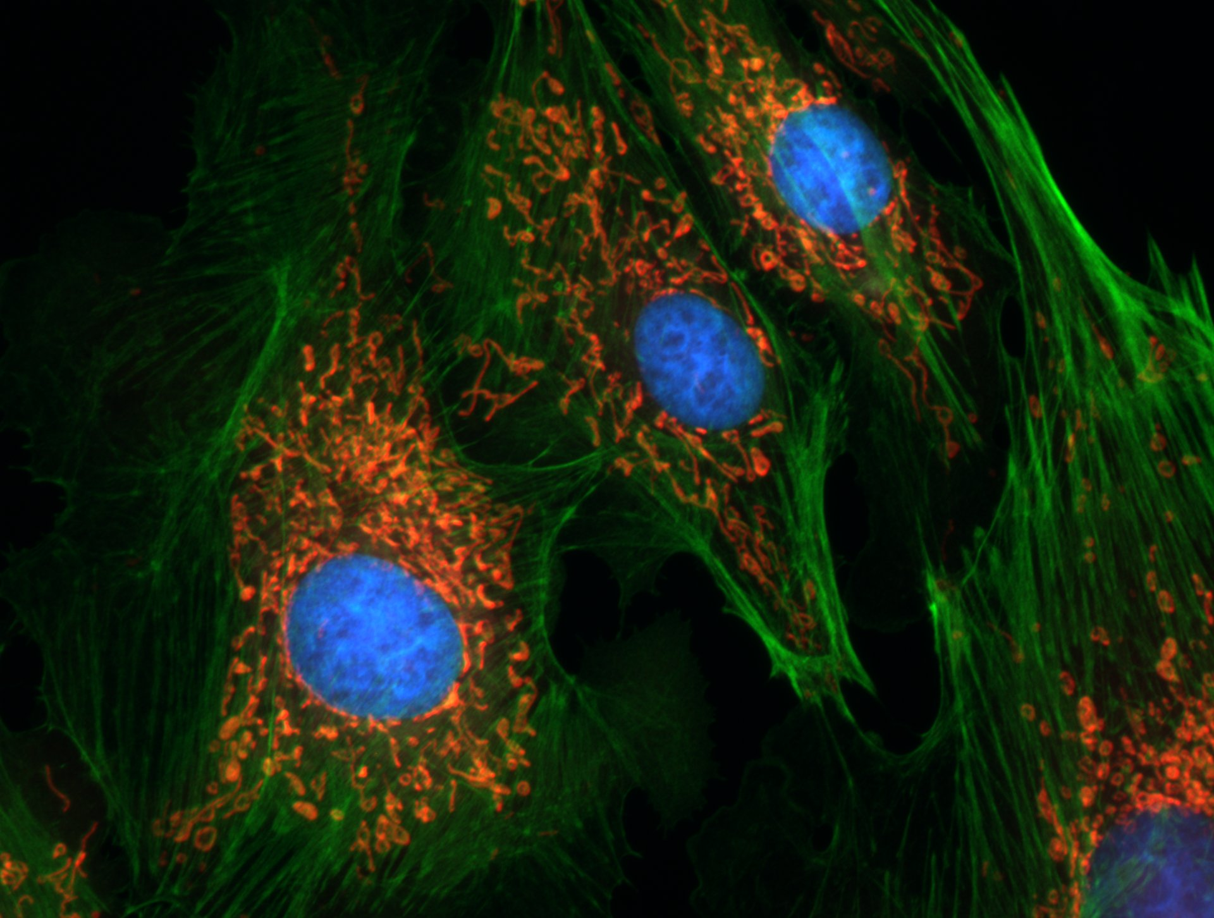
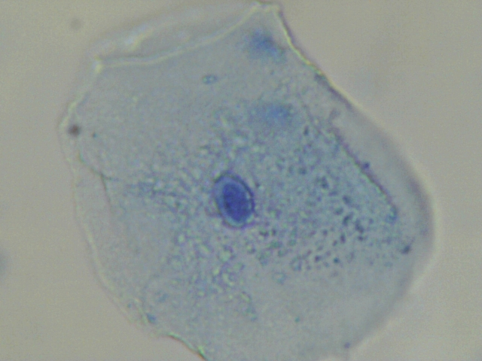
Can you identify the nucleus?
Erin Rod, CC BY 4.0, via Wikimedia Commons
Krishna satya 333, CC BY-SA 4.0, via Wikimedia Commons

Slide 10
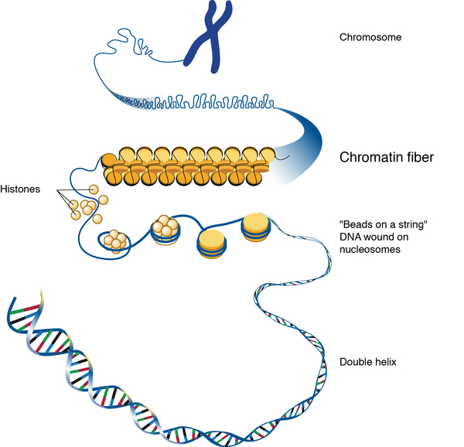
Deoxyribonucleic acid (DNA)
Almost all cells in your body have 46 molecules of DNA wound around histone proteins.
Chromatin
= DNA molecule + histones
When a cell reproduces, it winds the chromatin into tight fibres called chromosomes. This prevent tangling during replication.
Darryl Leja, NHGRI, Public domain, via Wikimedia Commons

Slide 11
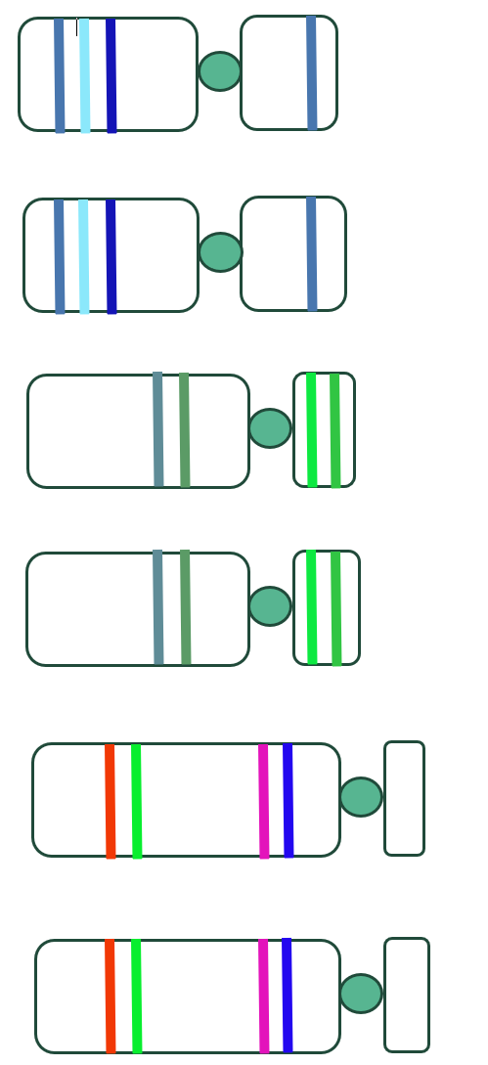
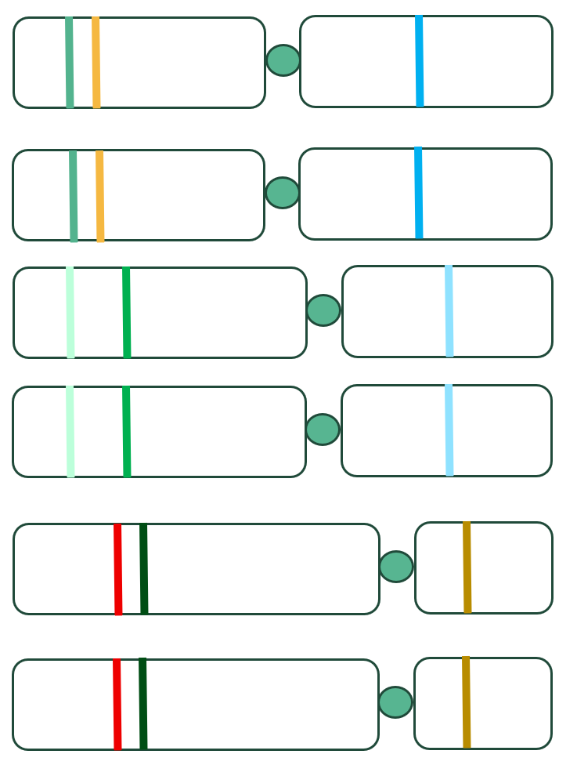
Find your homologous partner

Slide 12
Homologous chromosomes
A matching pair of chromosomes that are the same size and have the same genes.

Slide 13
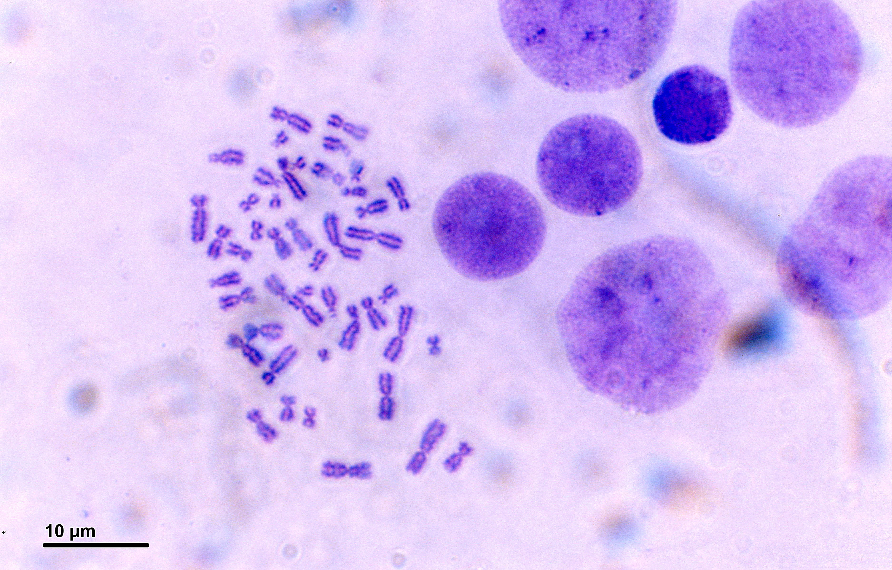
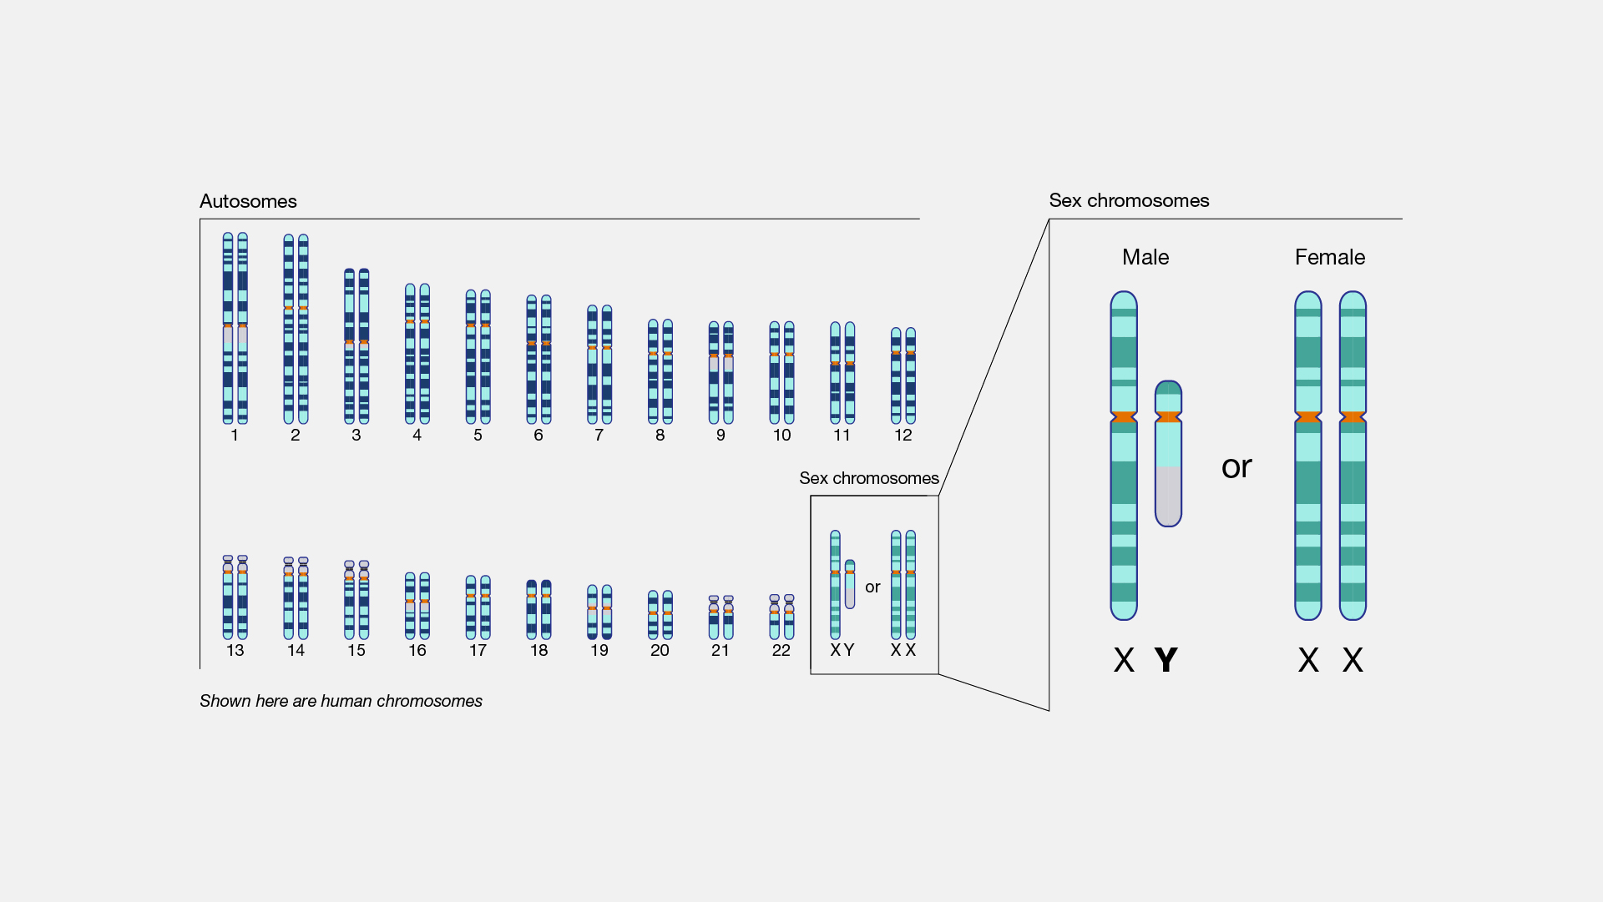
Human chromosomes
Doc. RNDr. Josef Reischig, CSc., CC BY-SA 3.0, via Wikimedia Commons
National Human Genome Research Institute (NHGRI), Public domain, via Wikimedia Commons

Slide 14
Karyotype
An individual’s complete set of chromosomes that may be arranged in numerical order.
Autosomes
Chromosomes that do not determine the sex of an individual.
Sex chromosomes
Chromosomes that determine the sex of an individual.
(Human females = XX, Human male = XY)

Slide 15
Gene
A section of DNA that has a function.
Gene
Darryl Leja, NHGRI, Public domain, via Wikimedia Commons

Slide 16
Compare genetic structures to analogy
Genetic structure | Wool analogy similarities | Wool analogy differences

Slide 17
Allele
Alternative types of the same gene at the same location on a homologous chromosome.

Slide 18
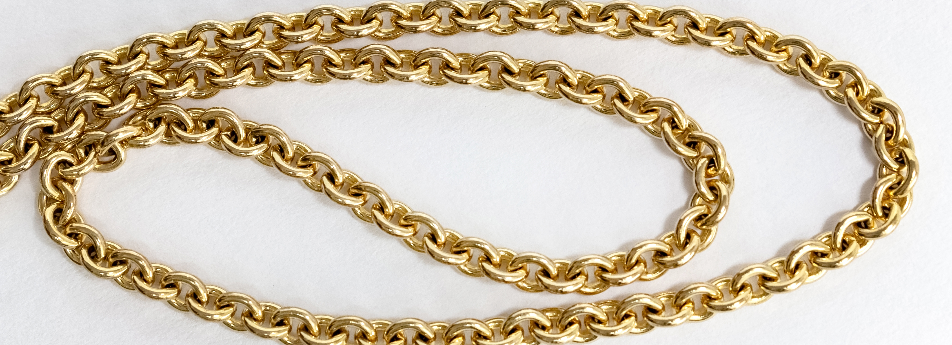
How is a gold chain like a chromosome?
W.carter, CC BY-SA 4.0, via Wikimedia Commons

Slide 19
L3 Inquire
Modelling DNA

Slide 20
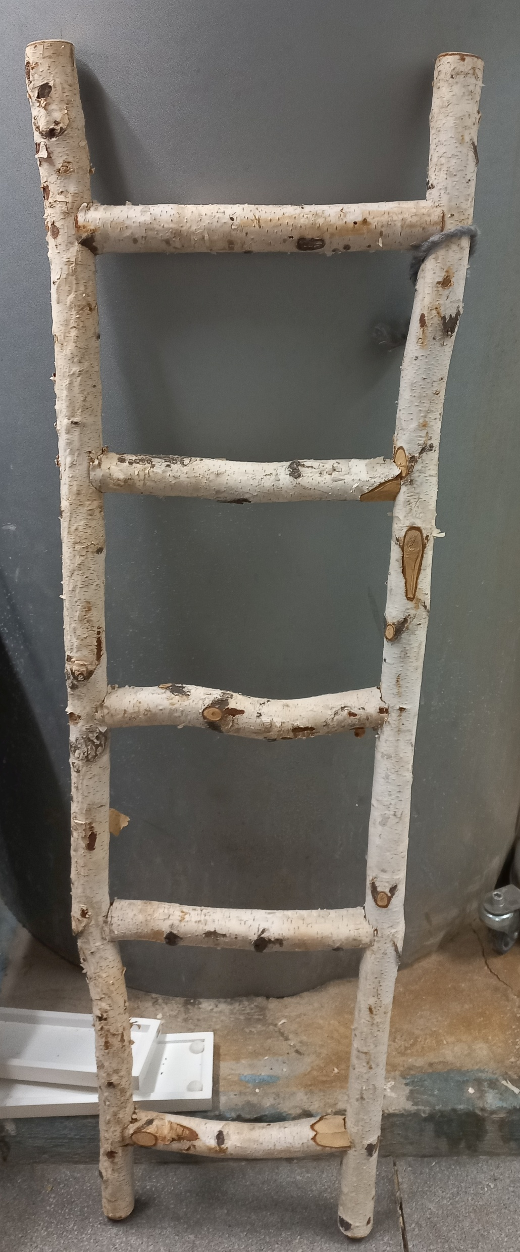
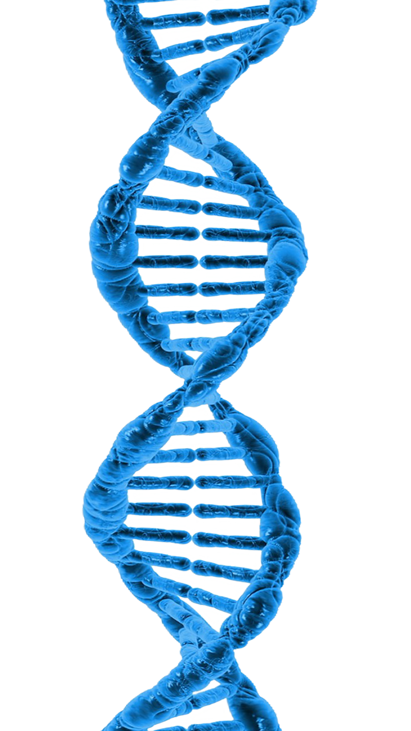
What are the strengths and limitations of this analogy?
Asurnipal, CC BY-SA 4.0, via Wikimedia Commons
Kadumago, CC BY 4.0, via Wikimedia Commons

Slide 21
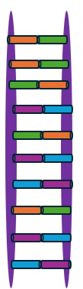
Build a DNA model
Cut the paper straws into 2 cm long sections. Each coloured straw section represents a particular DNA base. Record the colours you will use for each base in your model DNA.
Cut two of the pipe cleaners into 6 cm long segments. These will form the “rungs” on the DNA ladder.
Thread matching pairs of DNA bases (adenine paired with thymine, cytosine paired with guanine) onto each pipe cleaner segment.
Lay the remaining two pipe cleaners on the table in parallel, approximately 4 cm apart. This will form the sides of the DNA ladder (the sugar-phosphate backbone of the DNA).
Place the matched pairs of DNA bases across the sides of the ladder (sugar-phosphate backbone) so that they form the rungs of the ladder. Check that they are equal distances apart from each other.
Connect the pipe cleaner rungs (DNA bases) to the sides of the DNA ladder (sugar-phosphate backbone).
Gently twist the sides of the DNA ladder so that it forms a double helix.

Slide 22
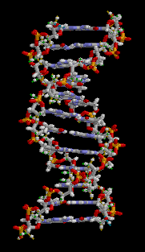
brian0918, Public domain, via Wikimedia Commons

Slide 23
DNA base sequence
Unaffected person ATCATCTTTGGTGTT
Person with cystic fibrosis ATCATTGGTGTT

Slide 24
L4 Inquire
Meiosis and fertilisation

Slide 25
Place in order of smallest to largest
Cell
Gene
Chromosome
Nucleus
DNA

Slide 26
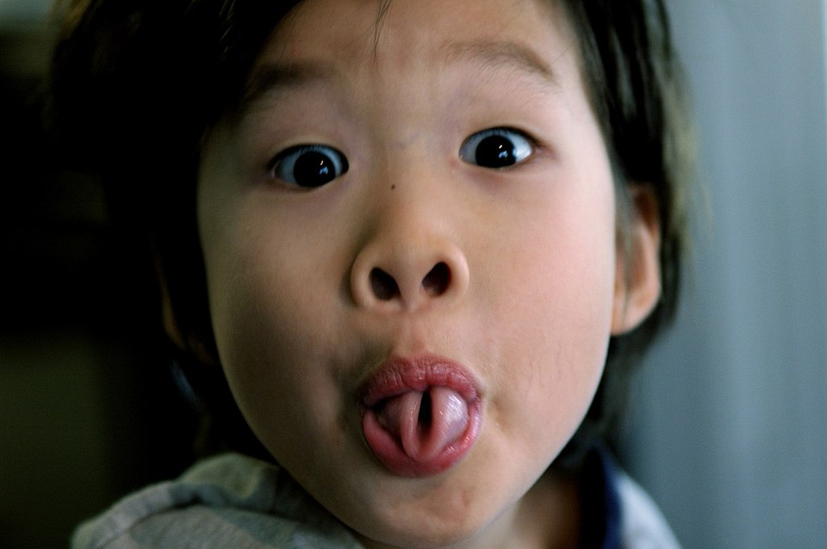
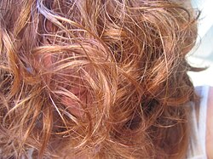
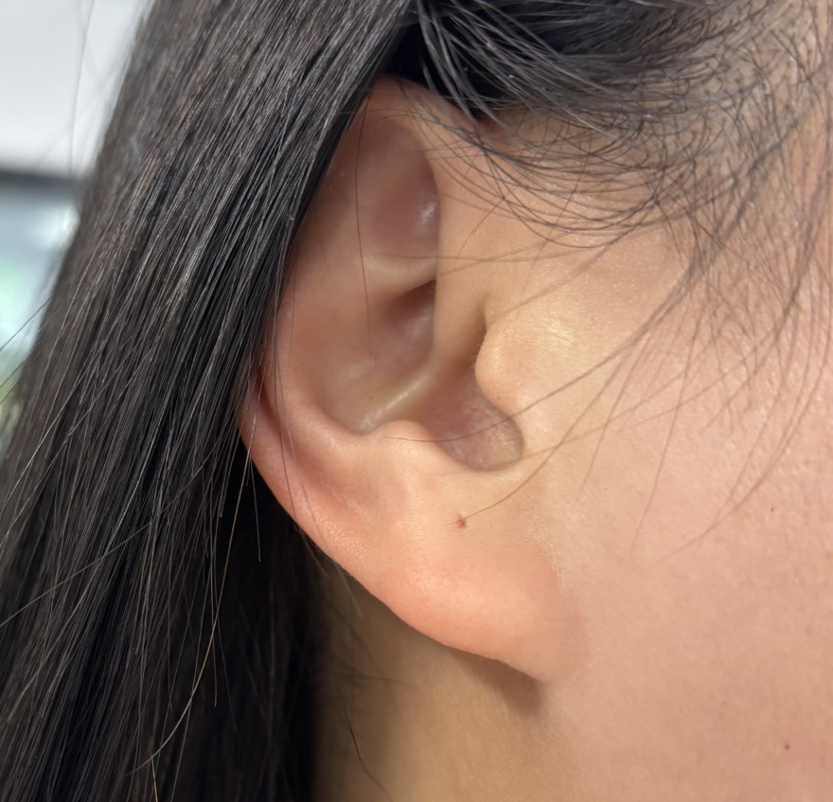
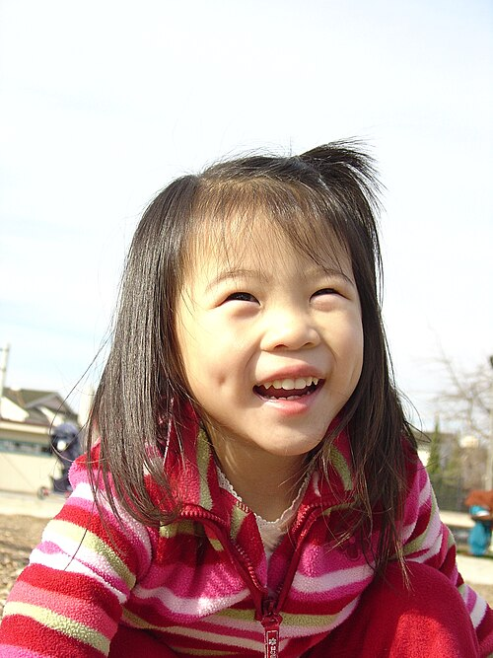
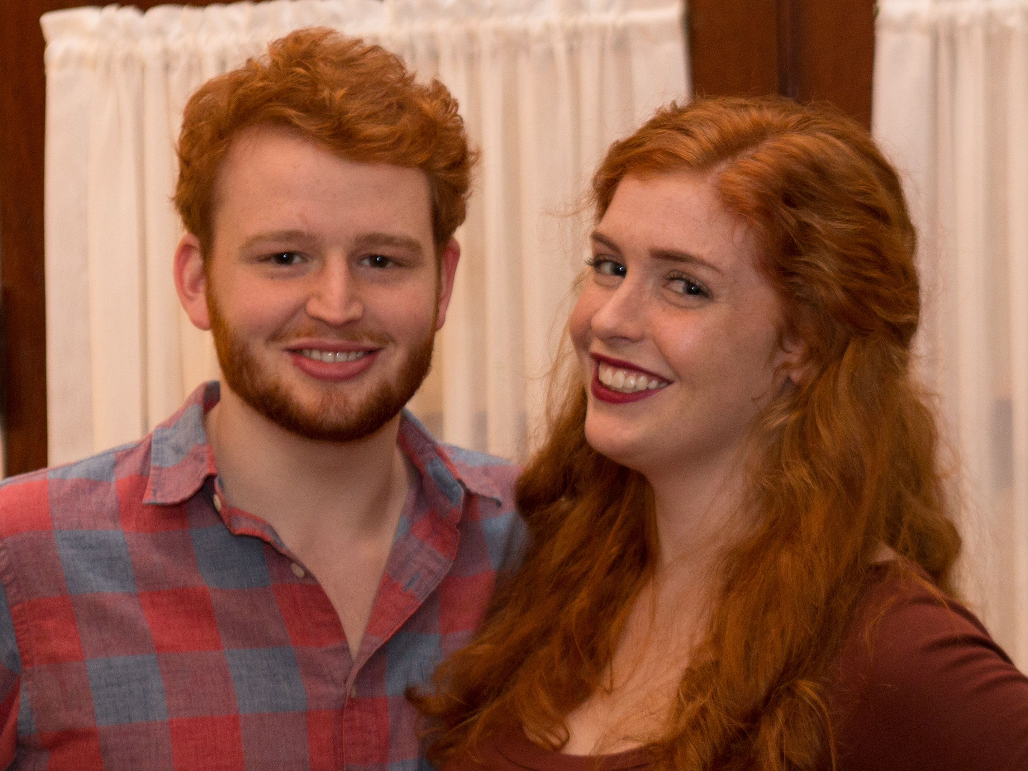
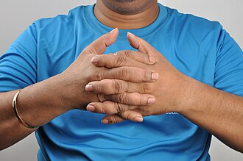
Inherited traits
Tongue rolling
Wavy hair
Attached earlobe
Gideon Tsang from Austin, USA, CC BY-SA 2.0, via Wikimedia Commons
shira gal, CC BY 2.0, via Wikimedia Commons
Hand clasping
Dimples
Red hair
C. Szeto from San Francisco, California, USA, CC BY 2.0, via Wikimedia Commons
Dpulitzer, CC BY-SA 4.0, via Wikimedia Commons
Biswarup Ganguly, CC BY 3.0, via Wikimedia Commons

Slide 27
Inherited trait | Your result | Class result (%)
Tongue rolling
Attached earlobes
Widow’s peak
Dimples
Cleft chin
Hitchhiker’s thumb
Hair on the middle finger
Freckles
Hand clasping (left on top)
Hair colour (dark hair)
Wavy/curly hair

Slide 28
Meiosis
A special type of cell division that halves the number of chromosomes in gametes (egg and sperm) cells.

Slide 29
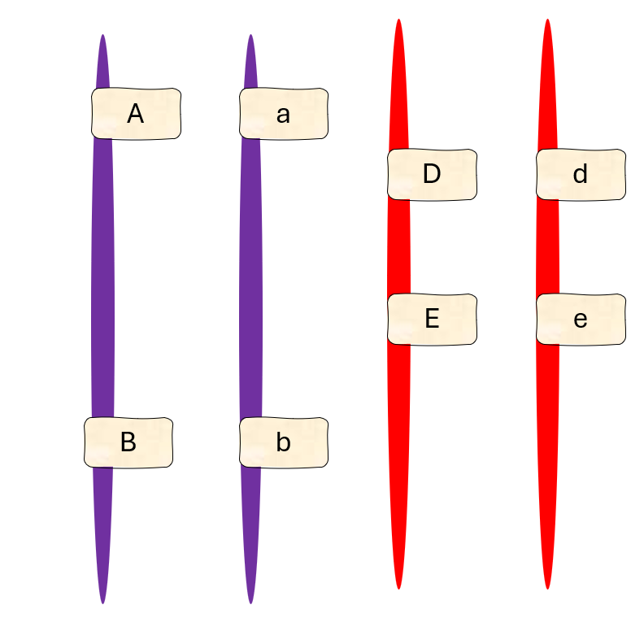
Meiosis mix-up

Slide 30

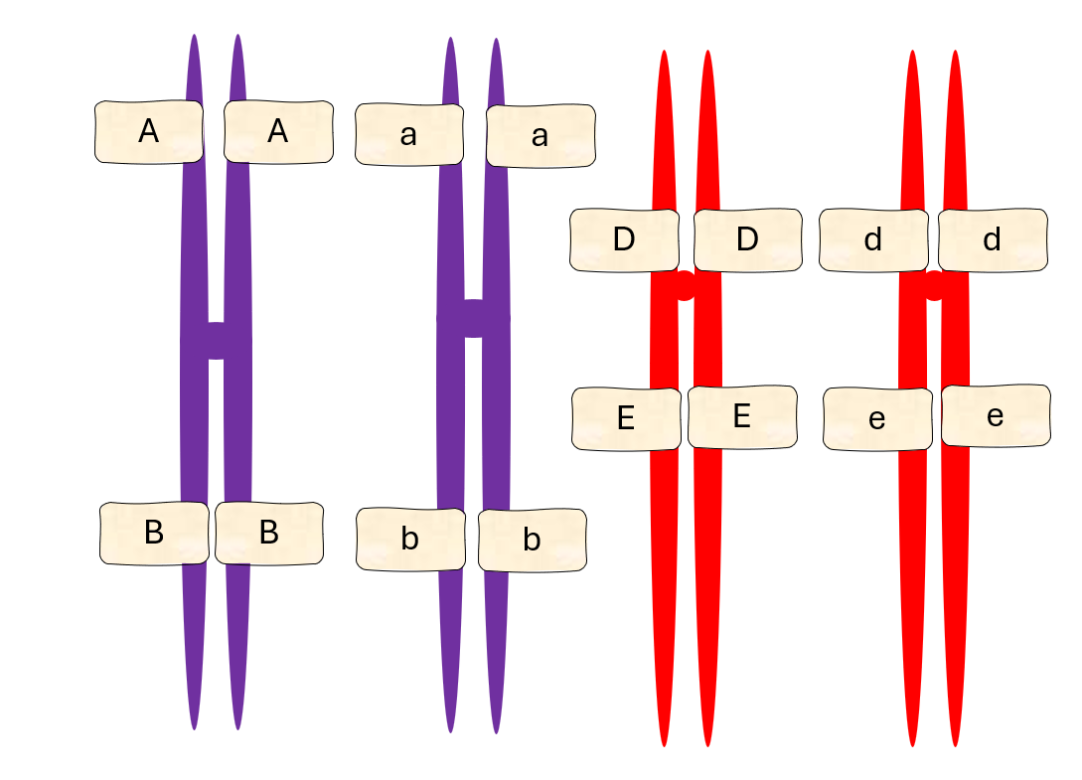
Meiosis I and cytokinesis
Prophase I
Metaphase I
A
A
a
a
B
B
b
b
d
d
D
D
e
e
E
E
Anaphase I
Cytokinesis I
Telophase I
A
A
a
a
A
A
a
a
B
B
b
b
A
A
a
a
D
D
b
b
D
D
d
d
D
D
B
B
d
d
E
E
d
d
e
e
E
E
e
e
B
B
e
e
E
E
b
b

Slide 31
Meiosis II and cytokinesis
Prophase II
Metaphase II
A
A
a
a
A
A
a
a
D
D
b
b
D
D
A
A
D
D
B
B
d
d
B
B
d
d
b
b
d
d
a
a
E
E
E
E
B
B
e
e
E
E
e
e
e
e
b
b
Cytokinesis II
Telophase II
Anaphase II
A
D
A
D
A
a
d
a
d
a
D
B
E
B
E
B
E
e
e
b
d
b
b
e
d
d
A
a
A
A
e
d
e
a
a
B
D
B
D
B
D
e
b
E
b
E
E
b

Slide 32
Random assortment
The random organisation of chromosomes in egg and sperm cells that increases genetic diversity during fertilisation.

Slide 33
Argumentation
Claim:
Each egg or sperm cell receives different combinations of traits.
Reasoning:
Evidence:

Slide 34
L5 Inquire
Mitosis, growth and repair

Slide 35
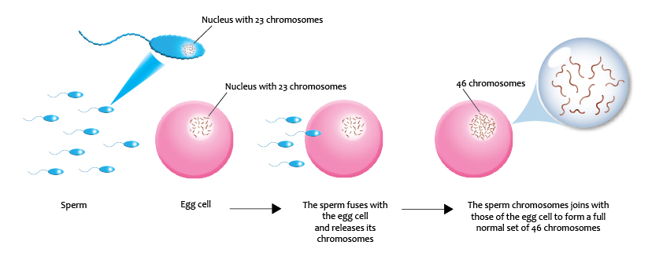
Fertilisation
Gametes
Genomics Education Programme, CC BY 2.0, via Wikimedia Commons

Slide 36
Cell division or multiplication
A
D
a
d
E
B
e
b
d
a
A
e
D
B
b
E

Slide 37
Mitosis
A process of cell division that produces two genetically identical nuclei.

Slide 38
Mitosis and cytokinesis
Prophase
Metaphase
Anaphase
A
A
a
A
A
A
A
a
a
a
a
a
D
D
B
B
B
B
b
b
b
b
b
d
d
b
B
B
d
E
E
e
d
d
d
e
e
e
D
D
D
e
e
D
E
E
E
E
Cytokinesis
Telophase
A
a
d
A
a
a
a
d
d
D
D
A
e
e
B
b
d
B
D
D
A
b
e
b
E
E
e
b
E
E
B
B

Slide 39
Mitosis vs meiosis
 | Mitosis | Meiosis
Models
Similarities
Differences

Slide 40
L6 Inquire
Visible traits

Slide 41
Which chromosome will you inherit?
National Human Genome Research Institute (NHGRI), Public domain, via Wikimedia Commons

Slide 42
Phenotype
The set of observable physical, biochemical and physiological traits of an organism. It is a combination of an individual’s genetic material and their environment.

Slide 43
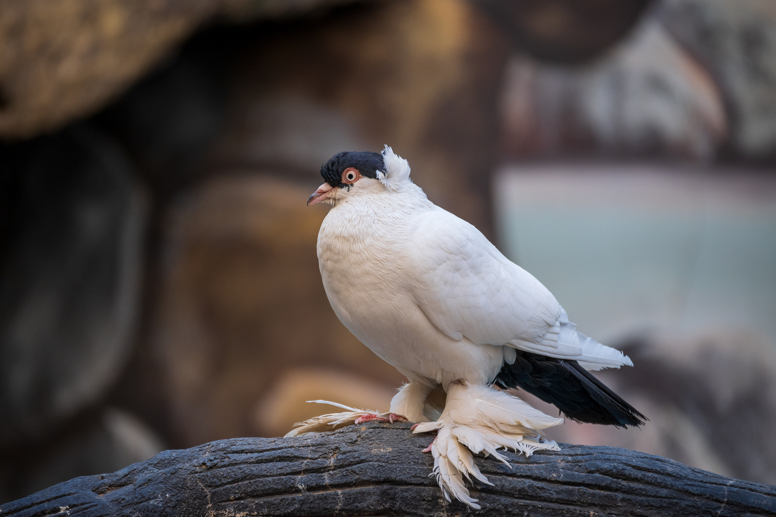
Pigeon phenotype
Head crest
Grouse
Foot slipper
Meshari Alawfi, CC BY 4.0, via Wikimedia Commons

Slide 44
Sex chromosomes
 | Male | Female
Humans | XY | XX
Pigeons | ZZ | ZW

Slide 45
Pigeon sex chromosomes
Parents Parent chromosomes | Father ZZ | Mother WZ
Parent gametes | Z Z | W Z

Slide 46
Genotype
The pairs of genetic alleles that are inherited from parents.
Or
The complete set of genetic material in an organisms.

Slide 47
Inheriting a crest
Allele from mother
Allele from father
F1 generation
+
+
+

Slide 48
Dominant trait
A trait that only needs a single copy of an allele to appear in the phenotype.
Recessive trait
A trait that needs two identical copies of the allele to appear in the phenotype.

Slide 49

Inheriting feathers on the leg (grouse)
Allele from mother
Allele from father
F1 generation
+
+
+

Slide 50
Pigeonetics
Trait | Description | Dominant | Recessive
Head crest | Feather that sticks up around the head | No crest | Crest
Foot feathers /slipper | Feathers on the foot instead of scales | Slipper = incomplete dominance | No slipper
Grouse | Feathers on the leg | No grouse | Grouse
Meshari Alawfi, CC BY 4.0, via Wikimedia Commons

Slide 51
Pigeonetics simulation
Your goal is to use the Pigeonetics simulation produced by the Stark Science Learning Centre at the University of Utah to breed a selected type of pigeon.
Gradually step through the introduction of breeding pigeons.
When ready to breed the pigeons, follow the steps below.
Use the arrow to select your pigeon parent (P generation). The genotype of the pigeon will appear below the image.
Use the arrow to select the allele that you want to appear in the next generation (F1 generation) of pigeons.
Repeat steps 1 and 2 for the second parent and alleles.
Select “Hatch” to determine your success.

Slide 52
Homozygous
Two identical copies of an allele.
Heterozygous
Two different copies of an allele.

Slide 53
L7 Inquire
Predicting inheritance

Slide 54
Inheriting a crest
Allele from mother
Allele from father
F1 generation
+
BB
B
B
+
Bb
B
b
+
bb
b
b

Slide 55
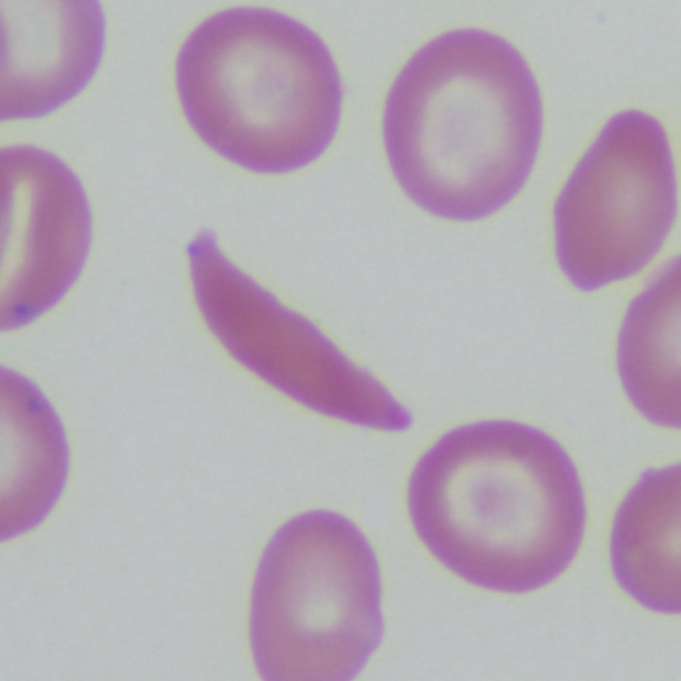
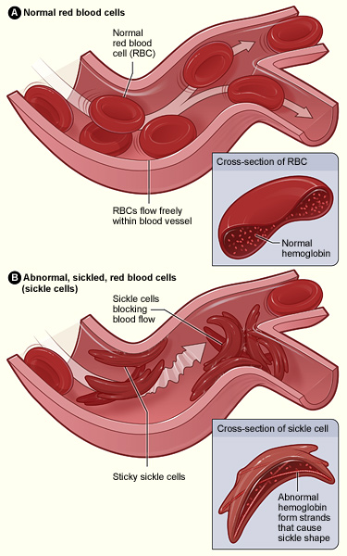
Sickle cell condition
Gregory Kato, CC BY-SA 4.0, via Wikimedia Commons
The National Heart, Lung, and Blood Institute (NHLBI), Public domain, via Wikimedia Commons

Slide 56
Inheriting genotype investigation
Write a capital “H” on one side of each counter and a lowercase “h” on the other side.
Each counter represents a sperm or ova/egg from the parent. Flip each counter and record the letters facing up in Table 1. This is the genotype of the first child.
Identify and record the phenotype of the child in Table 1.
Repeat steps 2 and 3 fifteen more times.
Calculate the percentage of offspring with each genotype and phenotype for your data and record in Table 2.

Slide 57
Class data
Genotype | Phenotype | Number of offspring | Percentage of offspring
HH
Hh
hh

Slide 58
Punnett squares
Parent genotype | Hh | Hh
Parent gametes | H h | H h
 | H | h
H
h
HH
Hh
Hh
hh

Slide 59
Punnett squares
 | H | h
H
h
HH
Hh
Hh
hh
Offspring genotype
Offspring phenotype
HH
Hh
Hh
hh
No sickle cell condition
No sickle cell condition
(carrier)
No sickle cell condition
(carrier)
Sickle cell condition

Slide 60
Carrier
A person that can pass on the allele for a particular recessive trait, and who does not show the trait in their phenotype.

Slide 61
Genetic probability
The expected outcome of inheriting a trait across many offspring. Each fertilisation is independent.

Slide 62
L7A Inquire
How much does screening cost?

Slide 63
DNA
Gene
Darryl Leja, NHGRI, Public domain, via Wikimedia Commons

Slide 64
DNA base sequence
Unaffected person ATCATCTTTGGTGTT
Person with cystic fibrosis ATCATTGGTGTT

Slide 65
Mutation
A change in the sequence of DNA bases caused by errors when the DNA is copied, or exposure to mutagenic chemicals or radiation.

Slide 66
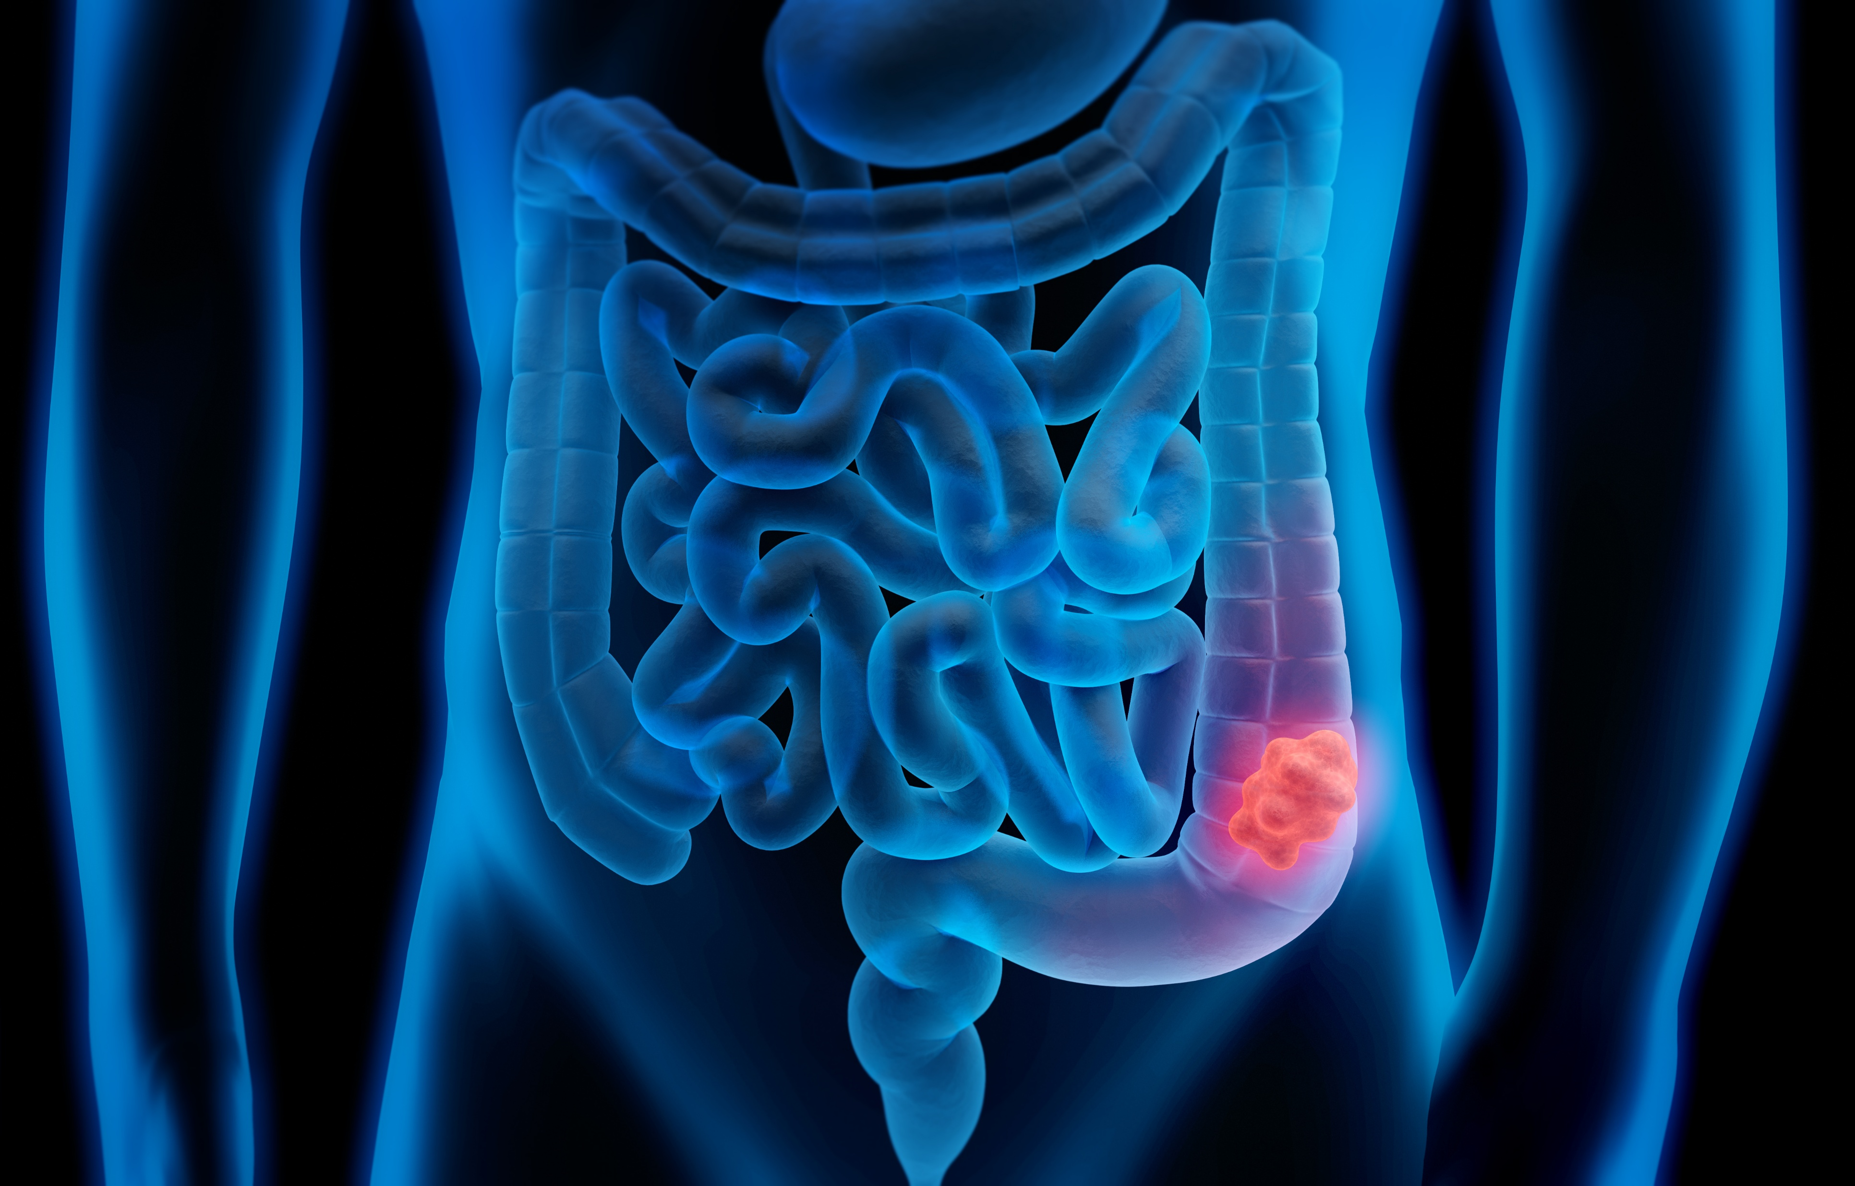
Bowel cancer
Bowel cancer occurs in the intestines and is caused by a combination of genetics and environment.
Some people are more likely to have mutations in the cells lining their bowel or large intestine.
If one cell accumulates many mutations, it can start growing and reproducing through uncontrolled mitosis.
peterschreiber.media via iStock

Slide 67
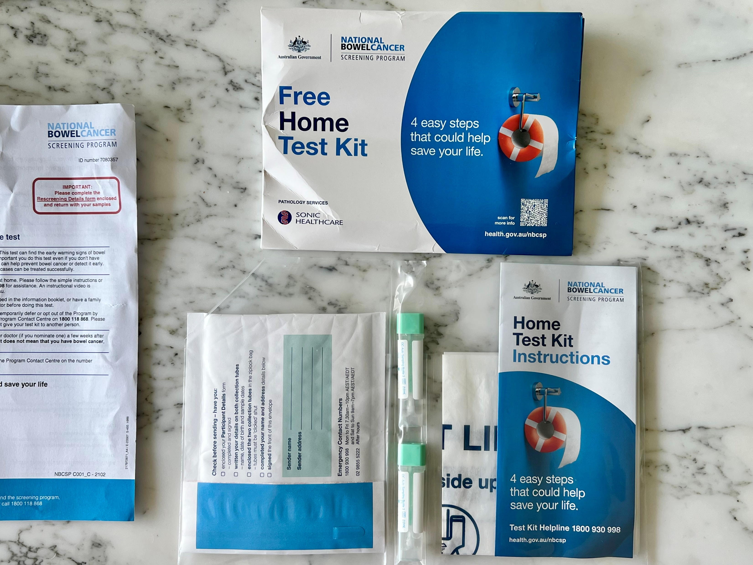
Testing for bowel cancer
Kgbo, CC BY-SA 4.0, via Wikimedia Commons

Slide 68
Bowel cancer screening
Cost of each test | $
Number of people over 50
Cost of testing each person every year | $
Number of people who are diagnosed with bowel cancer each year
 | Cost per person | Cost for every person diagnosed
Cost of early stage treatment (first year) | $ | $
Cost of late stage treatment (first year) | $ | $
Cost of test + early treatment |  | $

Slide 69
Bowel cancer screening
Cost of each test | $45
Number of people over 50 | 9,808,003
Cost of testing each person every year | $441,360,135
Number of people who are diagnosed with bowel cancer each year | 14,784
 | Cost per person | Cost for every person diagnosed
Cost of early stage treatment (first year) | $50,434 | $745,616,256
Cost of late stage treatment (first year) | $100,000 | $1,478,400,000
Cost of test + early treatment |  | $1,186,976,391

Slide 70
Argumentation
Claim:
Screening for bowel cancer saves the Australian Government money.
Reasoning:
Evidence:

Slide 71
L7 Act
Genetic counselling

Slide 72
DNA
Gene
Darryl Leja, NHGRI, Public domain, via Wikimedia Commons

Slide 73
Mind map of genetic inheritance

Slide 74
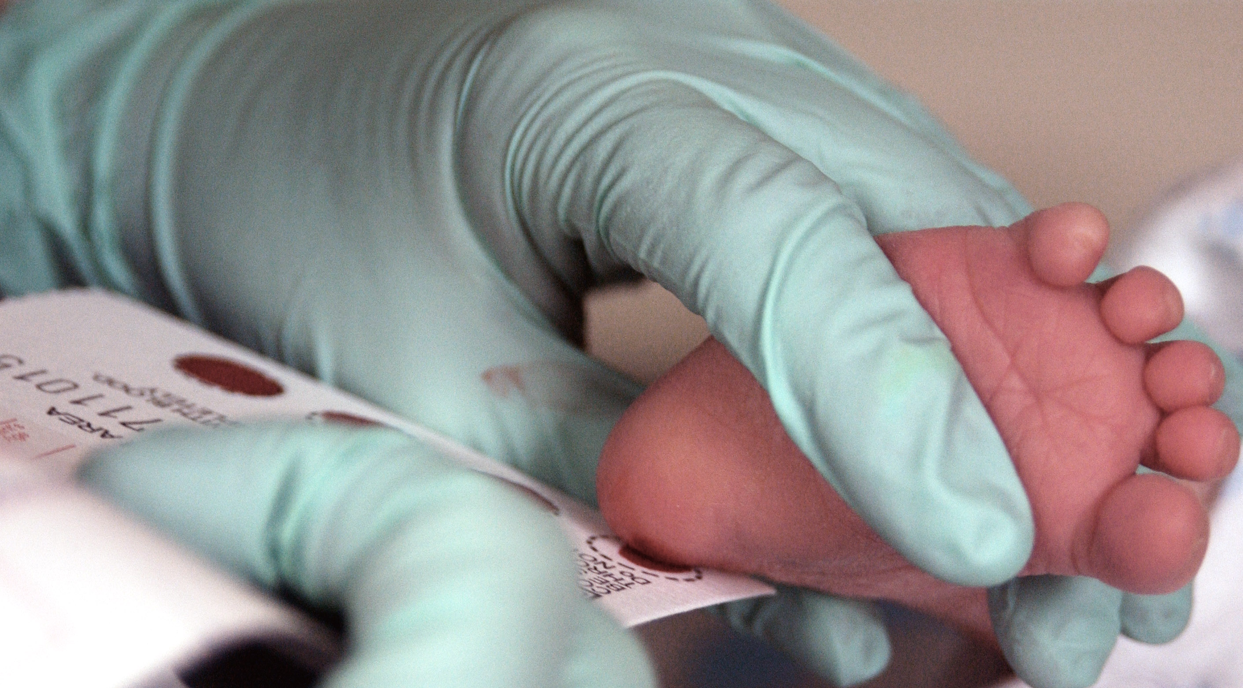
Genetic screening
U.S. Air Force photo/Staff Sgt Eric T. Sheler, Public domain, via Wikimedia Commons

Slide 75
What information should a genetics counsellor provide?
Brainstorm:

Slide 76

Decision making—what is it?
Decision-making is a process of:
weighing up risks and benefits.
identifying the consequences (long and short term).
identifying and considering the perspectives of everyone involved.
iStock/Iurii Garmash

Slide 77
Bioethical principles
Autonomy
Respecting a person’s right to make their own decisions about their body and treatment.
Beneficence
Acting in the patient’s best interests (doing good).
Non-maleficence
“Do no harm” — avoiding treatments that may cause unnecessary harm.
Justice
Treating people fairly and ensuring equal access to care and resources.

Slide 78
Role play
Role 1: Genetics counsellor
A couple expecting their first child has been offered genetic testing because there is a history of a cystic fibrosis condition in one side of the family. They are unsure whether to proceed with testing and have booked an appointment with a genetic counsellor.
The genetic counsellor’s role is to provide information and support decision-making, not to tell the parents what they should do.
Role 2: Parent-to-be
You are expecting a child and have been offered genetic testing. You must decide whether or not to proceed and have the genetic test prior to the birth of your child.

Slide 79
Role play discussion rules
Stay in character throughout the role-play.
Be respectful of different opinions and values.
Use evidence and information to support your statements.
Remember that there may not be one “correct” decision.
Focus on understanding the issue from another person's perspective.

Slide 80
Argumentation
Claim:
Genetic testing during pregnancy is ...
Reasoning:
Evidence:

Slide 81
Optional: Cystic fibrosis ethical dilemma
Mr. and Mrs. C come to a genetics clinic for prenatal diagnosis. They have each been tested to determine whether they carry the gene for cystic fibrosis, a hereditary lung disease that carries severe breathing problems. The cystic fibrosis gene is recessive, so a child must inherit a copy from each parent to get the disease. In this case both Mr. and Mrs. C are carriers for the cystic fibrosis gene. The specific mutations for each parent were identified in earlier tests.
Mrs. C who is pregnant, undergoes prenatal diagnosis to determine if the foetus is affected. DNA analysis indicates that the foetus does have two copies of the cystic fibrosis gene, but one of the mutations it carries is different from that of either Mr. or Mrs. C. That makes it virtually certain that Mr. C is not the baby’s father.

Slide 82
Good science communication
Accuracy – Information is scientifically correct, up-to-date, and based on reliable evidence.
Clear language – Complex scientific ideas are explained in language appropriate for the intended audience without unnecessary jargon.
Audience awareness – Communicates information in a way that is accessible and relevant to the intended audience while maintaining scientific integrity and using inclusive language.
Balanced presentation – Benefits, risks, limitations, and uncertainties are discussed rather than presenting only one side of an issue.
Transparency – Sources of information and areas of uncertainty are clearly acknowledged.
Appropriate use of statistics and data – Numbers are presented accurately and in context without exaggeration or manipulation.
Distinguishes facts from opinions – Scientific findings are clearly separated from personal views, ethical arguments, or policy recommendations.

