Slide 1
Science Connections
Yr 7 Water mixture rescue

Slide 2
L1 Launch
The importance of water

Slide 3
What if…we had no water?
Brainstorm…

Slide 4
The effect of no clean water
Inconvenient | Life-threatening

Slide 5
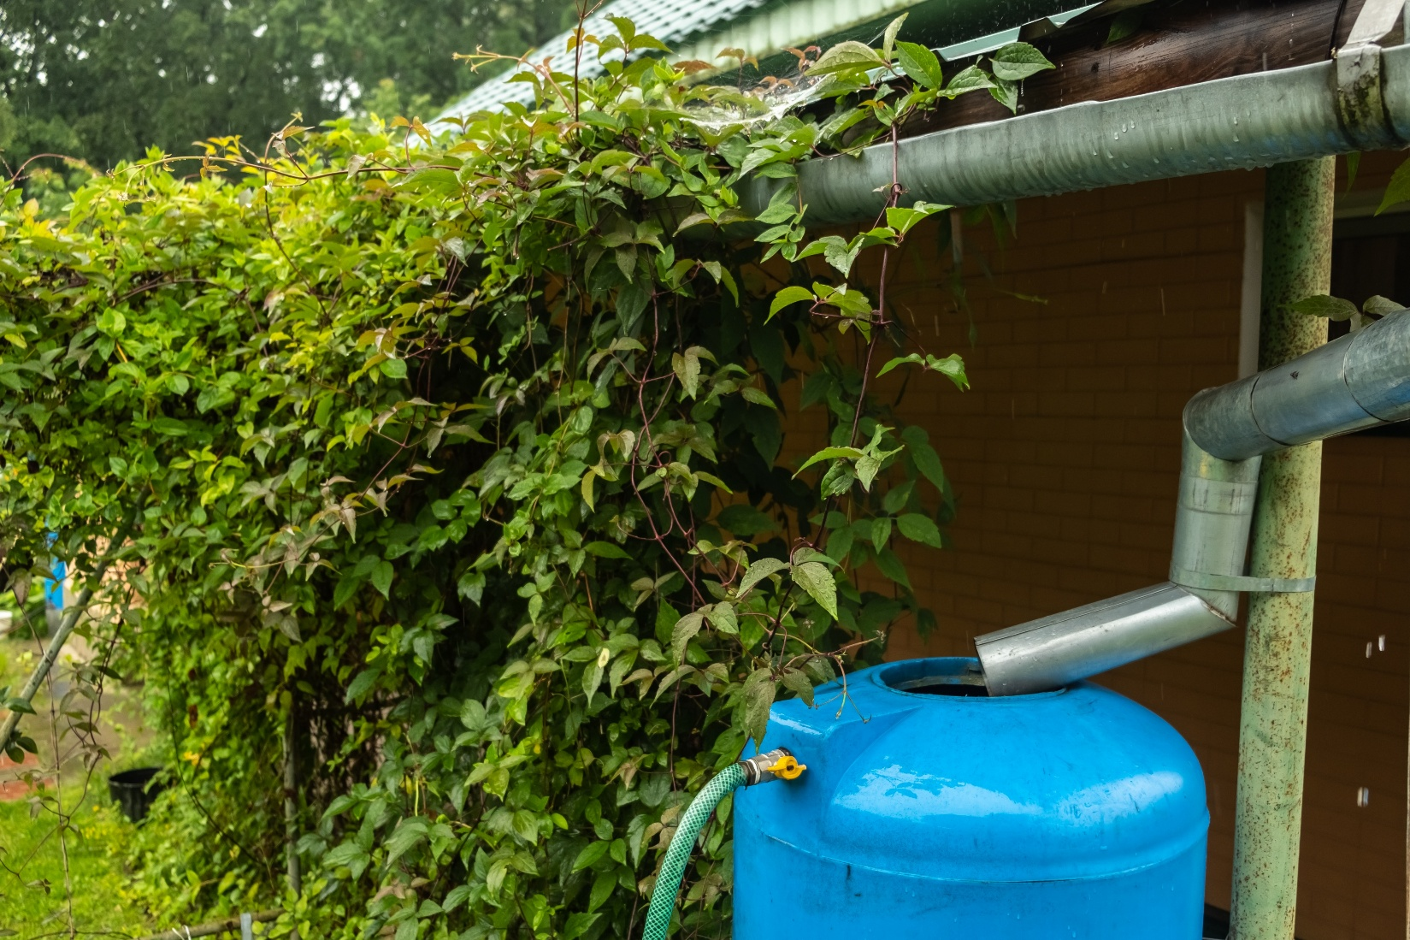
How rainwater is collected
Yevhenii Khil via iStock

Slide 6
Definitions
Pure
A substance that only has one type of particle.
Mixture
A substance that has more than one type of particle.

Slide 7
Australian Government rainwater quality requirements
End use | Does the water need to be clear? | Does the water need to be odourless? | Should the water be low in dissolved solids? | Is there no human pathogens, toxins or heavy metals?
Garden/lawn irrigation | Not required | Not required | Not required | Not required
Toilet flushing | Yes | Yes | Not required | Not required
Clothes washing | Yes | Yes | Not required | Not required
Showering/bathing | Yes | Yes | Yes | Not required
Drinking | Yes | Yes | Yes | Yes
https://www.yourhome.gov.au/water/rainwater

Slide 8
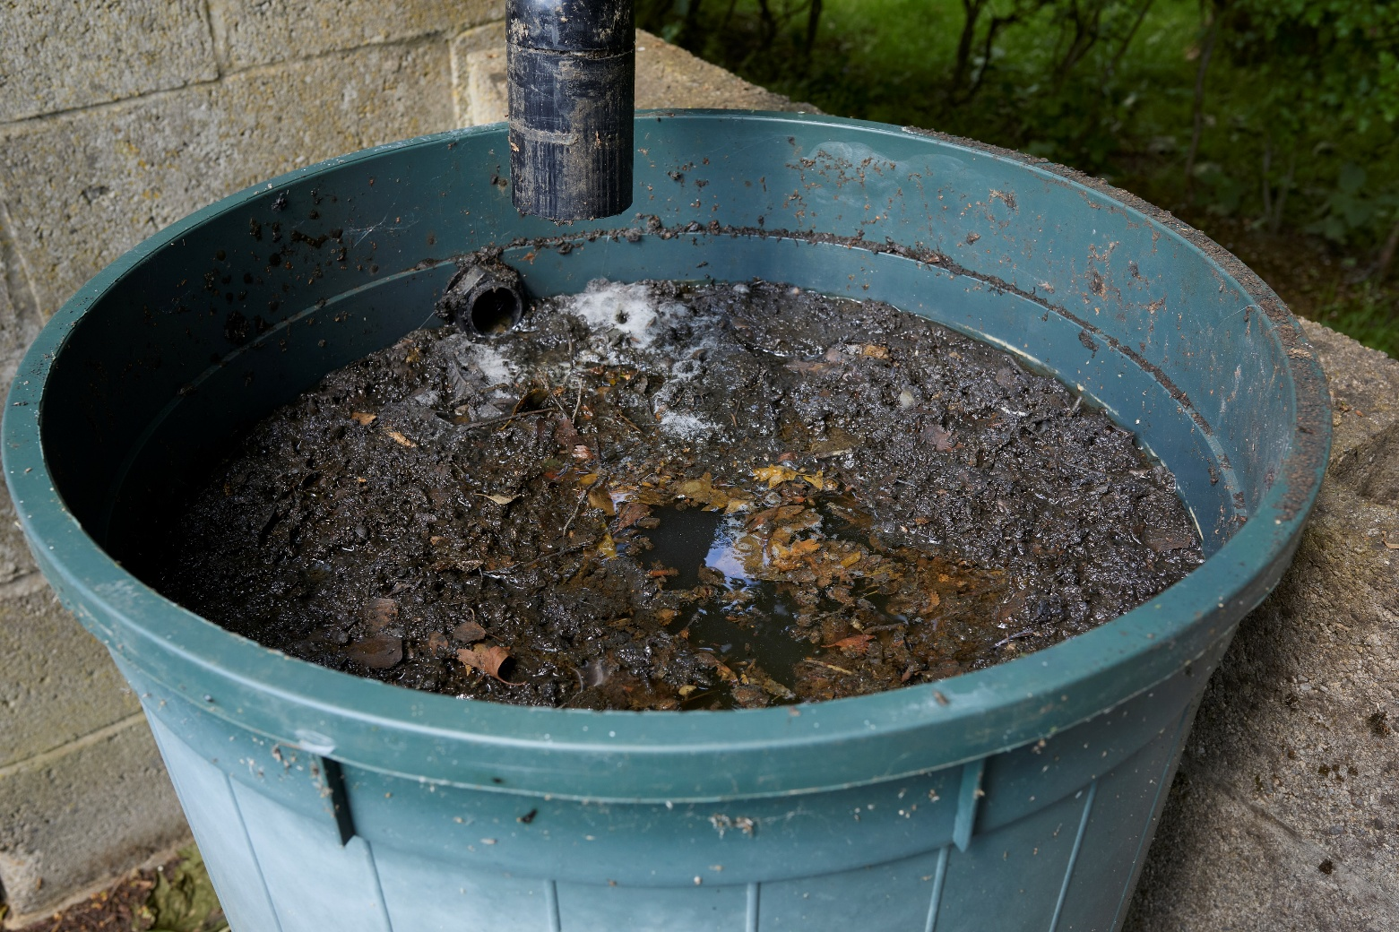
Design a rainwater system
Michael Campbell Cole via iStock

Slide 9
L2 Inquire
Rainwater mixtures

Slide 10
What is in the rainwater? How can it be used?
Michael Campbell Cole via iStock

Slide 11
Definition
Physical properties
How a substance looks and behaves.

Slide 12
How can we use the physical properties of particles to separate a mixture?

Slide 13
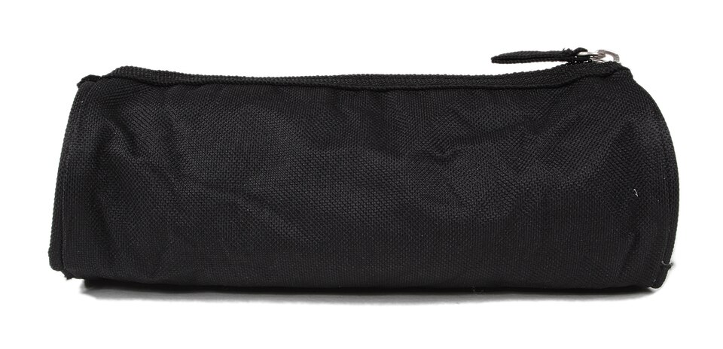
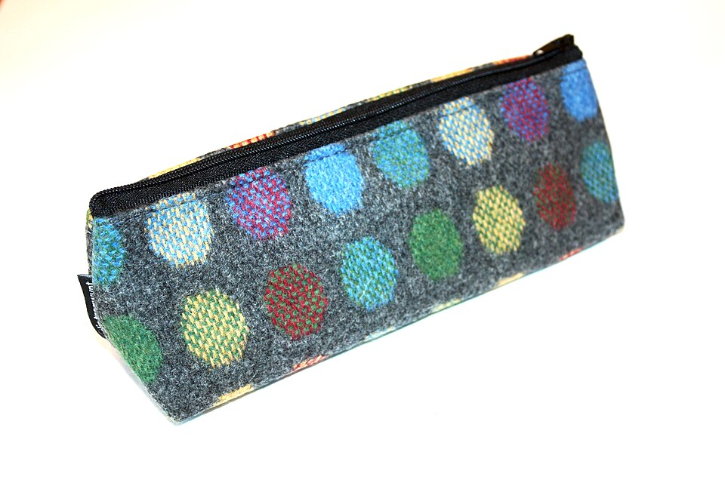
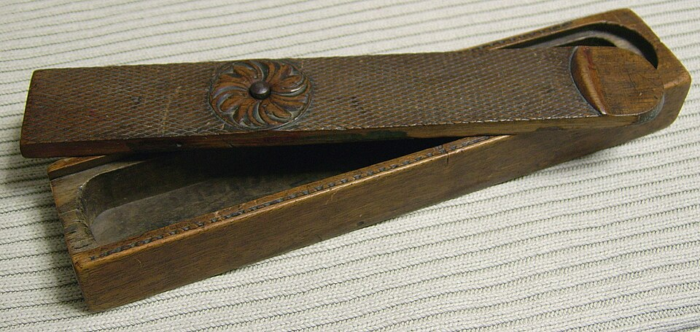
Properties of pencil cases
Lionel Allorge, CC BY-SA 3.0, via Wikimedia Commons
https://commons.wikimedia.org/wiki/File:Trousse_-_1.jpg
National Assembly for Wales from Wales, CC BY 2.0, via Wikimedia Commons
Sebastian Hartlaub, CC BY-SA 3.0, via Wikimedia Commons
https://commons.wikimedia.org/wiki/File:Pencil_case_(9416141198).jpg

Slide 14
Rainwater mixture
Rainwater components | Properties
Dust/dirt/sand
Bark and leaves
Iron fragments
Oily pollution
Water

Slide 15
Removing iron filings—hypothesis
If….
then….
because….

Slide 16
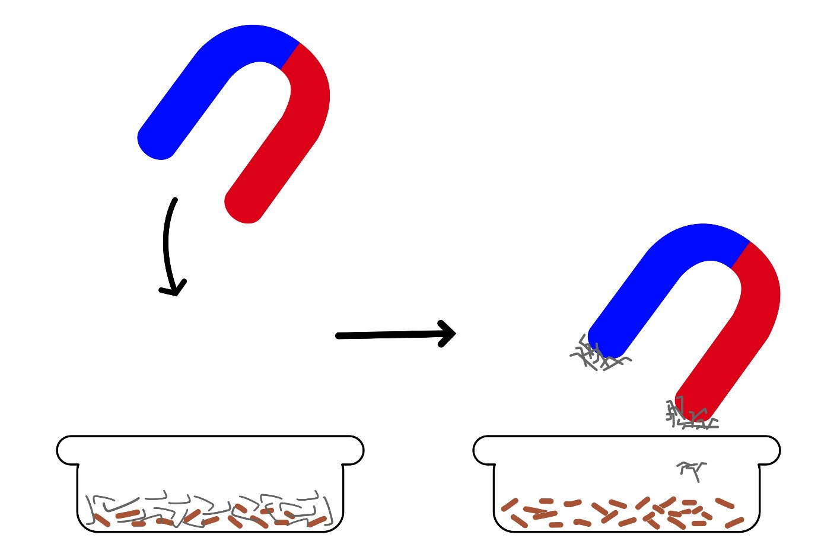
Removing iron from rainwater
Magnet in a plastic bag
Sulari Thimchukun via iStock

Slide 17
Discussion
What do you notice about the iron filings in the water?
Does the water affect whether the filings are magnetic?
Why are iron filings magnetic but other substances in the water are not?
If the rainwater also contains sand or dirt, how do they behave with a magnet?
Why is magnetism a useful property for separating iron filings from water?
Would this method work for other metals, like aluminium or tin? Why or why not?
Could magnetism be used to clean real-world polluted water? How?

Slide 18
L3 Inquire
Size matters

Slide 19

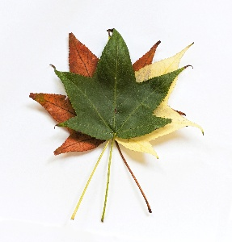
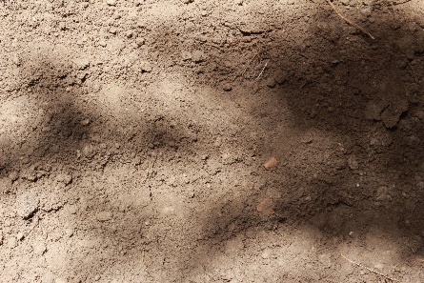
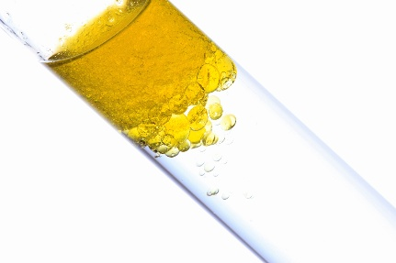
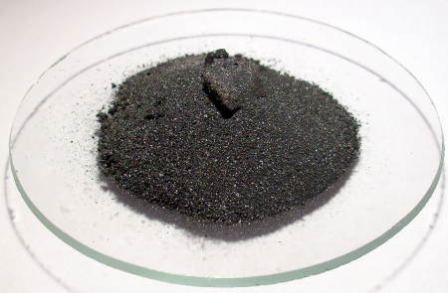
What are the properties of each part of the mixture?
Michael Campbell Cole via iStock
Leaves and bark
Dirt and sand
Oil pollution
Iron fragments
Carlos Valenzuela, CC BY-SA 4.0, via Wikimedia Commons
0x0077BE, CC0, via Wikimedia Commons
gyro via iStock
Ondřej Mangl, Public domain, via Wikimedia Commons

Slide 20
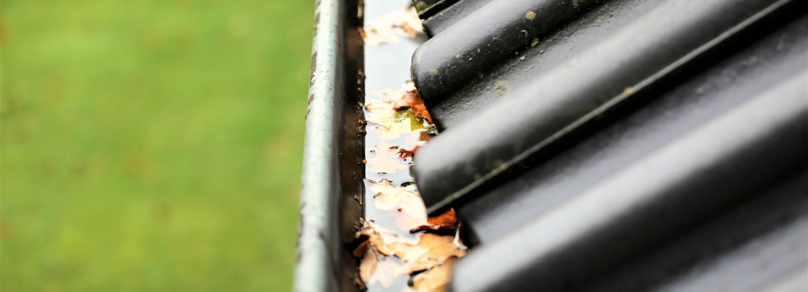
How can we remove the leaves and bark?
Ulf Wittrock via iStock

Slide 21
Filtering
A method to separate large-sized particles from liquids or gases using a barrier.

Slide 22
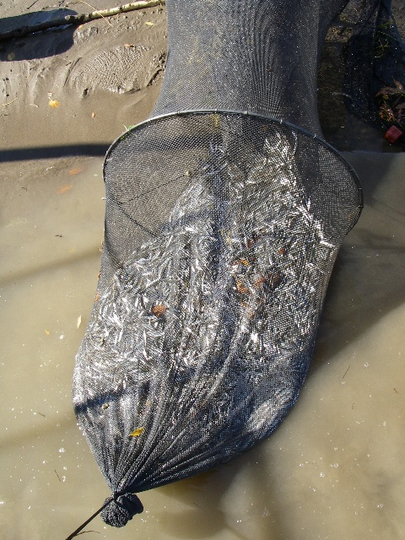
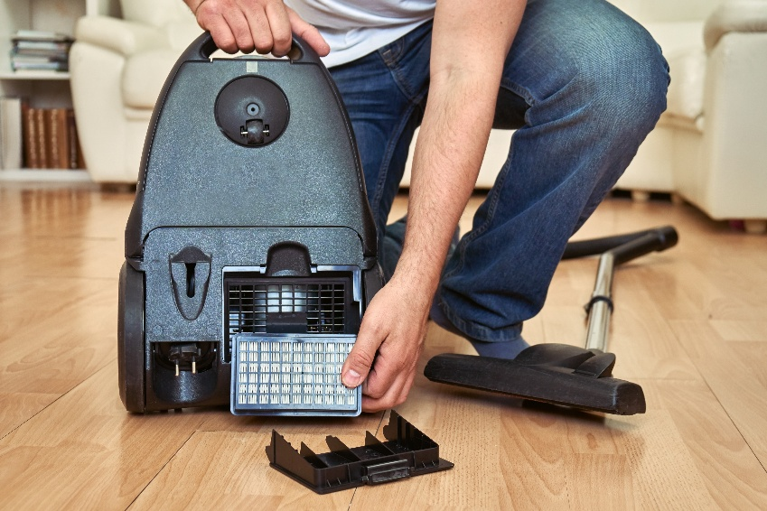
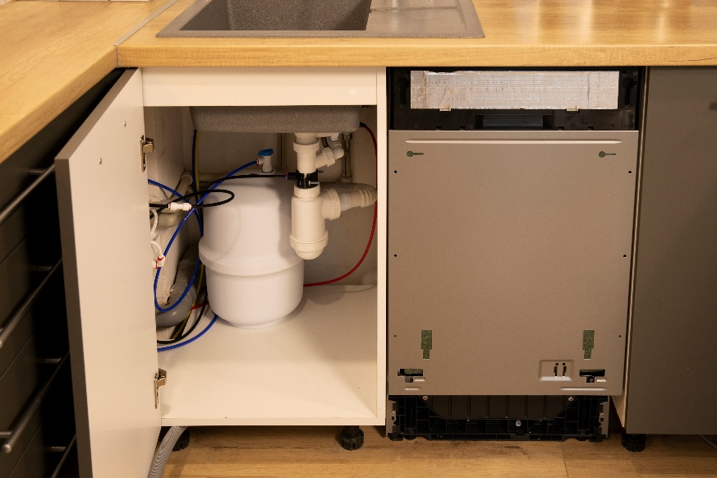
Types of filters
Dzurag via iStock
USFWS Mountain Prairie, Public domain, via Wikimedia Commons
Ivanna Bond via iStock
Vacuum
Fishing net
Water filter

Slide 23
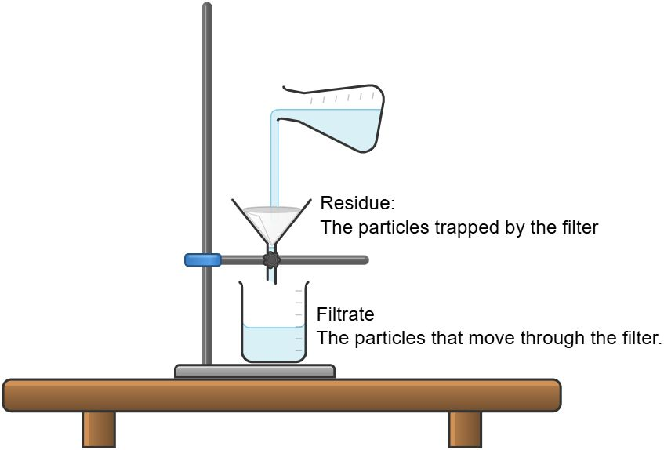
Filtering in a science lab
Created with Chemix (https://chemix.org)

Slide 24
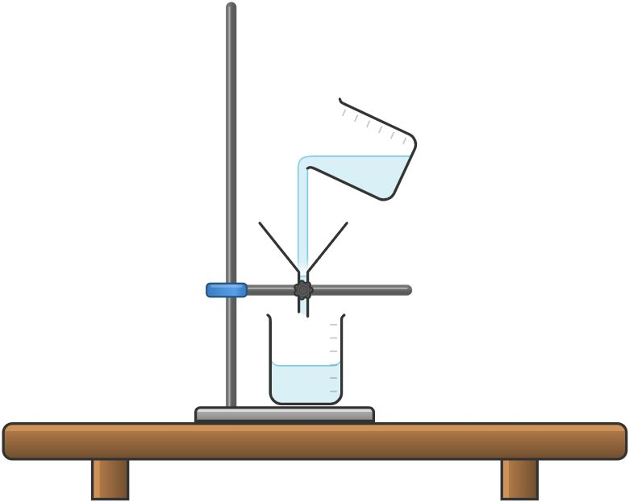
If…then…because…
How can we control the variables?
What risks do we need to consider?
Created with Chemix (https://chemix.org)

Slide 25
Size matters investigation
Observe the mixture
Observe the rainwater mixture and record what you see (leaves, dirt, colour).
Set up filtration 1 (wire mesh)
Place the wire mesh over a funnel.
Place the thin end of the funnel in a conical flask or beaker.
Slowly pour the amount of rainwater through the material and into the funnel. Be careful not to overflow the water.
Collect the rainwater filtrate and residue. Record your observations.
Set up filtration 2 (cloth)
Place cloth inside a funnel
Place the thin end of the funnel in a conical flask or beaker.
Slowly pour the amount of rainwater through the material and into the funnel. Be careful not to overflow the water.
Collect the rainwater filtrate and residue. Record your observations.
Clean equipment and wash hands.

Slide 26
Results
Type of filter used | What was removed? | What remained in the water? | Has the water quality been improved?
Wire mesh
Cloth

Slide 27
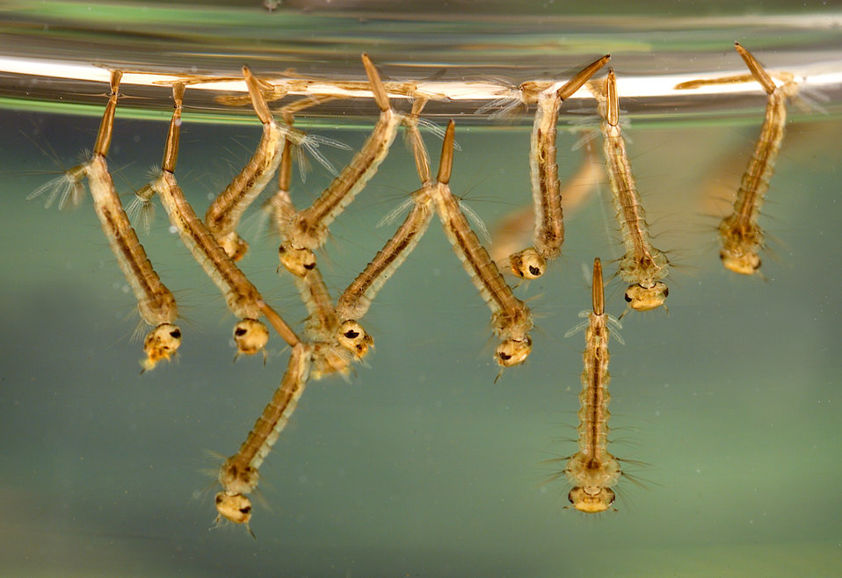
Mosquito larvae: Which filter should you use?
CDC / James Gathany, Public domain, via Wikimedia Commons

Slide 28
Argumentation
Claim:
_________ filter could be used to prevent mosquitos breeding in a rainwater tank.
Reasoning:
(Links the claim to the evidence.)
Evidence:
(Evidence from your experiment.)

Slide 29
L4 Inquire
Density, dirt and sludge

Slide 30
What will go through the pores?
Filter
Filter

Slide 31
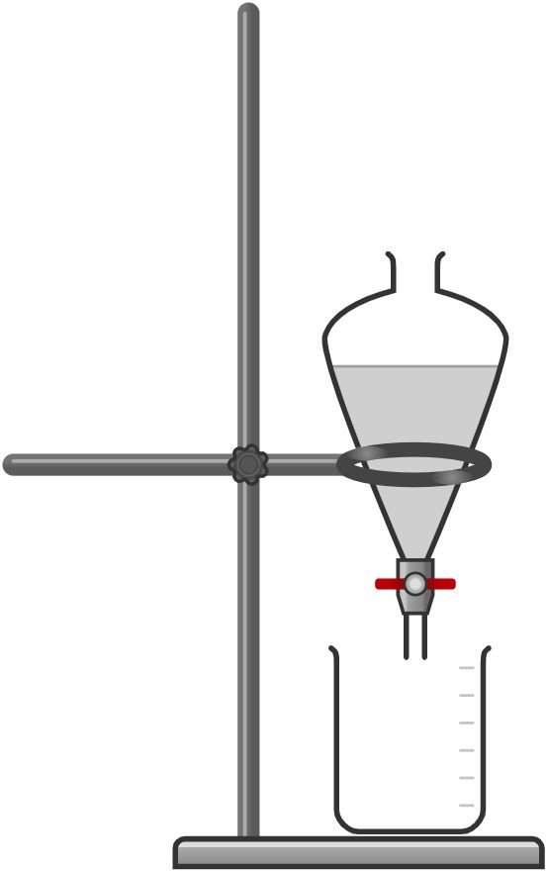
Separating funnel
Turn the stopcock horizontal to prevent the mixture from moving into the beaker.
Created with Chemix (https://chemix.org)

Slide 32
Suspension
A mixture in which solid particles are evenly spread throughout a liquid or gas but are large enough to eventually settle out over time.

Slide 33
Separating funnel after 30 minutes - hypothesis
If….
then….
because….

Slide 34
What makes some particles sink and others float?

Slide 35
Define volume.

Slide 36
Can two particles have the same volume and different mass?
Define mass.

Slide 37
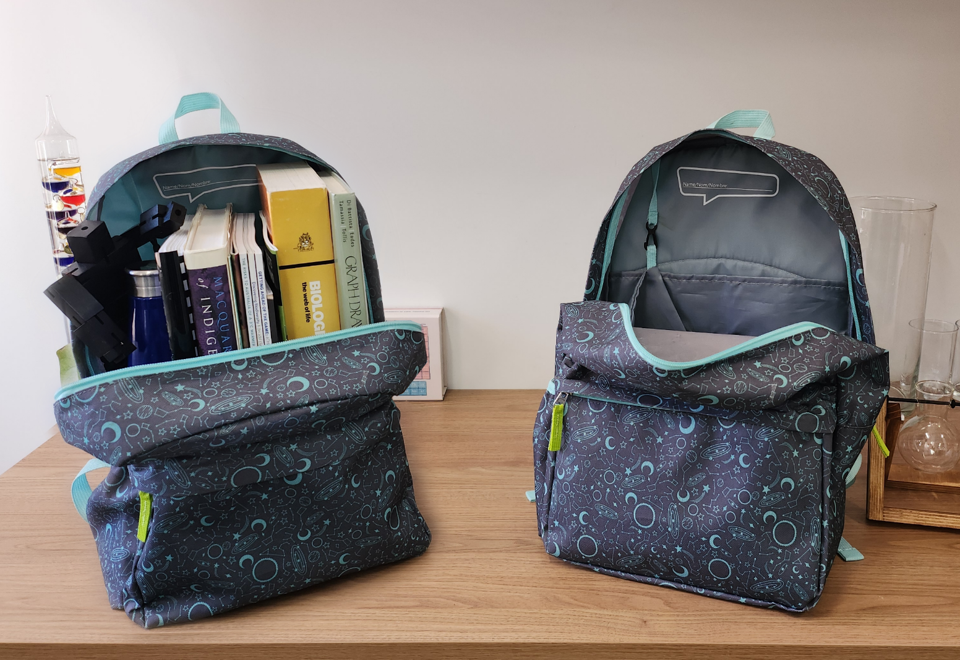
Which bag is denser?

Slide 38
Which object has more mass (more matter particles)?

Slide 39
Which object is more dense?
Both objects have the same volume.

Slide 40
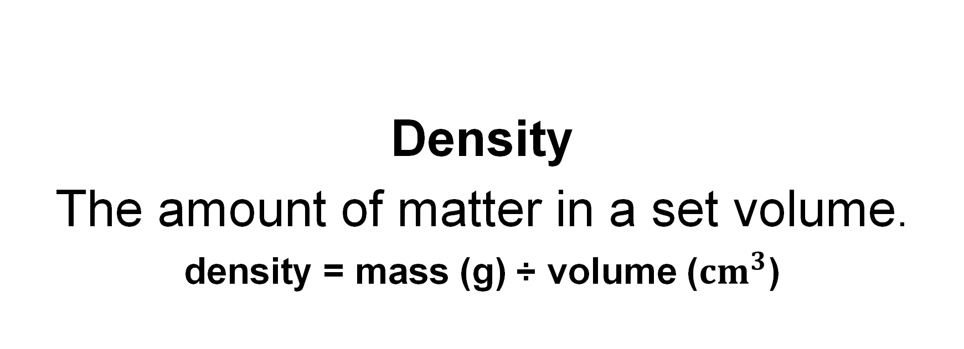
Density
The amount of matter in a set volume.
density = mass (g) ÷ volume (${cm}^{3}$)

Slide 41
Which object is more dense?

Slide 42
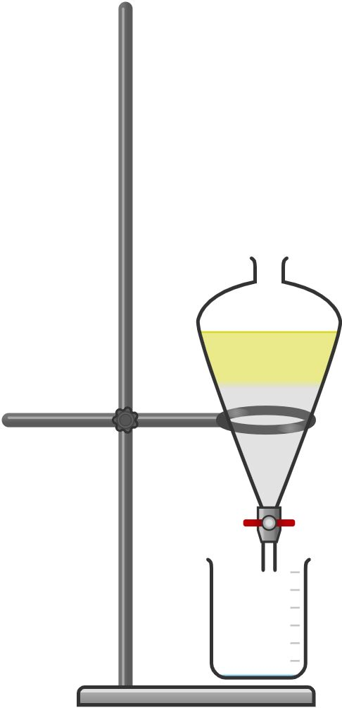
Observe the rainwater mixture
Created with Chemix (https://chemix.org)

Slide 43
Heterogeneous mixture
A mixture of different particles that are unevenly mixed or separated into layers.

Slide 44
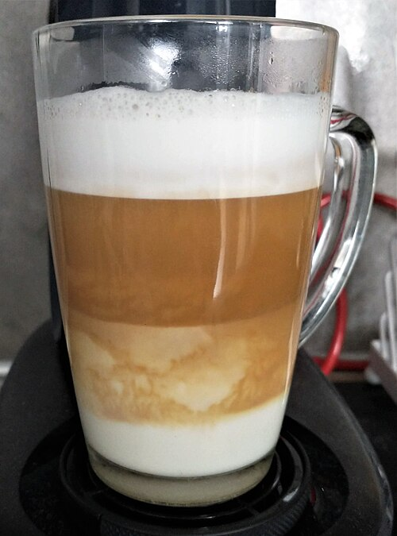
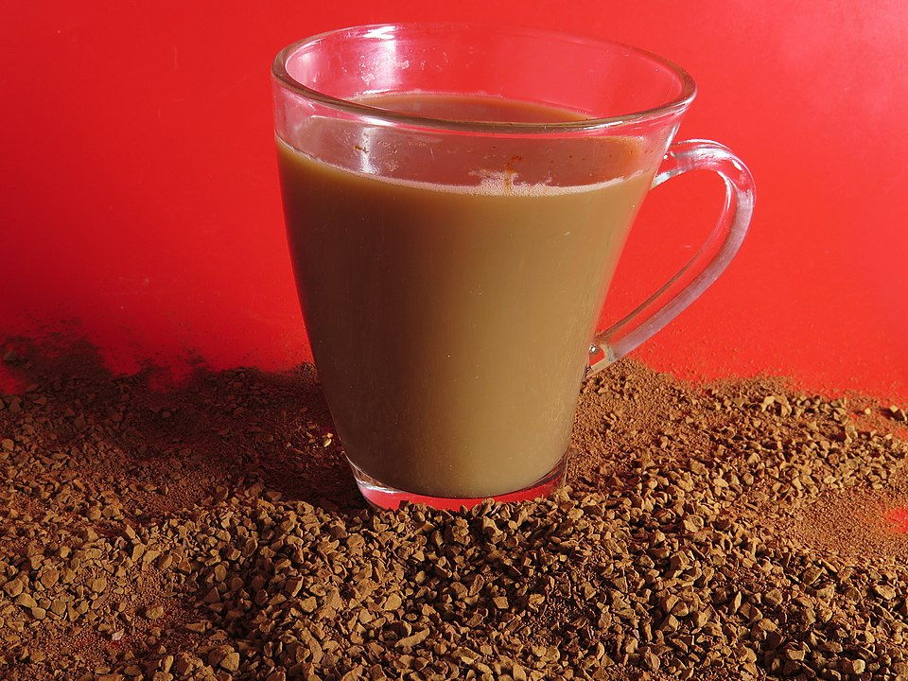
Which coffee mixture is heterogeneous?
Ortmozkin4, CC BY-SA 4.0, via Wikimedia Commons
MOs810, CC BY-SA 4.0, via Wikimedia Commons

Slide 45
Density of rainwater mixture
Low density oil
Turn the stopcock vertical to allow the sediment layer of the mixture to move into the beaker.
High density sediment
Created with Chemix (https://chemix.org)

Slide 46
Sedimentation
The process of high-density materials settling on the bottom of a mixture.

Slide 47
Select the correct word
(Sediment/Sedimentation) caused the (sediment/sedimentation) to settle on the bottom of the beaker.
Sedimentation caused the sediment to settle on the bottom of the beaker.

Slide 48
Homogenous mixture
A mixture of very small different particles that are evenly mixed and do not settle over time.

Slide 49

Identify the homogeneous and heterogeneous mixture.
Homogeneous
Heterogeneous

Slide 50
Record the properties of each density layer
Layer | Density | Appearance
1
2
3

Slide 51
Argumentation
Claim:
My hypothesis that _____________ was/wasn’t supported.
Reasoning:
The layers in the separating funnel are the same/different to that predicted in the hypothesis.
Evidence:
(Describe the layers in the separating funnel.)

Slide 52
L5 Inquire
Testing dissolved solids

Slide 53
What was in the rainwater?
Ulf Wittrock via iStock

Slide 54
What have we removed?
Michael Campbell Cole via iStock
Leaves and bark
Dirt and sand
Oil pollution
Iron fragments
Carlos Valenzuela, CC BY-SA 4.0, via Wikimedia Commons
0x0077BE, CC0, via Wikimedia Commons
gyro via iStock
Ondřej Mangl, Public domain, via Wikimedia Commons

Slide 55
Australian Government rainwater quality requirements
End use | Does the water need to be clear? | Does the water need to be odourless? | Should the water be low in dissolved solids? | Is there no human pathogens, toxins or heavy metals?
Garden/lawn irrigation | Not required | Not required | Not required | Not required
Toilet flushing | Yes | Yes | Not required | Not required
Clothes washing | Yes | Yes | Not required | Not required
Showering/bathing | Yes | Yes | Yes | Not required
Drinking | Yes | Yes | Yes | Yes
https://www.yourhome.gov.au/water/rainwater

Slide 56
Solute
The substance (salt) that dissolves.
Solvent
The dissolving medium (water).
Solution
A homogeneous mixture of a solute and solvent.

Slide 57
Australian Government rainwater quality requirements
End use | Does the water need to be clear? | Does the water need to be odourless? | Should the water be low in dissolved solids? | Is there no human pathogens, toxins or heavy metals?
Garden/lawn irrigation | Not required | Not required | Not required | Not required
Toilet flushing | Yes | Yes | Not required | Not required
Clothes washing | Yes | Yes | Not required | Not required
Showering/bathing | Yes | Yes | Yes | Not required
Drinking | Yes | Yes | Yes | Yes
https://www.yourhome.gov.au/water/rainwater

Slide 58
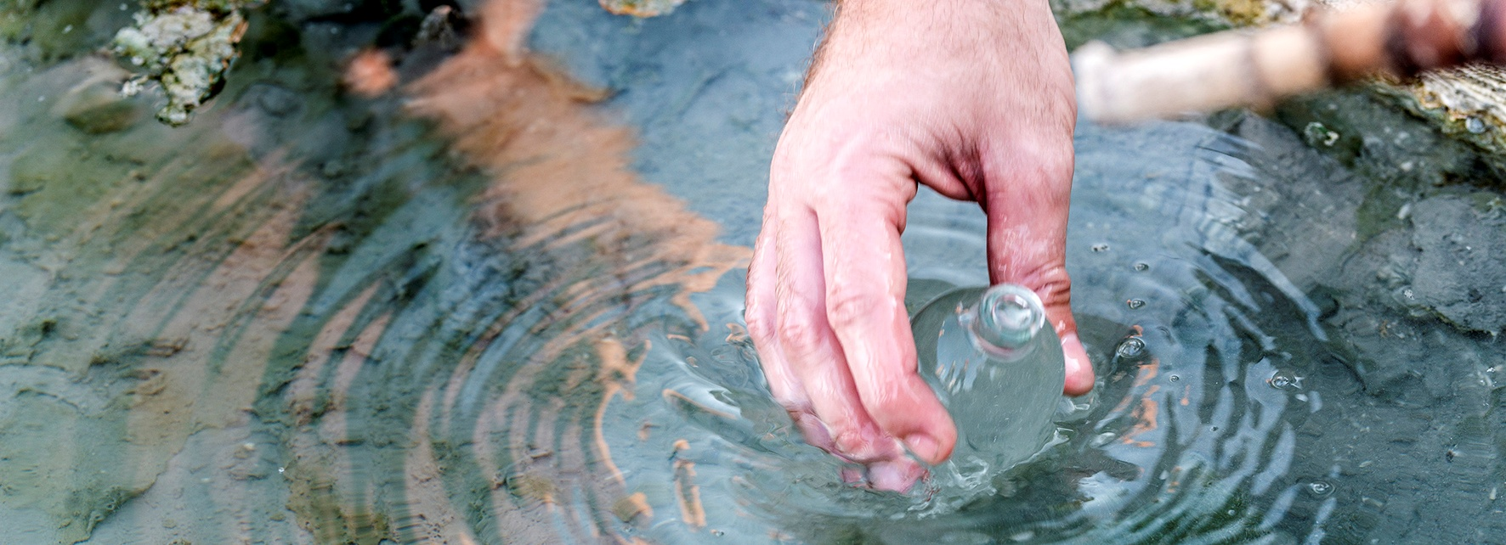
How can we test if dissolved solids are in rainwater?
André Künzelmann, CC BY-SA 3.0, via Wikimedia Commons

Slide 59
Australian drinking water guidelines
Total dissolved solids (mg/L) | Palatability
0 – 600 | Good
600 – 900 | Fair
900 – 1200 | Poor
>1200 | Unacceptable (unpalatable)
https://guidelines.nhmrc.gov.au/australian-drinking-water-guidelines/part-5/physical-chemical-characteristics/total-dissolved-solids

Slide 60
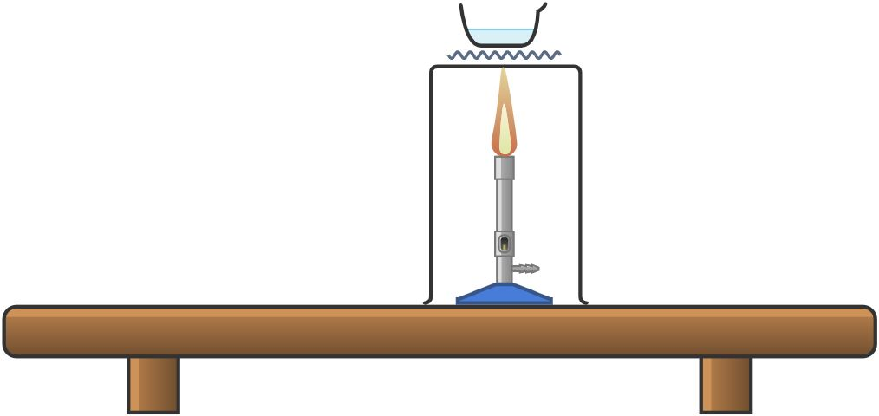
Crystallisation equipment
Created with Chemix (https://chemix.org)

Slide 61
Dissolved solids investigation
Determine the mass of the evaporating dish by weighing it on the balance. Record your results in Table 1.
Use the measuring cylinder to measure _____ mL of rainwater mixture. Carefully add the rainwater mixture to the evaporating dish. Record your observations of the mixture in Table 2.
Connect the Bunsen burner to the gas. Light the match, place it near the top of the Bunsen burner, then turn on the gas. (Ask your teacher if you are not sure how to do this.)
Turn off the Bunsen burner when most of the water has evaporated. Place a watch glass over the container to prevent the mixture spitting. The remaining heat in the dish will complete the process.
Record your observations of the crystals remaining in the evaporating dish in Table 2.
When the evaporating dish has cooled, use the balance to determine the mass of the evaporating dish containing the crystallised solids. Record your results in Table 1.
Calculate the mass of the crystallised solids. Record your results in Table 1.

Slide 62
Crystallisation
The process of evaporating the liquid solvent (water) from a solution so the solute forms crystals.

Slide 63
Represent crystallisation
Draw a labelled diagram of the solute and solvent particles in a homogeneous solution.
Draw a labelled diagram of the crystallised solute particles after crystallisation.

Slide 64
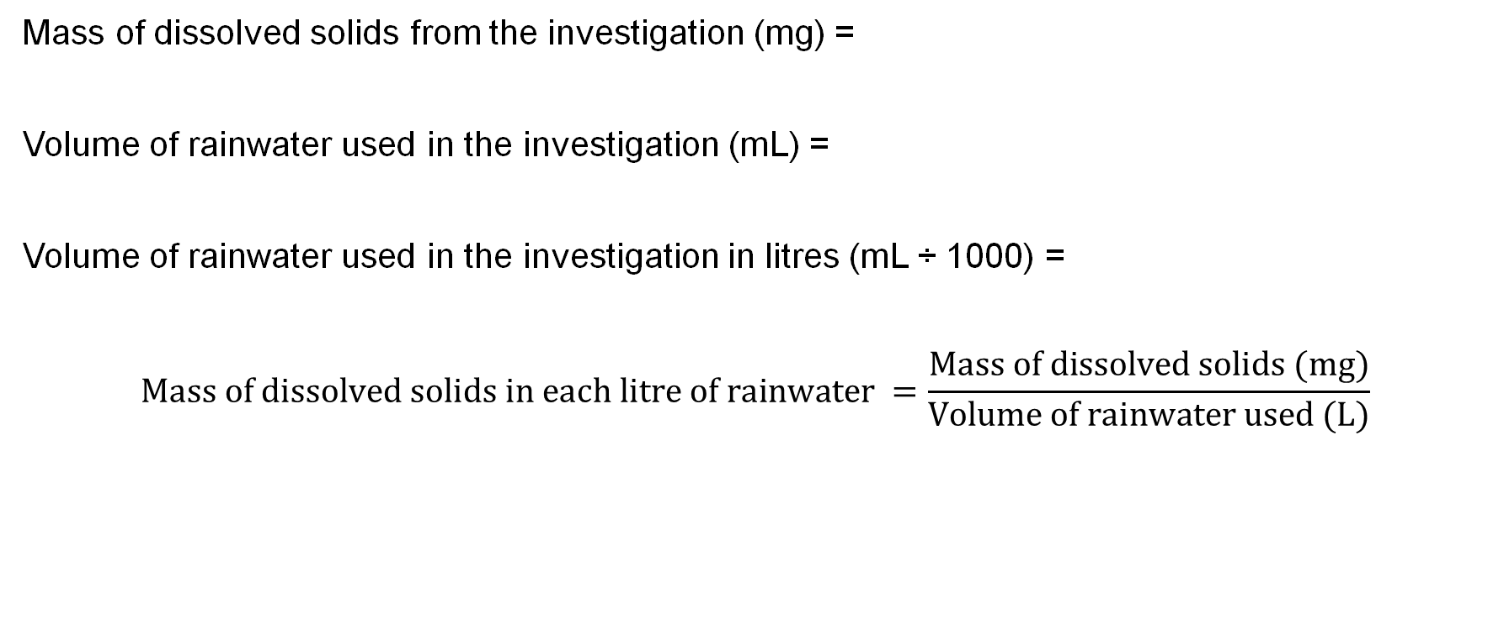
Calculate the mg/L of dissolved solids
Mass of dissolved solids from the investigation (mg) =
Volume of rainwater used in the investigation (mL) =
Volume of rainwater used in the investigation in litres (mL ÷ 1000) =
$$Mass of dissolved solids in each litre of rainwater =\frac{Mass of dissolved solids (mg)}{Volume of rainwater used (L)}$$

Slide 65
Argumentation
Claim:
The rainwater sample is/isn’t considered drinkable in Australia.
Reasoning:
(Links the claim to the evidence.)
Evidence:
(Evidence from your experiment.)

Slide 66
L6 Inquire
Testing for PFAS

Slide 67

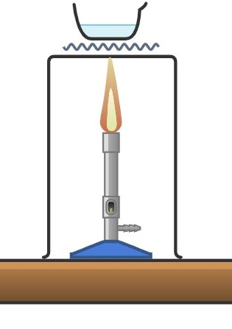
Separation techniques
Created with Chemix (https://chemix.org)

Slide 68
PFAS
(Per- and polyfluoroalkyl substances)
PFAS are human-made “forever chemicals” that resist heat, water, and oil, and don’t break down easily.

Slide 69
Chromatography
A way to separate particles that have different solubilities.

Slide 70
Solubility
How easily something dissolves in a liquid.

Slide 71
Soluble particles dissolve quickly
As the water moves up the paper, the most soluble ink dissolves first.
Less soluble inks take longer to dissolve and move past the top line.

Slide 72
Chromatography and solubility
Cut a strip of chromatography paper so it will hang inside the beaker without touching the sides.
Use the lead pencil to draw a line about 2 cm from the bottom of the paper. Draw another line 3 cm above the first line.
Use the marker to be tested to make a 0.5 cm circle on the bottom pencil line. Let it dry, then add another layer on the same spot to make it stronger.
Pour water in the beaker such that it reaches a height of 1 cm (the water level must be below the marker spot).
Attach the paper to a pencil or paper clip and suspend it in the beaker so the bottom of the paper touches the water, but the ink spot stays above the waterline.
Start the timer and leave the paper to sit, allowing the water to slowly rise up the paper.
When the water almost reaches the top pencil line, record the time.
As each colour reaches the top pencil line, record the time.

Slide 73
Results
Water or colour present | Time taken for the water or colour to reach the top pencil mark. (seconds)
Water front
Colour 1:
Colour 2:
Colour 3:

Slide 74
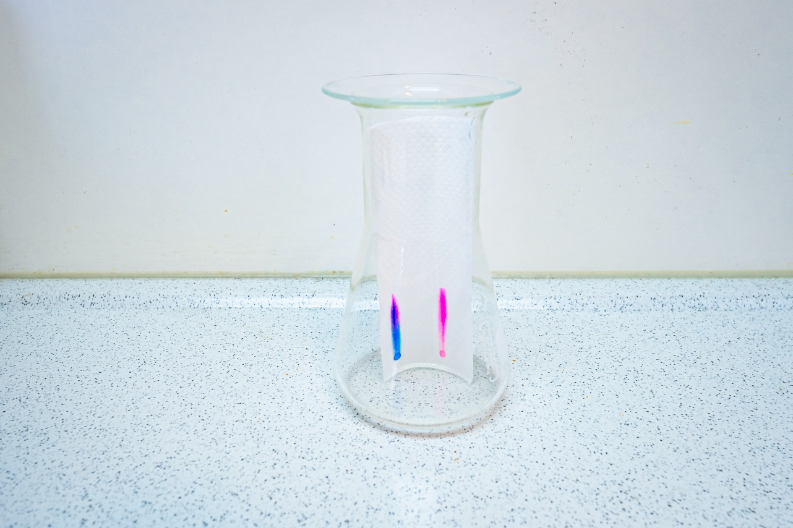
Which colour was most soluble?
Which colour was least soluble?
Meindert van der Haven via iStock

Slide 75
Which PFAS chemical is the most soluble?
Type of PFAS | Name | Uses | Chromatograph retention time (how long it takes to move to the detector) (minutes)
PFBS | Perfluorobutanesulfonic acid | Firefighting foams, carpets, and cleaning products | 7.62
PFOA | Perfluorooctanoic acid | Formerly used in Teflon | 15.85
PFOS | Perfluorooctanesulfonic acid | Firefighting foam and carpets | 17.91
PFHxS | Perfluorohexanesulfonic acid | Firefighting foams, stain-resistant fabrics, and food packaging | 13.58
Shoemaker, J. A., & Tettenhorst, D. R. (2018). Determination of selected per-and polyfluorinated alkyl substances in drinking water by solide phase extraction and liquid chromatography/tandem mass spectrometry (LC/MS/MS). National Exposure Research Laboratory.

Slide 76
Recommended Australian guideline PFAS values (µg/L)
Type of PFAS | Guideline value (µg/L)
PFBS | <1.0
PFOA | <0.2
PFOS | <0.008
PFHxS | <0.03
Per- and poly-fluoroalkyl substances (PFASs) - DCCEEW. (2022). Dcceew.gov.au. https://www.dcceew.gov.au/environment/protection/chemicals-management/pfas‌

Slide 77
L7 Inquire
Designing for sustainability

Slide 78
Rainwater tank
Yevhenii Khil via iStock

Slide 79
Australian Government rainwater quality requirements
End use | Does the water need to be clear? | Does the water need to be odourless? | Should the water be low in dissolved solids? | Is there no human pathogens, toxins or heavy metals?
Garden/lawn irrigation | Not required | Not required | Not required | Not required
Toilet flushing | Yes | Yes | Not required | Not required
Clothes washing | Yes | Yes | Not required | Not required
Showering/bathing | Yes | Yes | Yes | Not required
Drinking | Yes | Yes | Yes | Yes
https://www.yourhome.gov.au/water/rainwater

Slide 80
Rainwater mixture
Rainwater components | Properties
Dust/dirt/sand | - Small particle size - Brown or grey colour - Powdery / dry texture - Some settles slowly in water (if mixed)
Bark and leaves | - Larger particle size - Irregular shapes - Lightweight / floats on water - Rough texture
Iron fragments | - Metallic appearance - Magnetic - Hard and dense - Silver-grey colour
Oily pollution | - Oily or greasy texture - Shiny / slick surface - Often floats on water - Distinct smell
Water | - Clear liquid - Flows easily (liquid state) - Takes shape of container - Colourless and odourless (if clean)

Slide 81

Separation techniques
Created with Chemix (https://chemix.org)

Slide 82
Challenge
How can you make the rainwater in a tank as useful as possible?

Slide 83
Define
Outline how the rainwater will be collected and all the ways the rainwater could be used.

Slide 84
Ideate
Brainstorm ALL the different separation techniques that you could use.
Consider:
the materials you could use.
where the separation technique could be located:
        on the roof.
        going into the tank.
        in the tank.
        going to the tap.
        coming out of the tap.

Slide 85
Design and communicate the prototype
Describe the substances (and properties) that will be in the rainwater mixture.
Draw the water journey from the roof, downpipes, rainwater tank, hose/pipes and tap.
Identify the location of each separation technique on the drawing.
Describe how each separation technique separates a substance based on its property.
Describe how the usefulness of the water has increased.

