Slide 1
Science Connections
Yr 8 Tectonic collision course

Slide 2
Lesson 1
Quake detectives

Slide 3
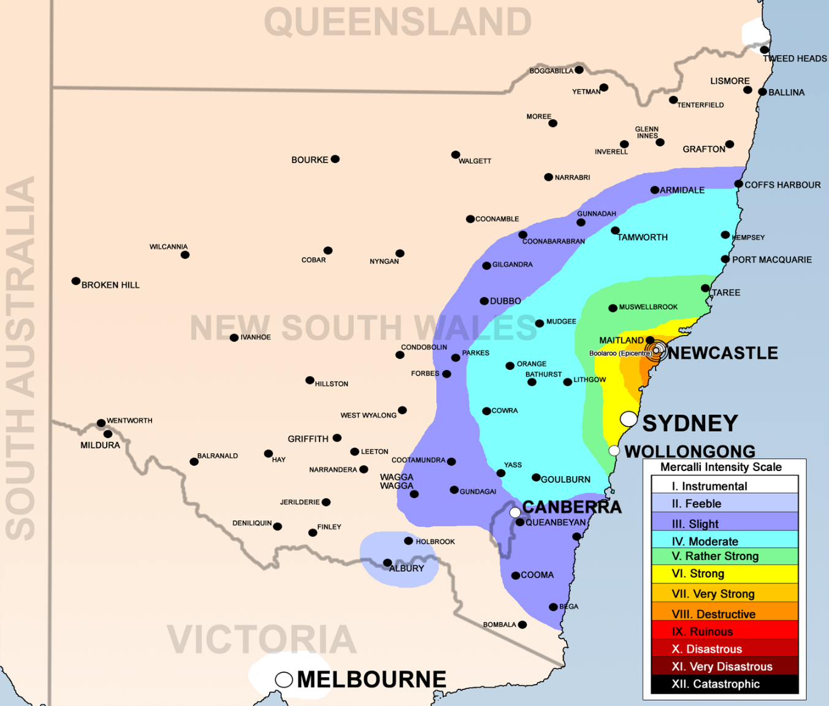
What if…?
Bidgee, CC BY 3.0, via Wikimedia Commons

Slide 4
Empathise
Say
What do they say?
What can you imagine them saying?
Think
What do their actions tell you about their thinking?
What decision do they need to make?
Feel
How do they describe or show their feelings?
Do
What do you see them do?
What can you imagine them doing?

Slide 5
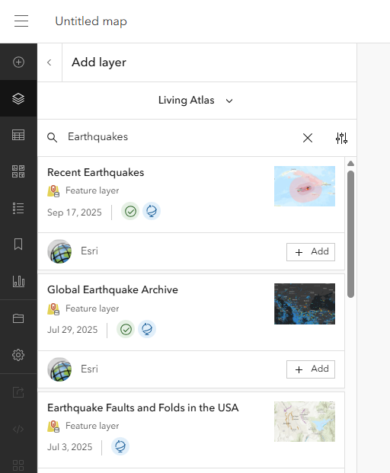
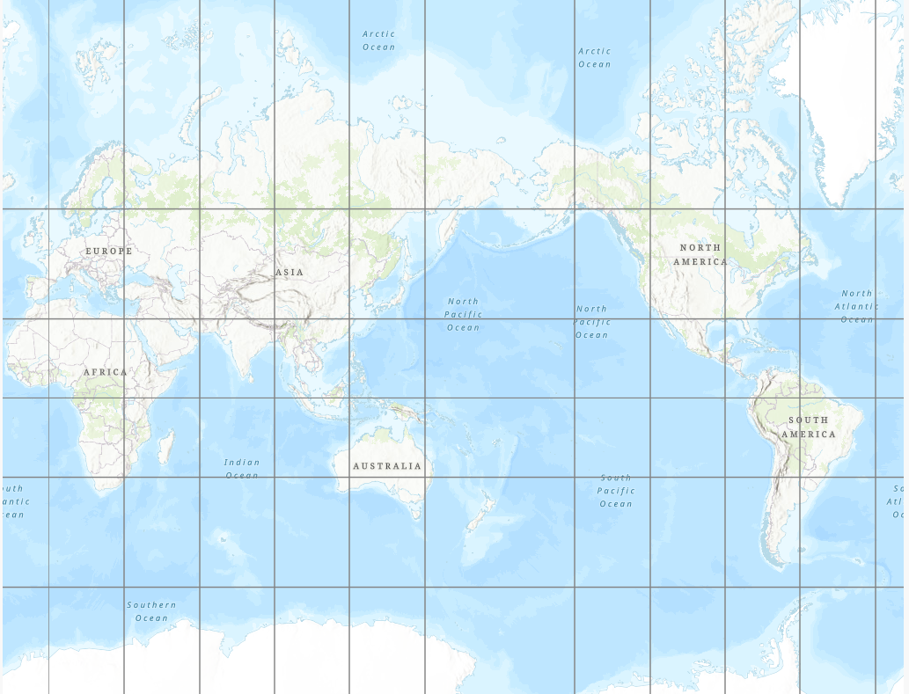
Mapping earthquakes

Slide 6
Argumentation
Claim:
Earthquakes are more likely to occur…
Reasoning:
Evidence from the map:

Slide 7
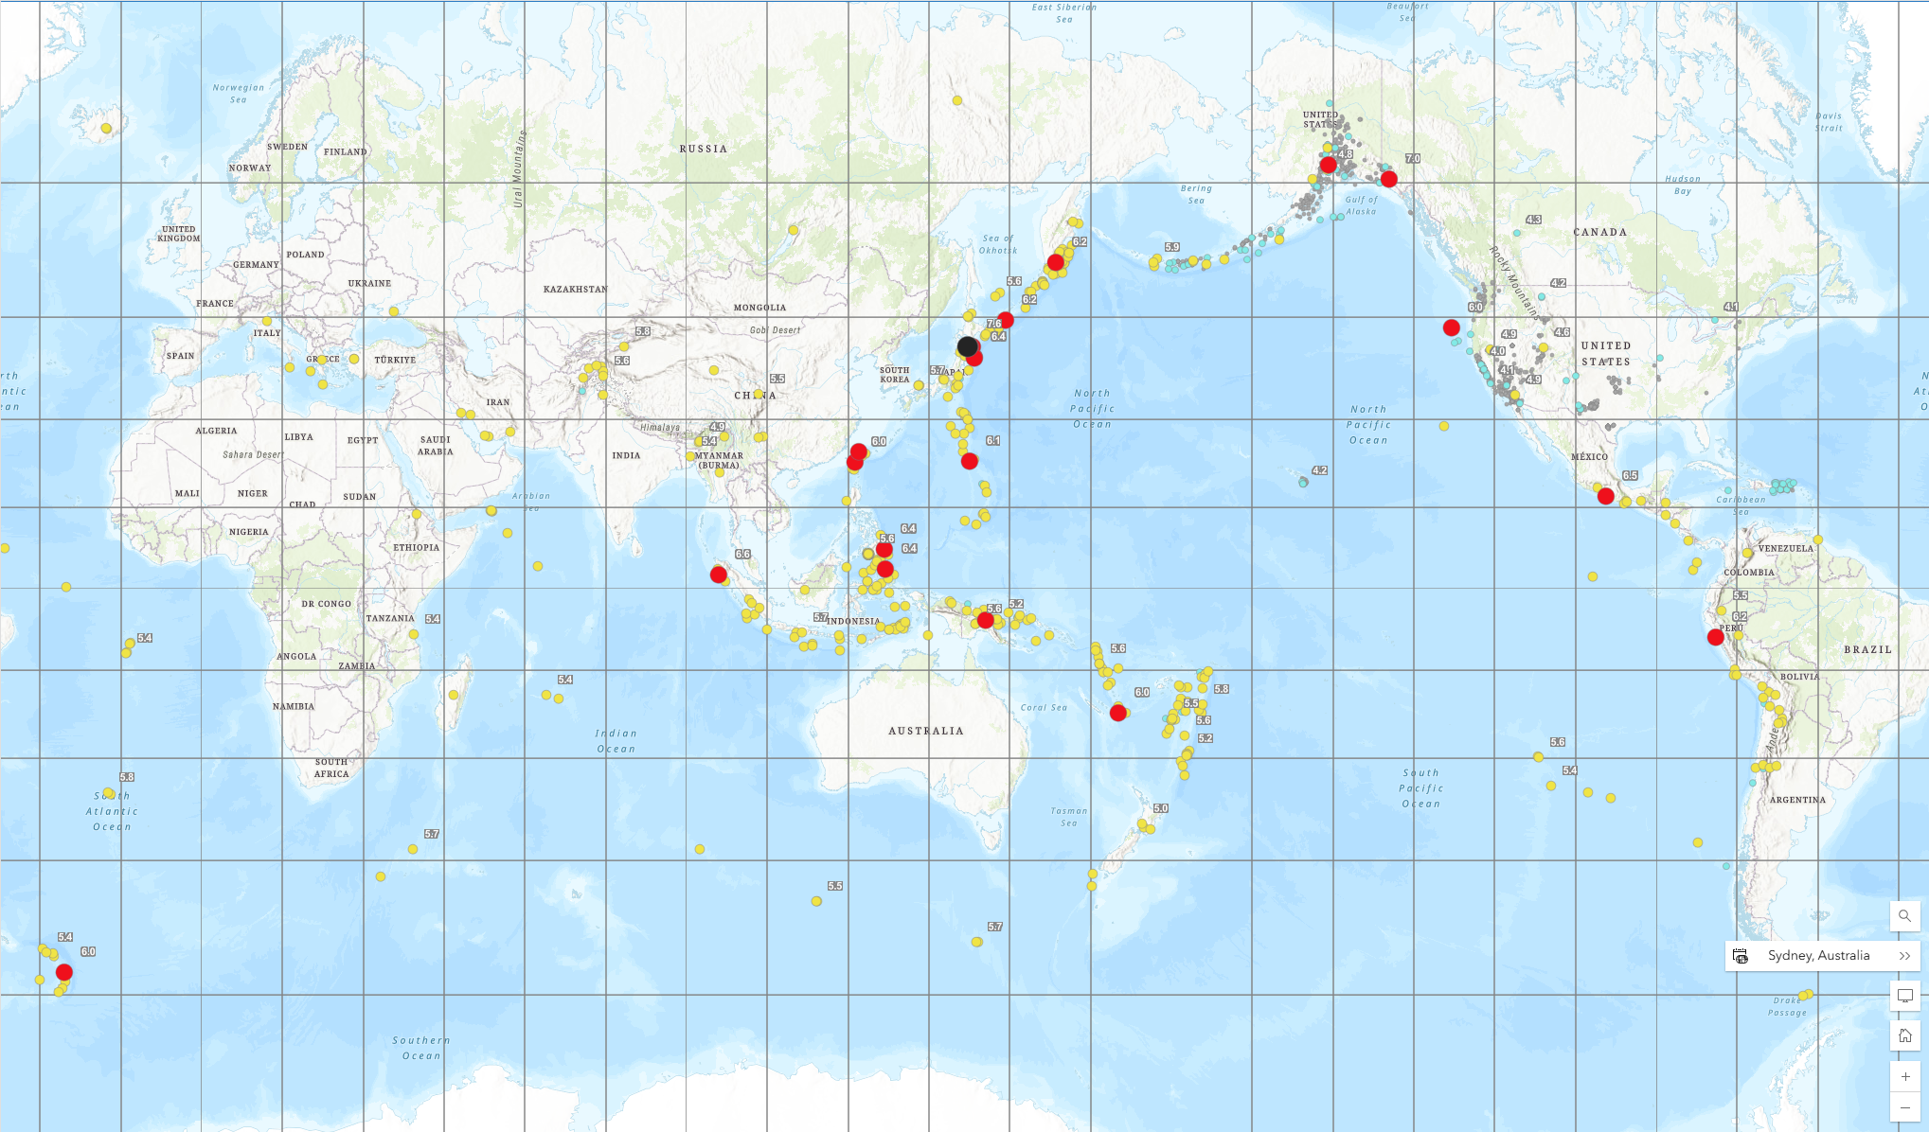
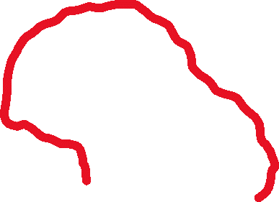
Ring of Fire

Slide 8
Is Australia in the Ring of Fire?
Does that mean we don’t have to worry about earthquakes?

Slide 9
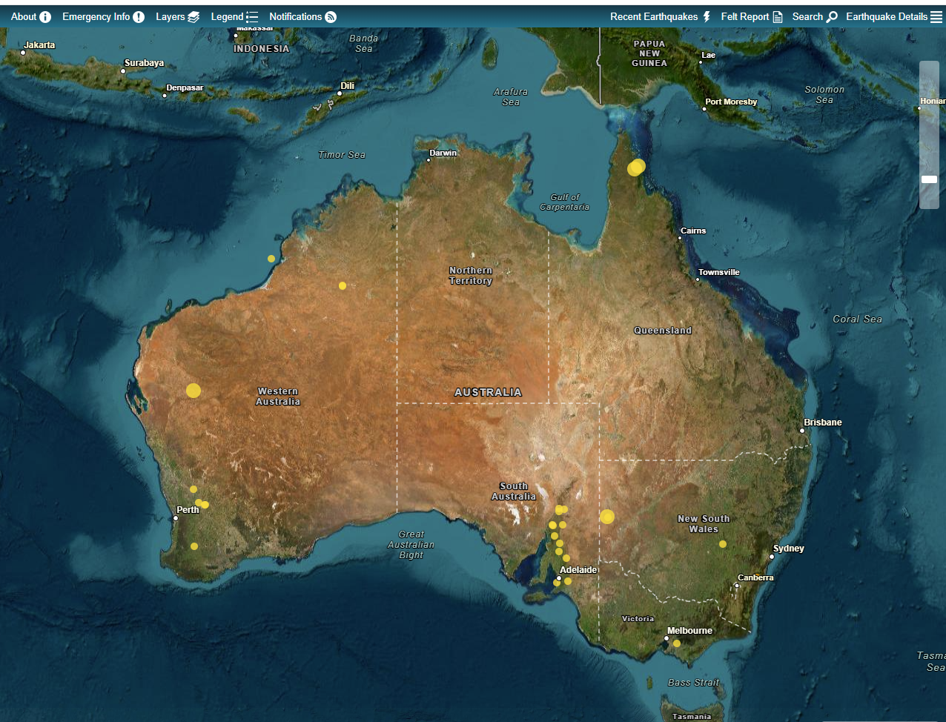
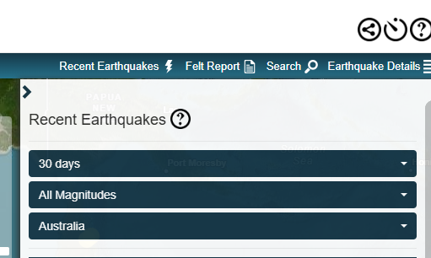
Australian earthquakes
https://earthquakes.ga.gov.au/

Slide 10
Discussion
Have earthquakes ever occurred near where we live? How might that influence our understanding of risk?
If an earthquake happened here, what parts of our town (or school) do you think would be most affected?
Why do people often think “Australia doesn’t get earthquakes”? What misconceptions exist?
If you were in charge of planning for natural hazards in your state, how important would earthquakes be on your priority list?

Slide 11
Lesson 2
Quakes and plates

Slide 12
How do scientists study how the earth moves over time?

Slide 13
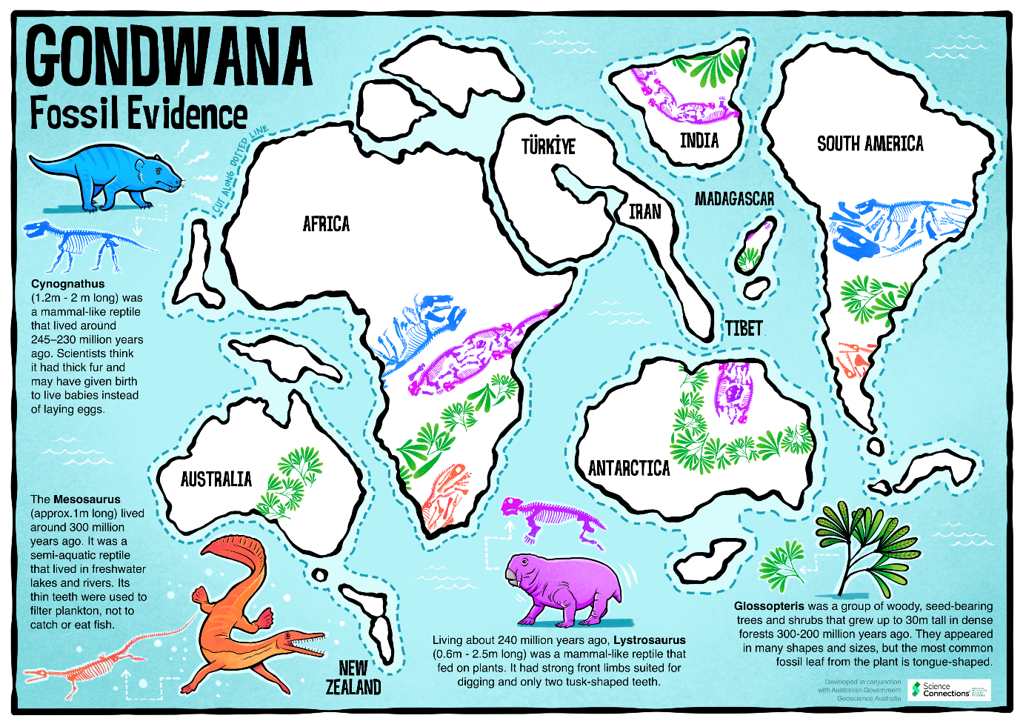
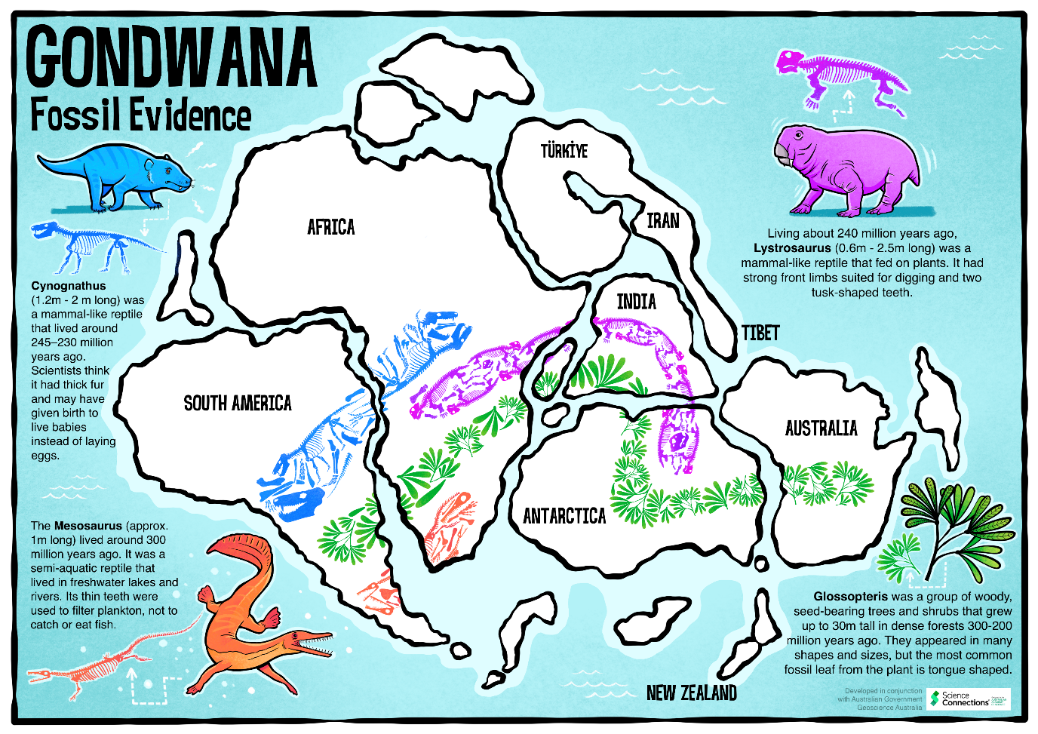
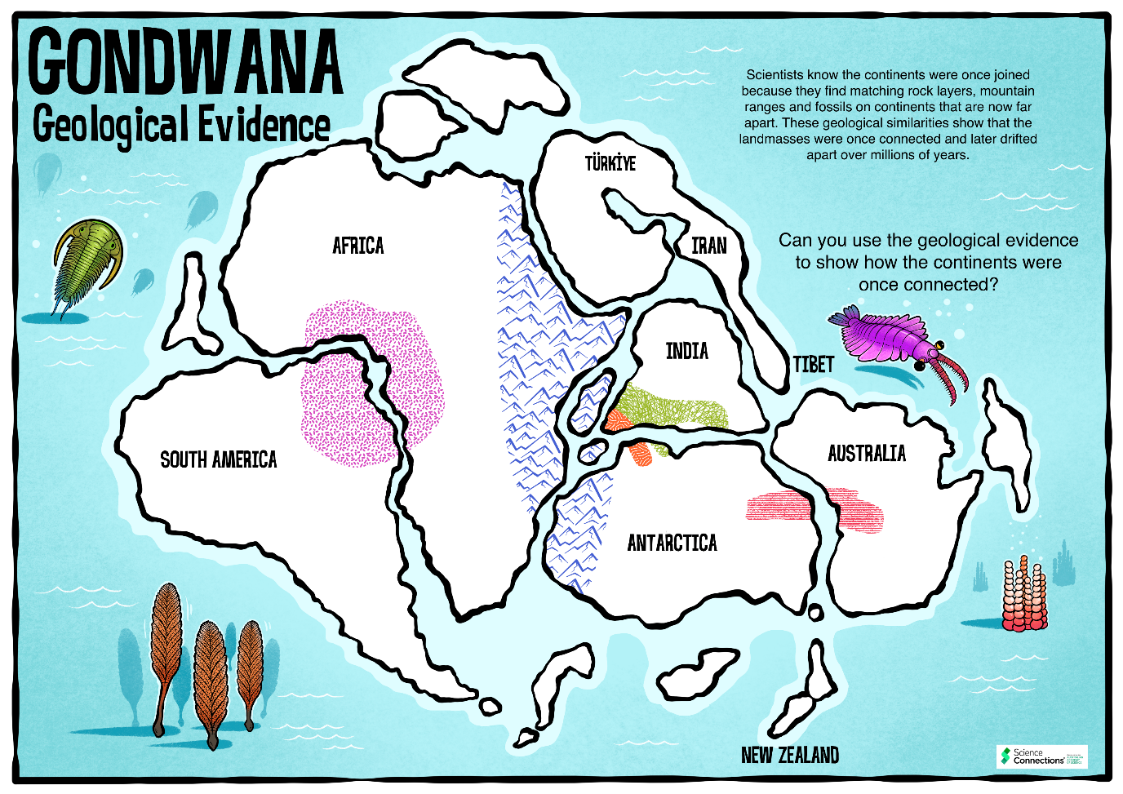
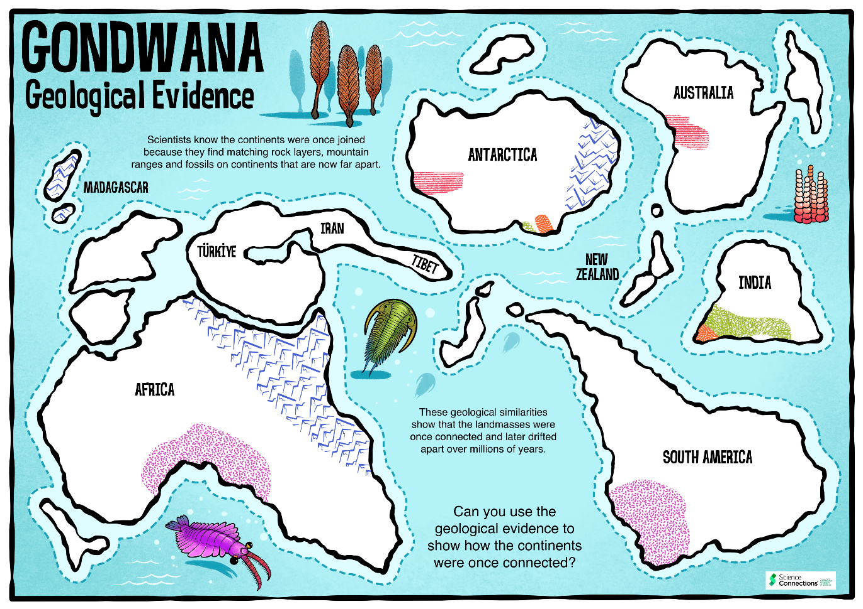
Moving Earth evidence
Add jigsaw puzzle picture

Slide 14
Discussion
What do these two sets of data suggest about the land masses in the southern hemisphere?
What does it mean for scientists to collaborate?
How might scientists from different countries work together on the same research?
Why is it helpful when scientists with different skills or backgrounds work together?
Why do scientists compare their results with other scientists’ findings?
Do you think peer review always makes science perfect? Why or why not?
Can you think of a time when feedback from others improved your own work (school, sports, music, etc.)?
How does collaboration and peer review help the public trust scientific information?
Should scientists always agree with each other? Why is disagreement sometimes useful?

Slide 15
Discussion
How can we locate the edges of the tectonic plates?
What do you think makes the tectonic plates move?
Is the layer under the tectonic plates liquid or solid?
Is it possible for something to look solid, but still move?
How quickly do these continents move?

Slide 16
Tectonic plates
Large rigid plates on the outer crust layer of the Earth called the lithosphere. These tectonic plates move over a partially molten (but still solid) inner layer called the asthenosphere.

Slide 17
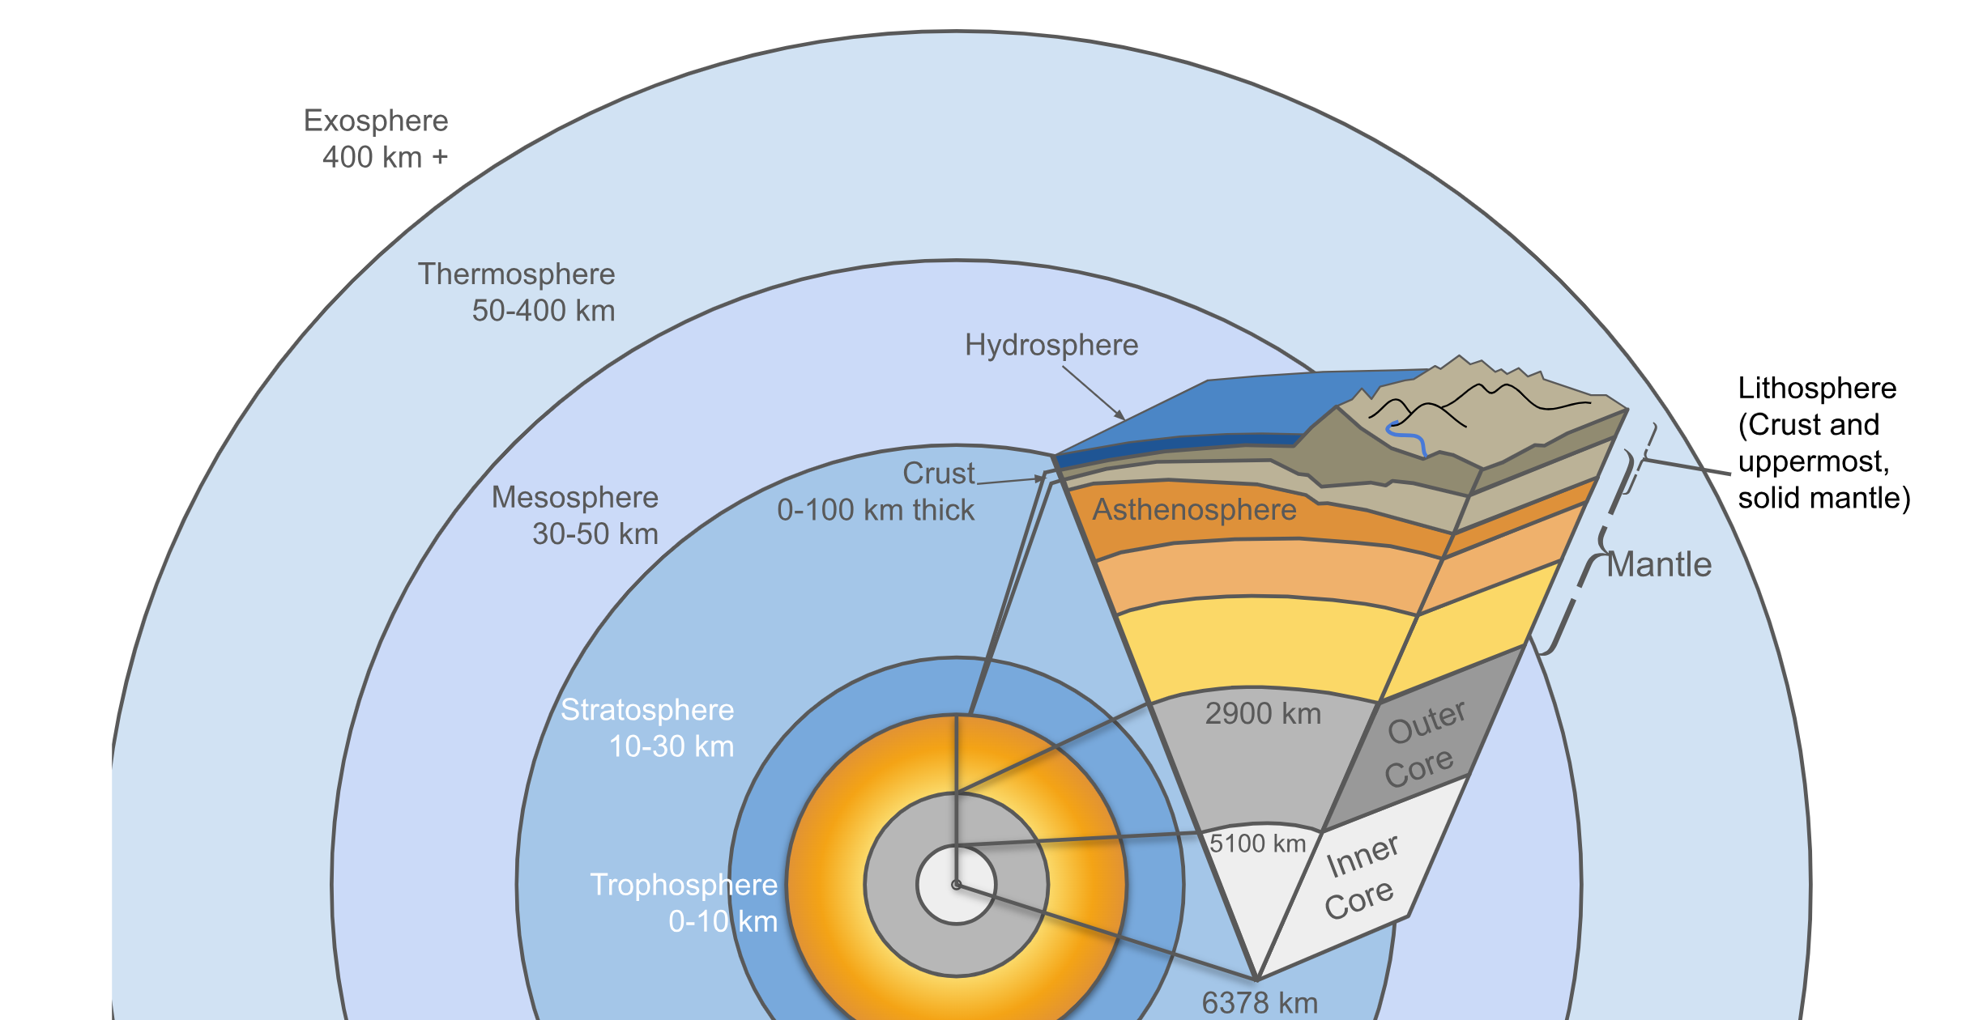
Earth’s layers
Wikimeatier, CC BY-SA 4.0, via Wikimedia Commons

Slide 18
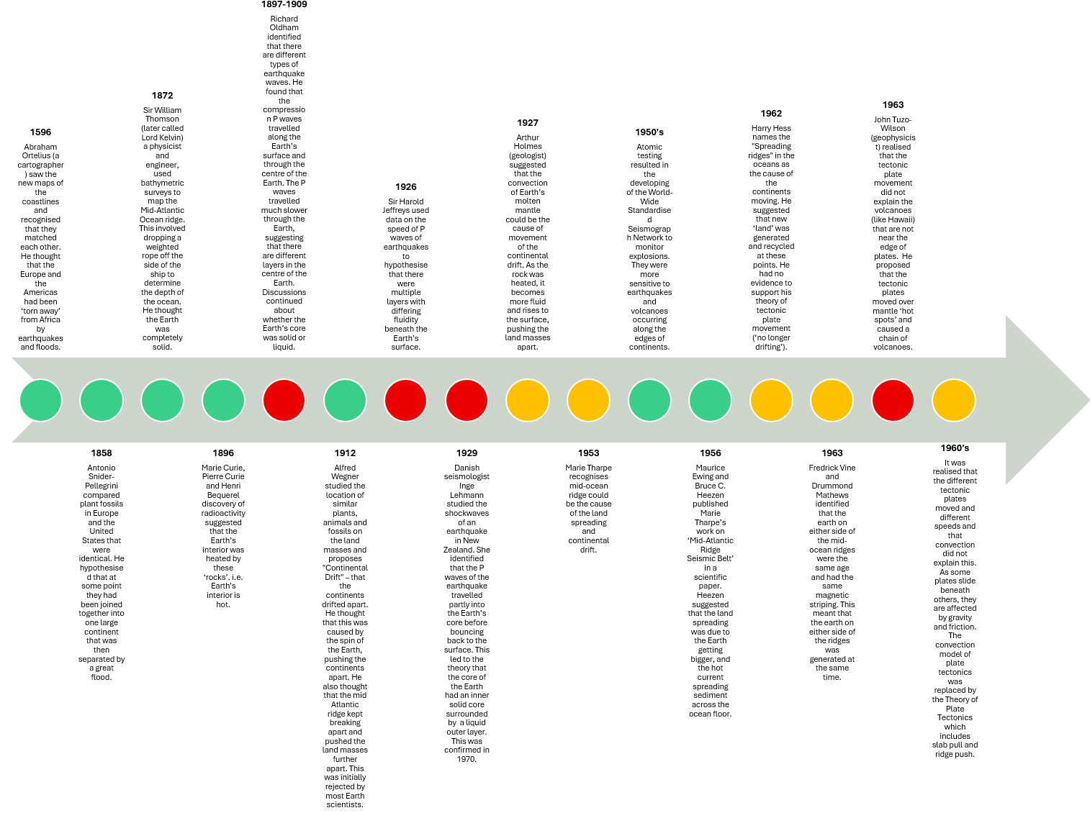
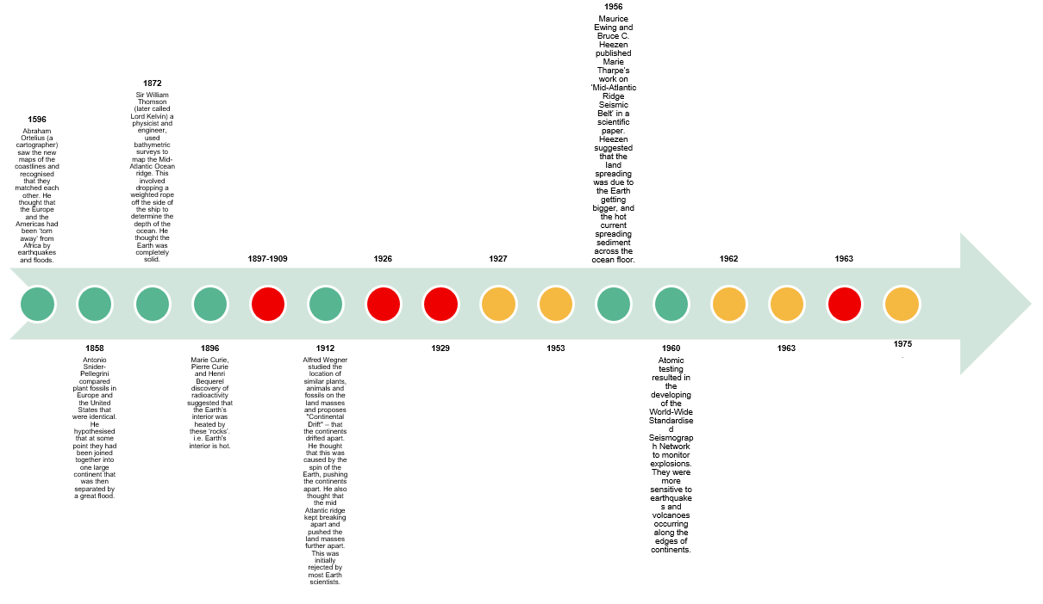
How did scientists develop tectonic plate theory?

Slide 19
Discussion
Do you think scientists always know the “next step” in a discovery? Why or why not?
What does it mean when scientists “build on the ideas of others”?
How can one scientist’s work help another scientist fill in a missing gap?
Why might two scientists look at the same evidence but reach different conclusions?
How can scientists’ backgrounds, experiences, or fields affect their opinions?
Is disagreement a bad thing in science? Why or why not?
Why might one scientist need more evidence than another before agreeing with an idea?
How does new evidence sometimes change what scientists think?

Slide 20
Sir Mark Oliphant (1981)
“I must admit that I am a rebel, attracted by the boldly unorthodox, and that I have a sneaking wish that the pundits of the present-day accepted cosmology be proven at least partially wrong. I remember in the 1920s, as a student in Adelaide, hearing a debate between Sir Douglas Mawson, Professor of Geology, and Wood-Jones, the Professor of Anatomy, concerning Wegener’s ideas of continental drift. Wood-Jones wanted it to be true, for it helped explain the distribution of animals, plants and their fossil remains. Mawson, the celebrated geology expert, thought it an absurd idea that rigid rocks could flow in that strange manner.”
Formal opening of the Australian Academy of Science’s Expanding Earth symposium

Slide 21
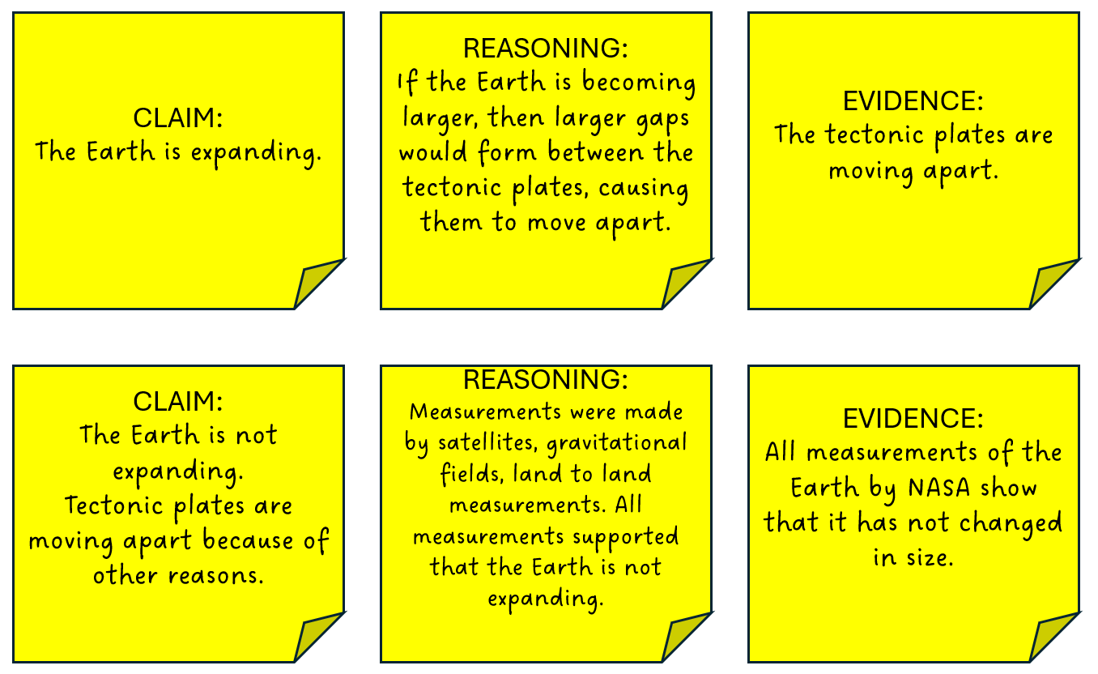
Compare the claims

Slide 22
Lesson 3
Forces beneath our feet

Slide 23

Why do tectonic plates move?

Slide 24
Convection
The transfer of heat through the physical movement of a fluid caused by density differences. This means hotter, less dense material rises, while cooler, more dense material sinks.

Slide 25
Discussion
How does the heat in the centre of the Earth affect the surface of the Earth?
What can happen when two tectonic plates move toward each other?
How can convergent boundaries cause mountains or earthquakes?
What happens when plates move away from each other?
Where on Earth are divergent boundaries commonly found?
What is subduction, and how is it different from general convergence?
Why does one plate sink under another at a subduction zone?
What natural events (volcanoes, earthquakes, trenches) are common near subduction zones?
What is a hot spot, and how is it different from a plate boundary?

Slide 26
Types of boundaries
Convergent boundary
A convergent boundary is where two tectonic plates move toward each other. This can cause mountains, earthquakes, or volcanoes, depending on the types of plates involved.
Subduction zone
A subduction zone is a type of convergent boundary where one tectonic plate sinks beneath another because it is denser. This process can create deep ocean trenches, volcanoes, and strong earthquakes.

Slide 27
Types of boundaries
Divergent boundary
A divergent boundary is where two tectonic plates move away from each other. Magma rises to fill the gap and cools to form new crust, often creating mid-ocean ridges or rift valleys.
Transform boundary
A transform (transforming) boundary is where two tectonic plates slide past each other horizontally. The plates do not collide or move apart, so no new crust is created or destroyed, but the movement often causes earthquakes.
Hot spot
A hot spot is an area where hot magma rises from deep within the Earth, not at a plate boundary. As a tectonic plate moves over it, a chain of volcanoes can form (like the Hawaiian Islands).

Slide 28
How can we tell what type of boundary is at the edges of the Indo-Australian plate?

Slide 29
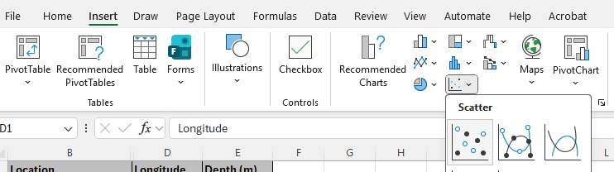
Graph longitude and elevation for Indo-Australian earthquakes

Slide 30
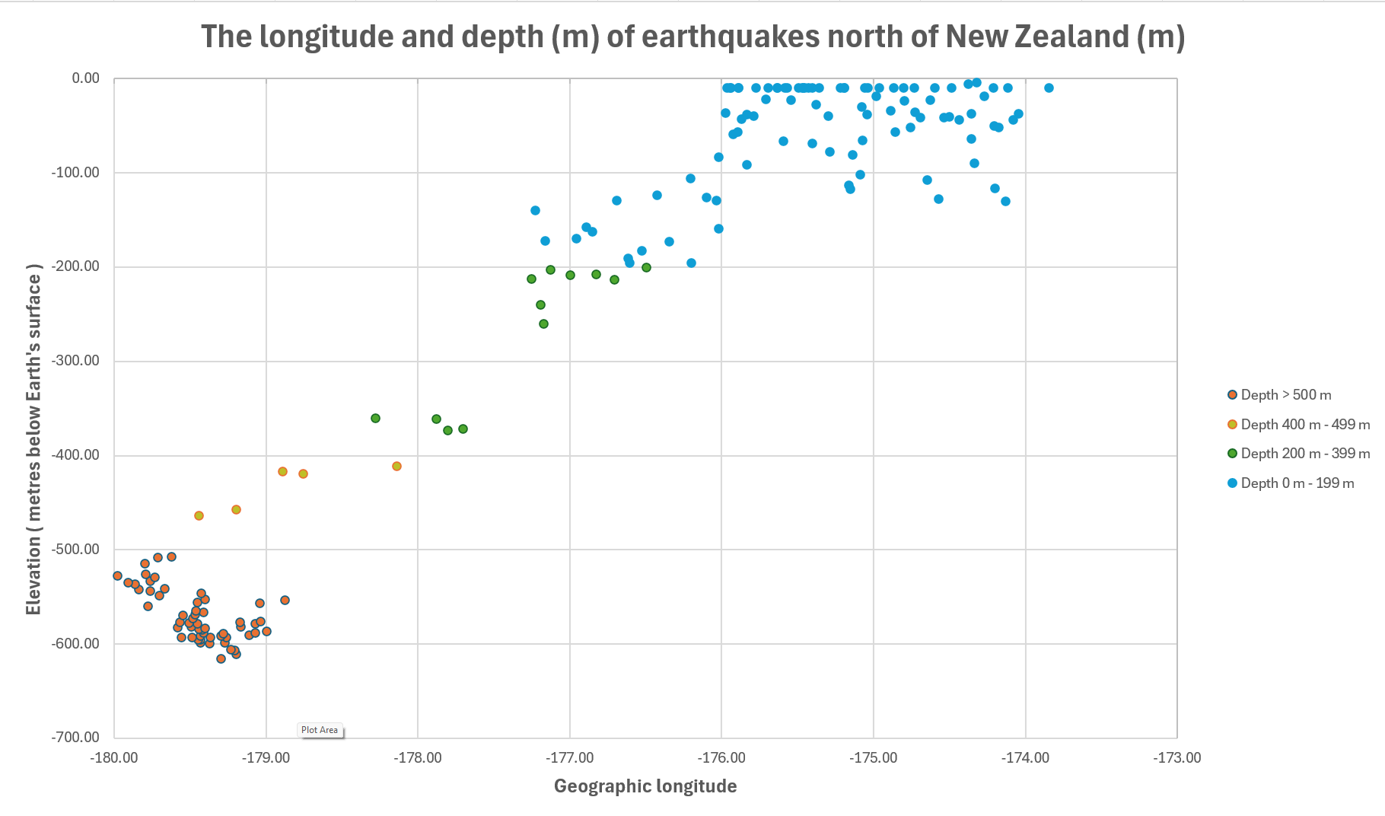
Indo-Australian plate
What does the y-axis (vertical axis) show?
Where is the sea level on the graph?
What do you notice about the shape of the graph?
Which plate is moving downwards?
What type of tectonic boundary is this?
What do you think happens to the plate that is ‘hanging down’?
What effect do you think this pull at the end of the tectonic slab has on the rest of the plate?
How do you think this force compares to the force provided by convection?

Slide 31
Slab pull
The gravitational force that pulls down on a dense cold oceanic plate that is subducting beneath another plate. This is the main driver of tectonic plate movement.

Slide 32
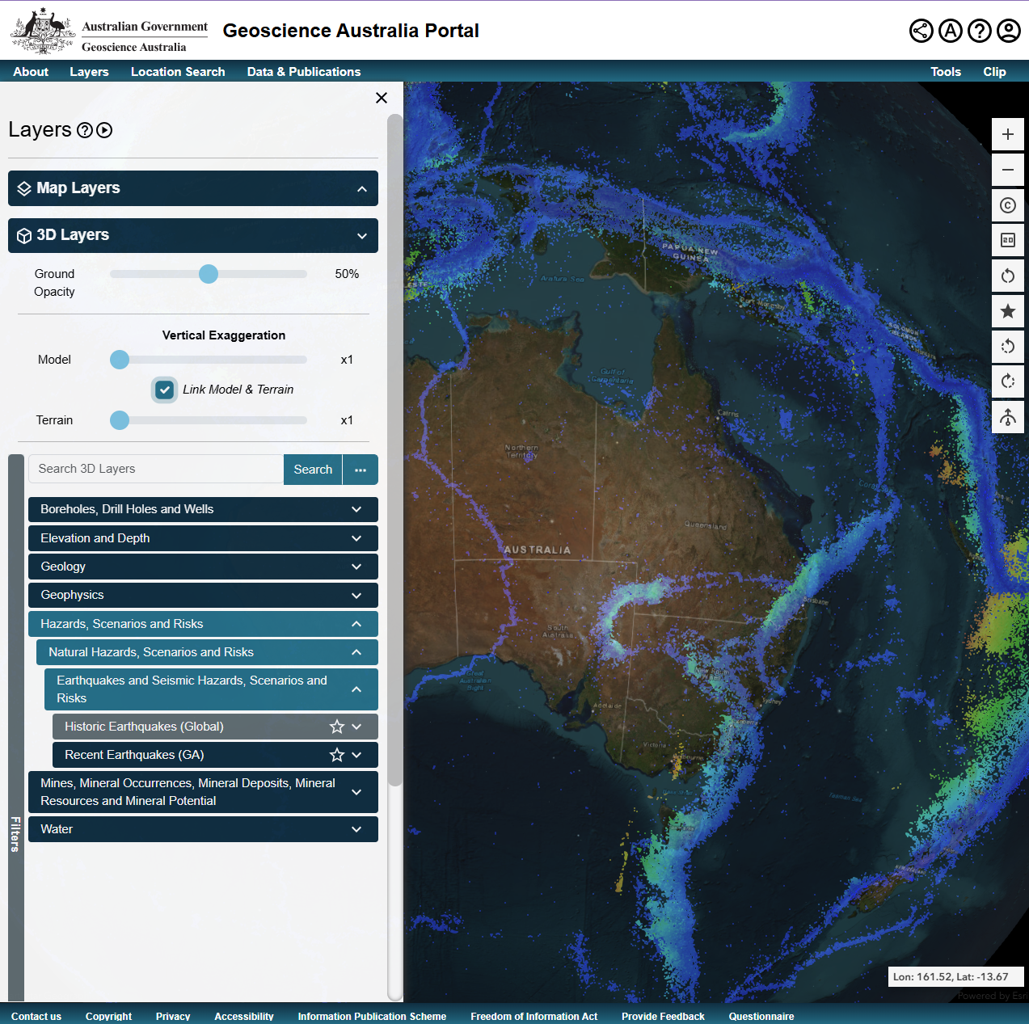
Geoscience Australia Portal 3D map
Rotate the Earth to locate New Zealand
Increase ‘Ground Opacity’ to 60%-70%
Identify the subduction zone north of New Zealand.
Can you find other subduction zones?

Slide 33
Scientific modelling
 | Graph | 3D
Advantages
Disadvantages

Slide 34
Ocean ridge push
The force that pushes tectonic plates apart at a divergent boundary.

Slide 35
Divergent (move apart)
Transform (slide past)
Convergent (collide)
Types of boundaries
Continental crust
Same fossils on different continents
Hard lithosphere
Tectonic plates
Oceanic crust
Evidence for movement
Earth layers
Gondwana
Flowing mantle
Matching rock layers and geological structures
Causes of movement
Convection heat
Slab pull
Ocean crust push

Slide 36
Lesson 4
Tsunami

Slide 37
Do we need to know about earthquakes in other parts of the world?

Slide 38
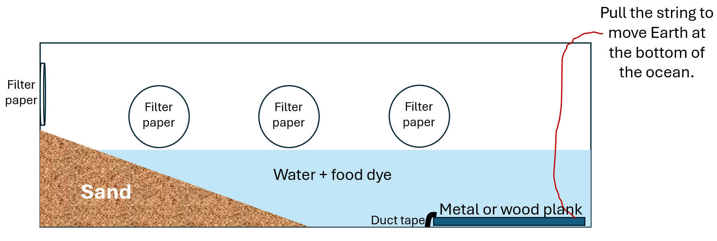
Tsunami tank

Slide 39
Tsunami
A series of powerful ocean waves caused by sudden displacements of water by earthquakes, landslides or volcanic activity.

Slide 40
Does it make any difference if the tsunami waves arrive at high tide or low tide?

Slide 41
Discussion
How does the magnitude of an earthquake influence the volume of water displaced during a tsunami-generating event?
In what ways does a large landslide displace more water than a smaller one, even if both occur in the same location?
What challenges arise when trying to detect small water-level changes in deep water?
Why must sensors around tectonic plate boundaries be extremely sensitive?
Why are tectonic plate edges the key location for placing water-displacement sensors?
What could be the consequences of relying on sensors that are not sensitive enough?
How might false positives or missed detections impact public trust in warning systems?

Slide 42
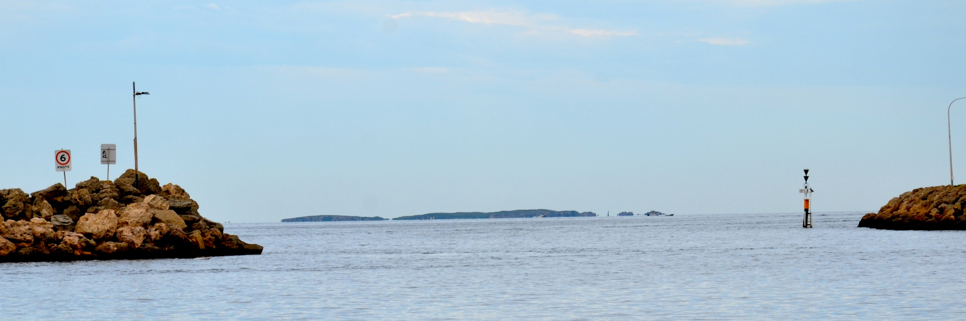
Vardon Harbour
Hypothesise what would happen if tsunami waves arrived at low tide or high tide.
Photographs by JarrahTree...commons.wikimedia.org, CC BY 2.5 AU, via Wikimedia Commons

Slide 43
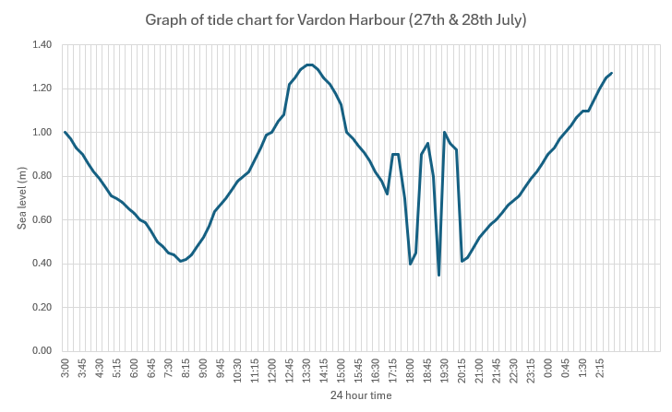
Vaden Harbour
What is the normal high tide at Vardon Harbour? What time was this?
What is the normal low tide at Vardon Harbour? What time was this?
What is unusual about the graph?
What do the three high sea level events represent?
What should the normal tide movement look like during this time?
How much higher is the sea level than it should be?
What would happen if these tsunami waves happened at high tide? How high would the water level be?

Slide 44
Lesson 5
Shake, rattle, and roll

Slide 45
How could we predict the effect that earthquakes will have?

Slide 46
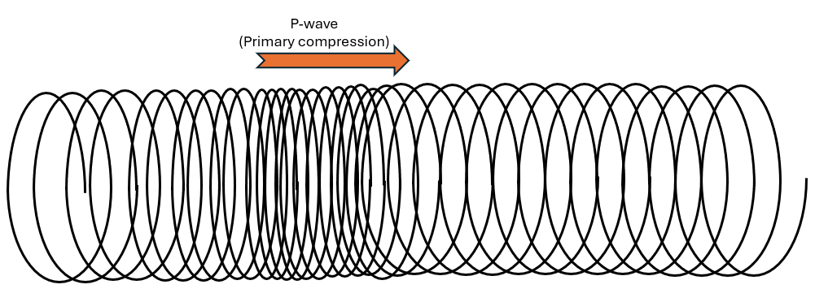
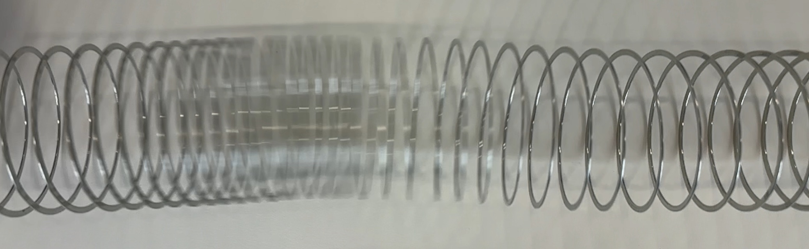
P (primary or compression) wave
Energy/Earth movement

Slide 47
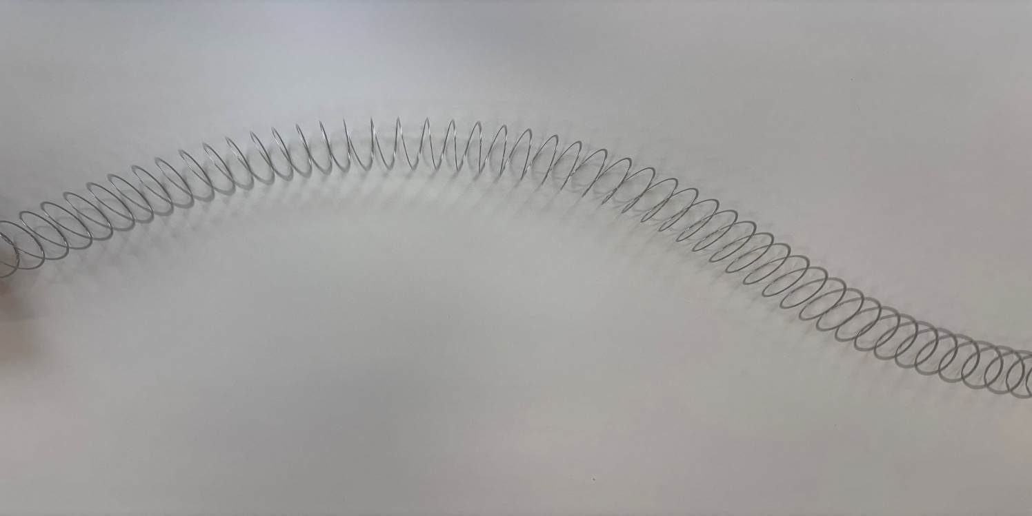
S (secondary or shear) wave
Earth movement
Energy movement

Slide 48
Surface wave
Only travels along the Earth’s surface and are slower to arrive.

Slide 49
Discussion
How do P waves move the ground, and how might this motion feel to a person?
How do S waves move differently from P waves?
Why are surface waves usually responsible for the most damage?
How might the motion caused by S waves or surface waves affect a person’s balance?
Why do some people describe earthquakes as rolling, shaking, or jolting?
How might people experience different motions depending on how close they are to the epicentre?
Why is understanding seismic wave motion important for earthquake-resistant building design?

Slide 50
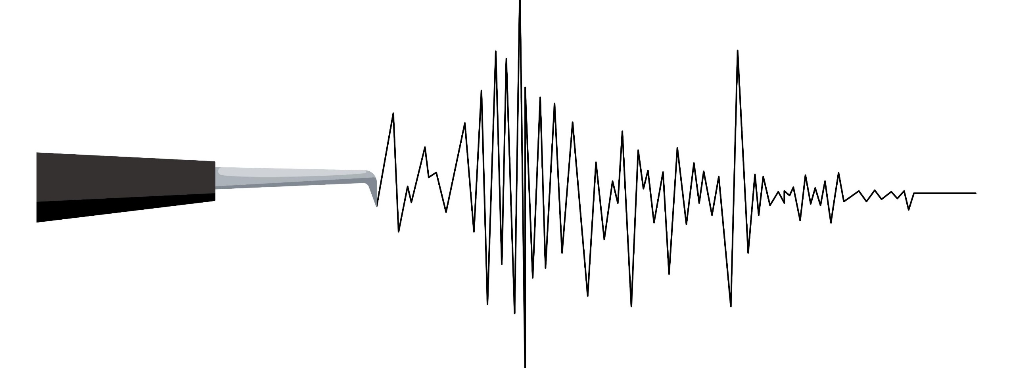
Seismogram
S wave arrival
Surface wave arrival
P wave arrival
S-P time
iStock/IRYNA NASKOVA

Slide 51
Comparing earthquake waves
P waves | S waves | Surface waves
The first wave measured by seismograph | The second wave measured by seismograph | The last waves measured by seismograph
Compression wave | Transverse/shear waves | Highest amplitude waves
Move through solids and liquids | Only move through solids (not liquids) | Travel across the surface of the Earth
Medium moves in same direction to the wave/energy movement | Medium moves in perpendicular direction to the wave/energy movement | Medium moves side to side or in a rolling motion

Slide 52
How can we model the different types of earthquake waves and their impact?

Slide 53
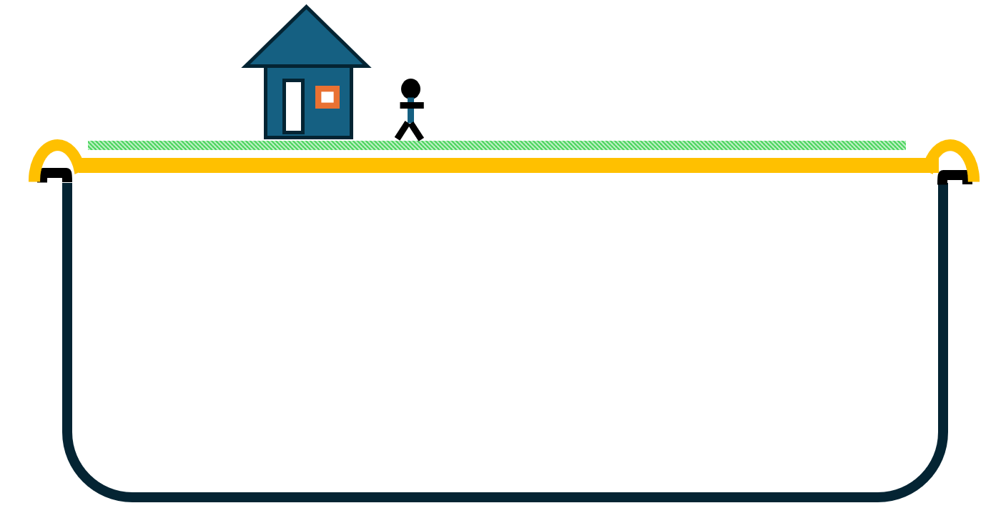
Seismic wave model
Place the large tub (with no lid) on a flat surface.
Hook the occy straps on the short edges of the large tub so that they are suspended across the open top.
Place the flexible surface on top of the suspended occy straps to represent the Earth’s crust.
Pull or push the occy straps to model:
  P waves: pull then release the occy straps
  S waves: move the occy straps from side to side
  Surface waves: move the occy straps down and then quickly release them

Slide 54
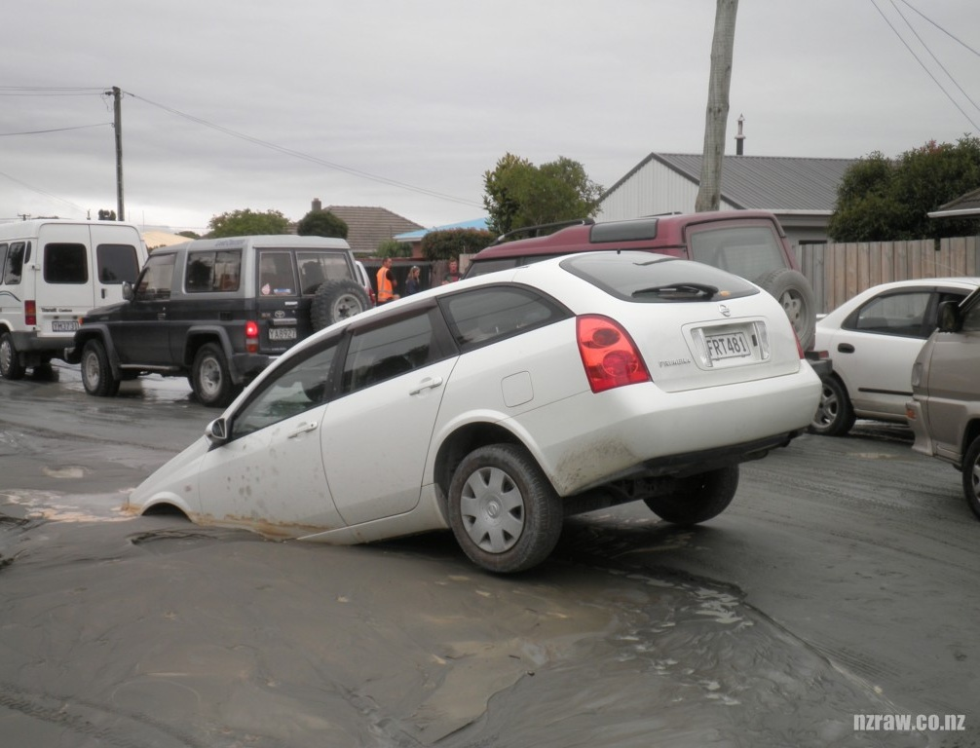
Liquefaction model
Place the sand and water in the plastic tub.
Mix it thoroughly until all the sand is consistently damp.
Use the spoon to bury the ping pong ball in the sand. This represents an empty tank or pipe that is buried under the ground.
Place the remaining objects on the surface of the sand.
Simulate an earthquake by tapping the side of the tub or gently shaking the tub back and forth.
www.nzraw.co.nz CC BY-NC-ND 2.0

Slide 55
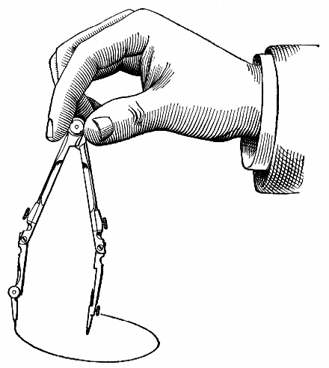
Locating the epicentre (Geoscience Australia)
Identify the P and S waves on the seismograms from Quakeville Station, Pearsons Crossing Station and Well Station.
Measure the time between the start of the P and S waves on each graph (P-S time). This can be done by using the time measurements at the base of each graph (10 marks = 10 seconds). Record this time in Table 1 of the Resource sheet.
Use the time-distance graph on page 2 of Epicentre hunt to convert the measured P-S time for each station into a distance. Record this distance in Table 1.
Identify the town of Quakeville on the map on page 4 of Epicentre hunt.
Expand the compass drawing tool to 5.3 cm between the pencil and the metal point. This represents 53 km (the distance between the town and the epicentre).
Place the metal point of the compass drawing tool in the centre of Quakeville. Draw a circle around the town to represent the possible locations of the epicentre.
Repeat this process of expanding the compass to the appropriate distance for Pearson Crossing Station and Well Station and drawing a circle around each station.
Mark an ‘X’ on the location where all three lines overlap to show the epicentre of the earthquake.

Slide 56
Compare the earthquake models
Model | Advantages | Limitations
Seismic wave model
Liquefaction model
Epicentre model

Slide 57
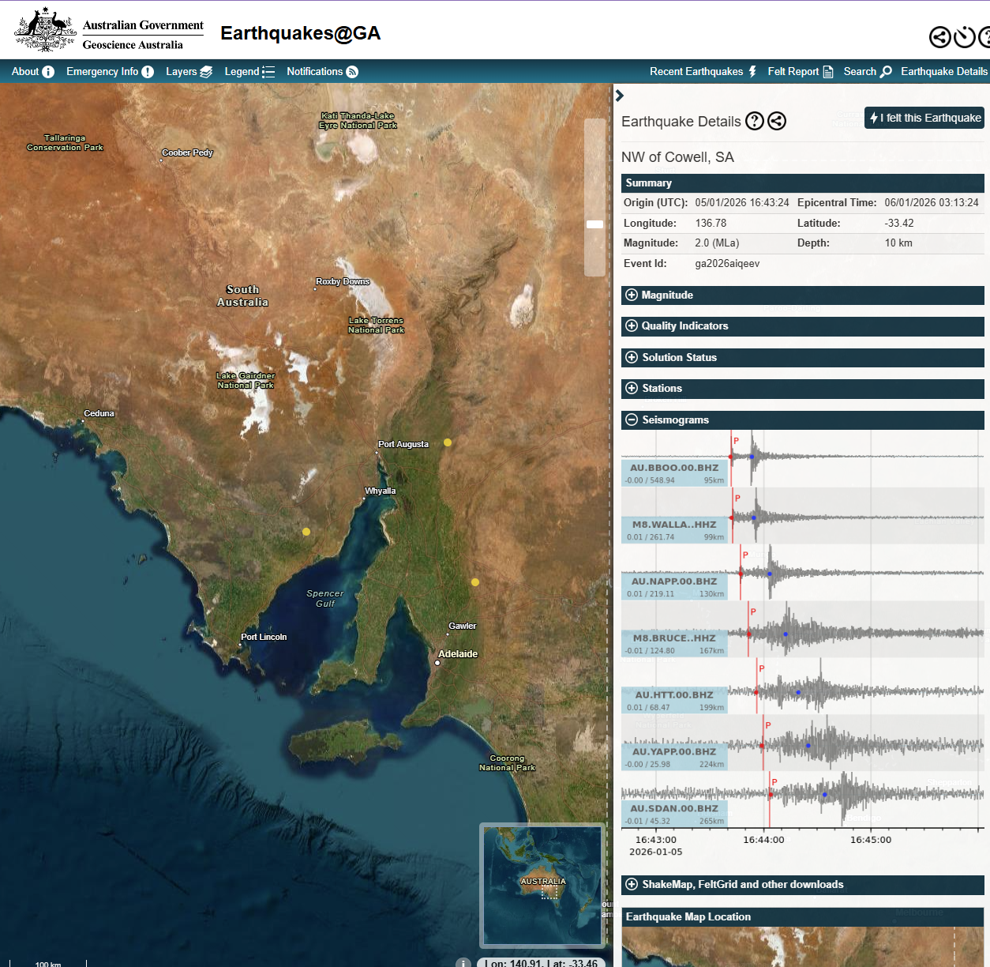
Geoscience Australia monitors earthquakes

Slide 58
Lesson 6
Earthquake materials

Slide 59
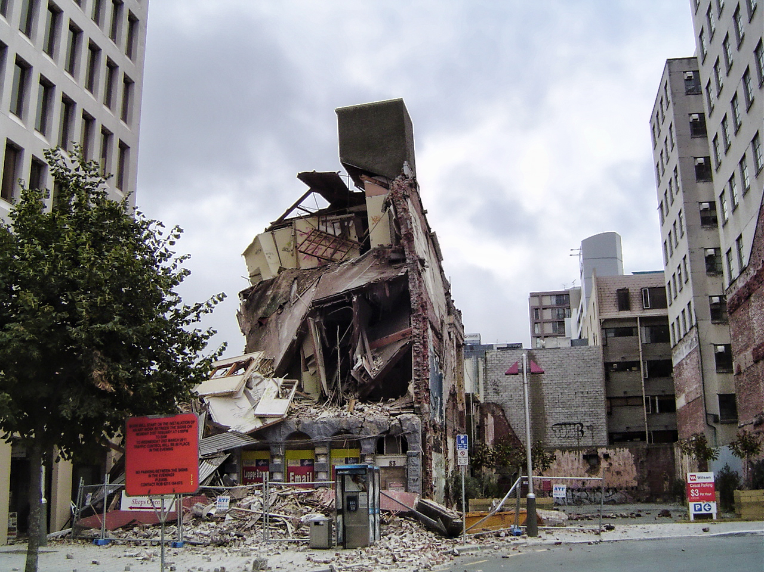
What materials were used in this building?
Lee Hanner, CC BY-SA 2.0, via Wikimedia Commons

Slide 60
Properties of materials
Rigidity
The ability of a material to resist movement
Flexibility
The ability of a material to bend without breaking
Strength
Tensile strength: the ability to resist being stretched
Compressive strength: the ability to withstand being compressed
Yield strength: the level where a material is permanently deformed

Slide 61
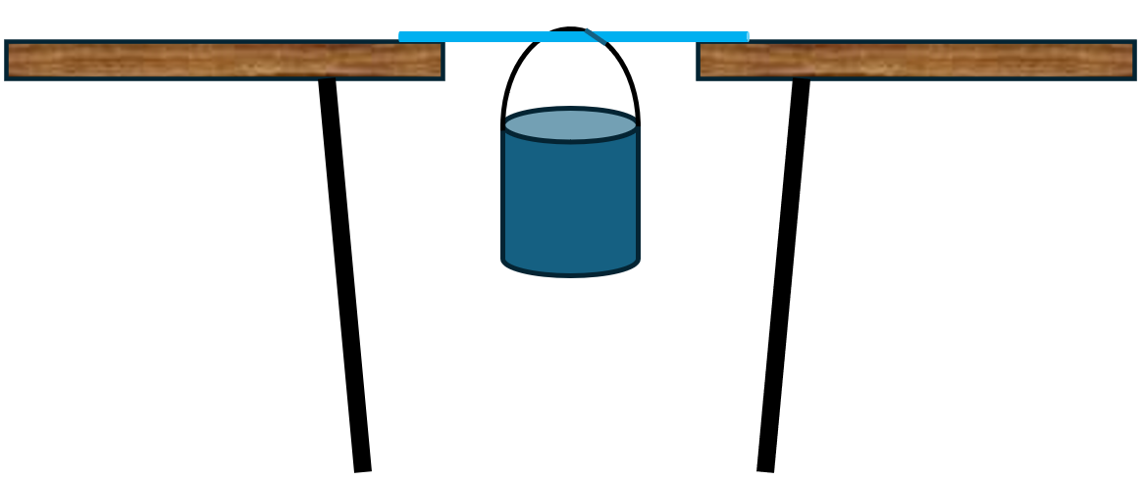
Plan an investigation into flexibility and strength

Slide 62
Discussion
Explain why it was important to test the wood, bamboo, and metal using the same setup.
Describe how the results for flexibility would change if the material bending was measured from different angles.
Describe how you knew the material had reached its yield point.
Describe what might happen to the results if too much weight were added too quickly.
Compare this testing model to what happens to materials during an earthquake.
Describe how this experiment could be improved to better represent real-world conditions.
Explain how engineers balance strength, flexibility, and safety when designing structures.

Slide 63
Which material should be used in earthquake zone?
Claim:
Reasoning:
Evidence:

Slide 64
Can we build with it?
Why might it be harder to build structures using round bamboo rods instead of flat pieces?
How could the shape of bamboo make walls or straight edges harder to build?
What building techniques or tools could help make bamboo structures stronger?
How can combining bamboo with another material (such as string, glue, or wire) make it stronger or more stable?
Can combining materials change how flexible or stiff a structure is? Why?
Why might one material be good for strength, while another is better for holding things together?
Can you think of an example where combining materials makes something better than using just one?

Slide 65
Lesson 7 ACT
Designing for earthquakes

Slide 66
Geoscience Australia Portal 3D map
Rotate the Earth to locate New Zealand.
Increase ‘Ground Opacity’ to 60%-70%.
Identify the subduction zone north of New Zealand.
Can you find other subduction zones?

Slide 67
Discussion
Why do you think people still choose to live in areas where earthquakes happen often?
What challenges might people face living in an area with frequent earthquakes?
How could earthquakes affect homes, schools, and hospitals?
Looking at the list of earthquakes from the past year, what do you notice about how often they occur?
Are most earthquakes small or large? Why is this important?
What was the most recent ‘large’ earthquake recorded, and where did it happen?
Why do you think some earthquakes cause more damage than others?
How is living in an earthquake-prone area different from living in a place with few or no earthquakes?
If you lived in an area with frequent earthquakes, what would worry you the most and why?

Slide 68
Define
Outline the location for the house to be built and the communities that live in the area. Consider the materials that might be available, the risks of earthquakes or tsunamis, and the lifestyle of the community (e.g. Do multiple generations live in the same building? Do people live alone? How do they shop or obtain food?).

Slide 69
Ideate
Brainstorm the key features that could be used to minimise damage during an earthquake or tsunami. Consider:
the way the earth will move.
the type of materials that could be used.
the use of counterbalance weights.
natural land features that may minimise the risk of tsunamis.

Slide 70
Design the prototype
Select the different features that are required for the house. Consider the size of the building, doorways and windows.
Is the type of soil important (liquefaction)?
Consider whether the building would need to survive both earthquakes and tsunamis.

