Slide 1
Science Connections
Year 10 Newton meets AI

Slide 2
L1 Launch
Accidental physics

Slide 3
How did you travel to school today?
“Forty years ago, 75 per cent of children walked or rode to school, but this has now dropped to just one in five, meaning children are missing valuable opportunities to incorporate physical activity into their daily routines.”
The Kids Research Institute Australia, Curtin University, 2024

Slide 4
Annual road deaths in Australia
Australian Road Deaths Database – Bureau of Infrastructure and Transport Research Economics. (2025). catalogue.data.infrastructure.gov.au. https://catalogue.data.infrastructure.gov.au/dataset/australian-road-deaths-database

Slide 5
Don’t get caught in the TRAAP!
Timeliness: When was the information/data published or updated?
Relevance: Is the information/data relevant to the discussion?
Authority: Is the publisher of the information an expert on the information being published?
Accuracy: Can the information be verified by another source?
Purpose: Why was the information/data published?

Slide 6
Annual road deaths in Australia
Australian Road Deaths Database – Bureau of Infrastructure and Transport Research Economics. (2025). catalogue.data.infrastructure.gov.au. https://catalogue.data.infrastructure.gov.au/dataset/australian-road-deaths-database

Slide 7
Argumentation
Claim:
It is more dangerous for students to walk to school now than in the past.
Reasoning:
???
Evidence:
???

Slide 8
Speed
How fast an object travels a distance.
3 metres/second = travels 3 m every second
= travels 6 m every 2 seconds

Slide 9
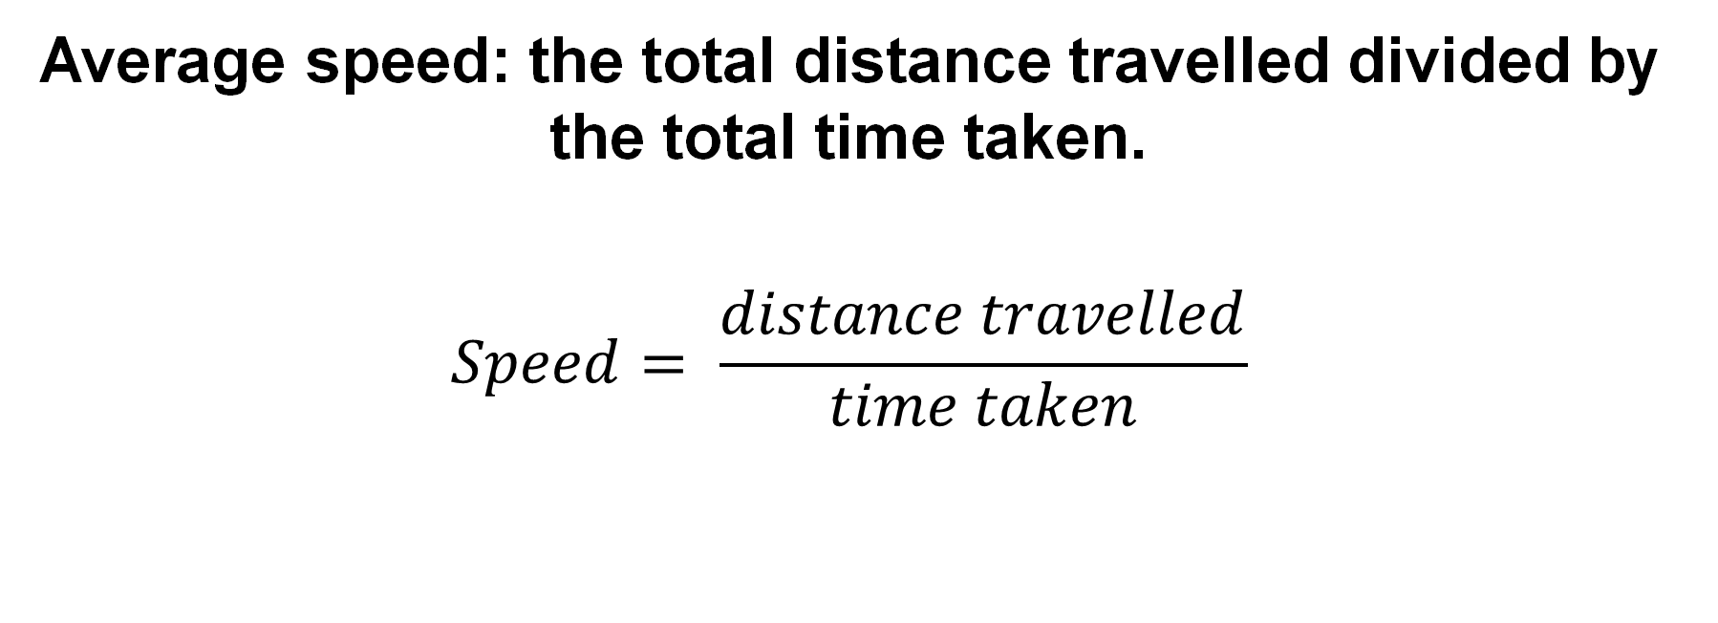
Speed
Average speed: the total distance travelled divided by the total time taken.
$$Speed= \frac{distance travelled}{time taken}$$

Slide 10
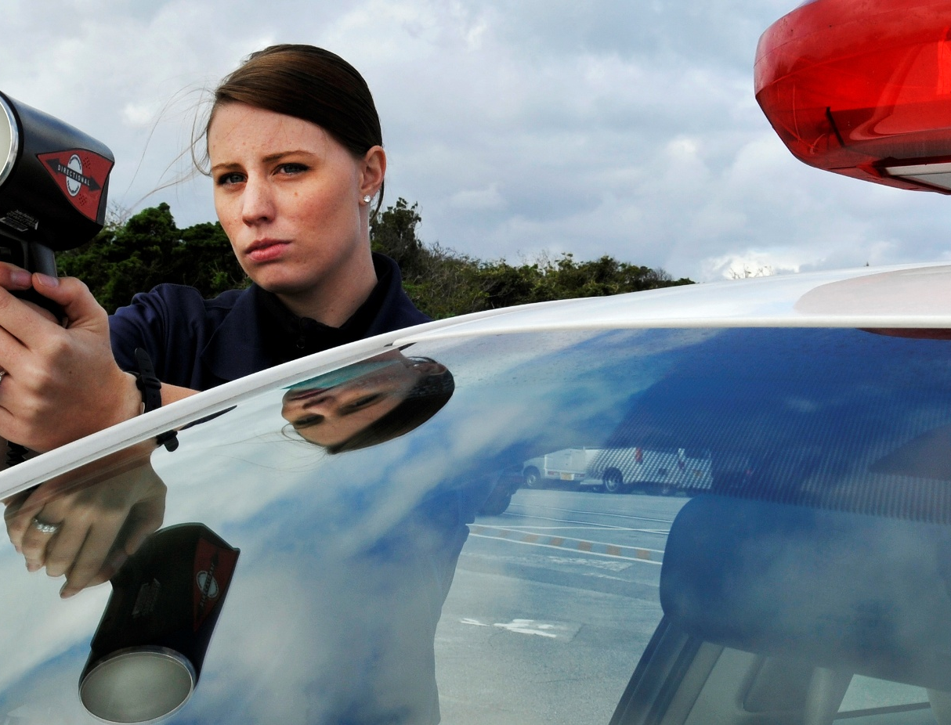
Speed
Instantaneous speed
The speed of an object taken at a particular time.
US Air Force from USA, Public domain, via Wikimedia Commons

Slide 11
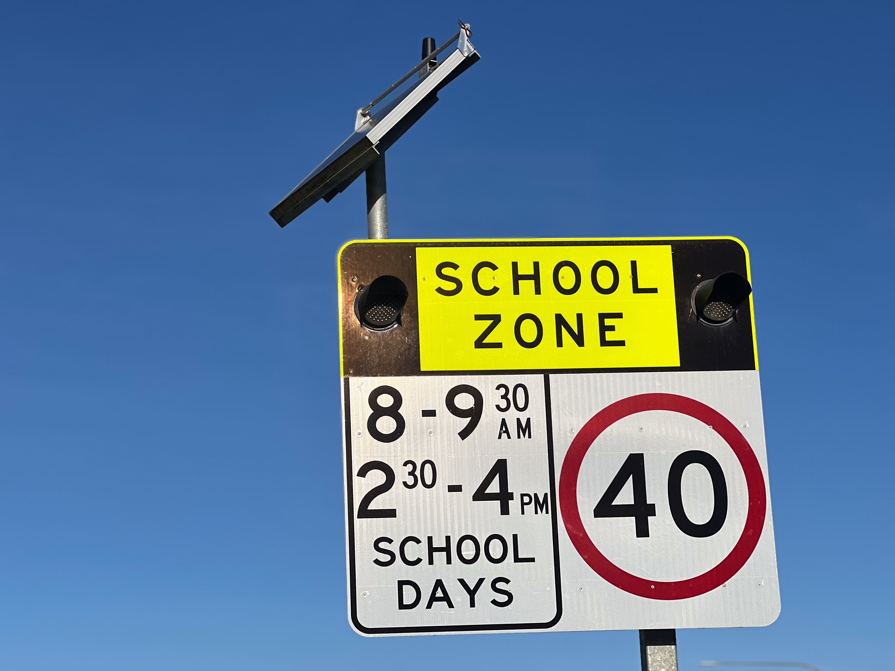
Are cars speeding?
Select a safe location outside your school where you can observe cars travelling 50 or 100 m. Allocate a person who will watch all traffic to ensure the people doing the measuring are safe.
Measure 50 or 100 m along the road. Mark the starting point and finish point using chalk or cones.
Place 1 person at the starting point. This person will raise their hand when the front of a car passes them.
Place 1 person with a stopwatch at the finish point.
As each car approaches, the timer starts the stopwatch when they see the person at the starting point raises their hand.
Stop the stopwatch as soon as the front of the car crosses the finish line. Record the time.

Slide 12
Discussion
What were the challenges of measuring the average speed of the cars?
How did the time you measured for a particular car compare with the time measured by another group?
What factors could have affected any differences in the time measured?
What did/could you change to make the average speed measurements more reliable?
If a car slows down when passing the school, but speeds up after, how does that affect its average speed through the school zone?
If a car is going faster than the speed limit outside a school, how might that affect safety of the roads?
How could technology (like speed cameras or radars) help monitor average speeds outside schools?

Slide 13
L2 Inquire
Fast, faster, fastest

Slide 14
What do we mean when we say a car is speeding?

Slide 15
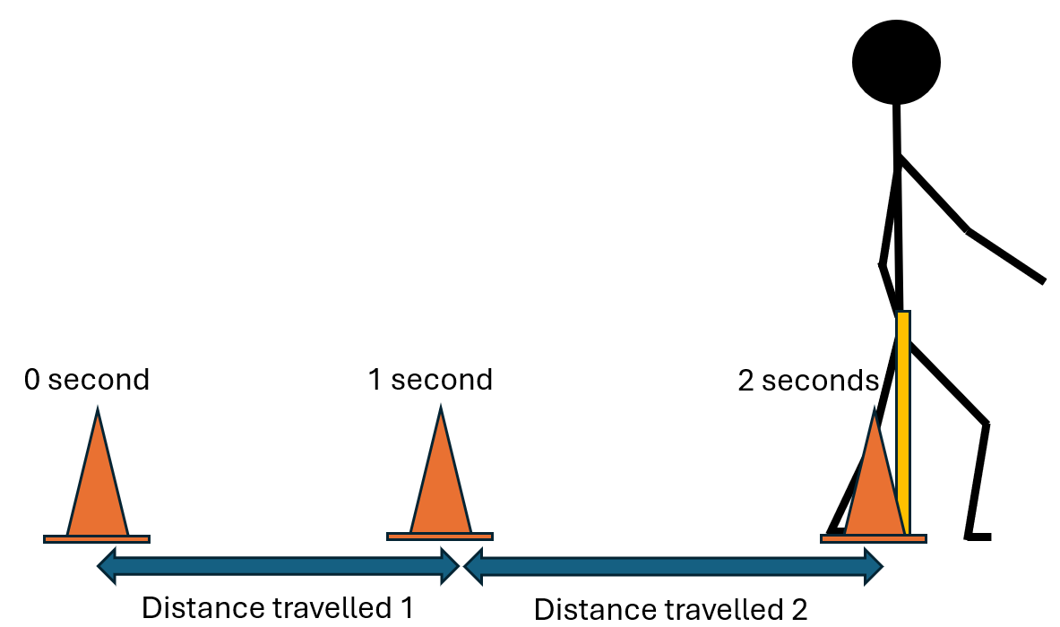
Measuring speed
The Walker walks 10 m at a constant speed.
The Timer uses the metronome or timer to count the seconds aloud.
The Markers place cones at the location of the Walker each second.
On ‘go’:
  The Walker should walk at their own pace alongside the tape measure, not in time to the metronome.
  The Timer should count the seconds aloud.
  Each second, the Marker should place a cone on the tape measure at the Walker’s centre of mass.
Record the distance travelled during each second
Draw a graph of distance travelled each second.

Slide 16
Discussion
What does each column represent on the graph?
During which time period did the Walker travel the fastest? How do you know?
Why might the Walker have travelled more slowly during some time periods?
How could we work out the average speed that Walker travelled?

Slide 17
How would the graph change if the Walker moved faster?

Slide 18
Compare the two graphs
Is this what you expected the graph to look like?
How is this graph different to the first graph?
Why are the columns longer?
During which time period did the Walker travel the fastest?
During which time period did the Walker travel the slowest?
How could we calculate the average speed of the Walker during this investigation?

Slide 19
Fast or slow?
High speed/Fast | Low speed/Slow
Place each of the following in the correct column
Takes longer to travel 10 m
Takes less time to travel 10 m
Travels further in 10 s
Travels a shorter distance in 10 s

Slide 20
L3 Inquire
Think fast

Slide 21
What do we know about autonomous cars?

Slide 22
What do we need to know about autonomous cars?

Slide 23
How do self-driving cars work?
https://www.youtube.com/watch?v=taMP_n3wL7M

Slide 24
Testing reaction times
Student 1 holds the ruler vertically above Student 2’s thumb and forefinger. The ‘0’ of the ruler should be equal with the thumb and forefinger.
Student 1 drops the ruler randomly (without warning) and Student 2 tries to catch it as quickly as possible between their thumb and forefinger.
The distance the ruler falls before being caught will determine the reaction time.
Record the position of Student 2’s fingers on the
ruler in cm.
Repeat this 5 times and average the distances.

Slide 25
Do distractions affect reaction times?
What type of distractions could affect a person’s reaction time?
How could you control the environment to test reaction times with and without distractions?
Who will have their reaction times tested? Why did you choose that person?
How could you make sure your test is reliable?
Why do you think you may need to repeat the test many times?
How will you collect or record your data?
What variable might be difficult to control?
How will you make sure your experiment is safe and respectful to everyone?

Slide 26
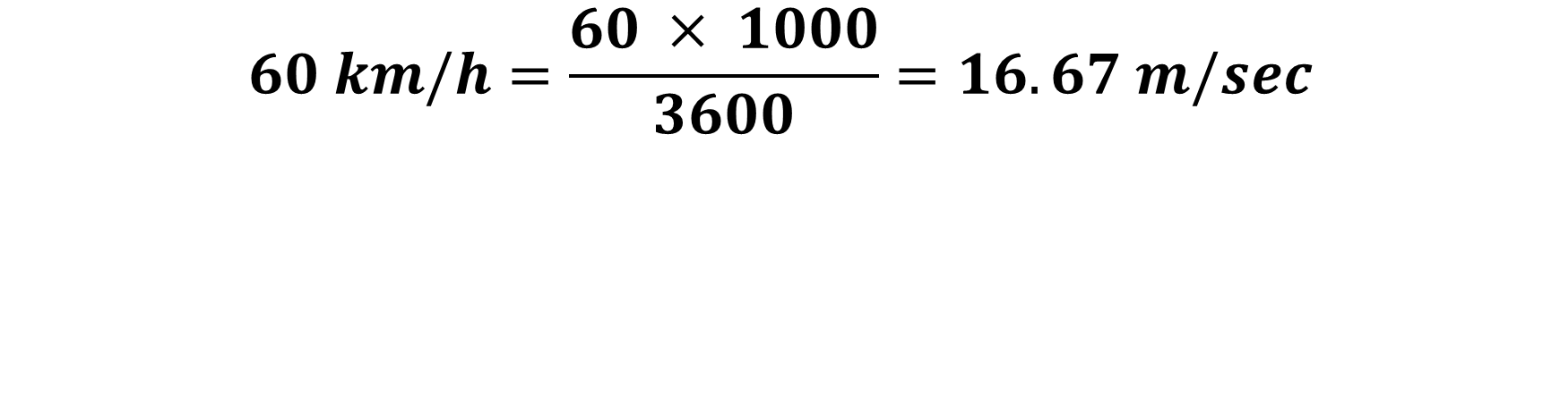
Convert km/h to m/s
$$60 km/h=\frac{60 × 1000}{3600}=16.67 m/sec$$

Slide 27
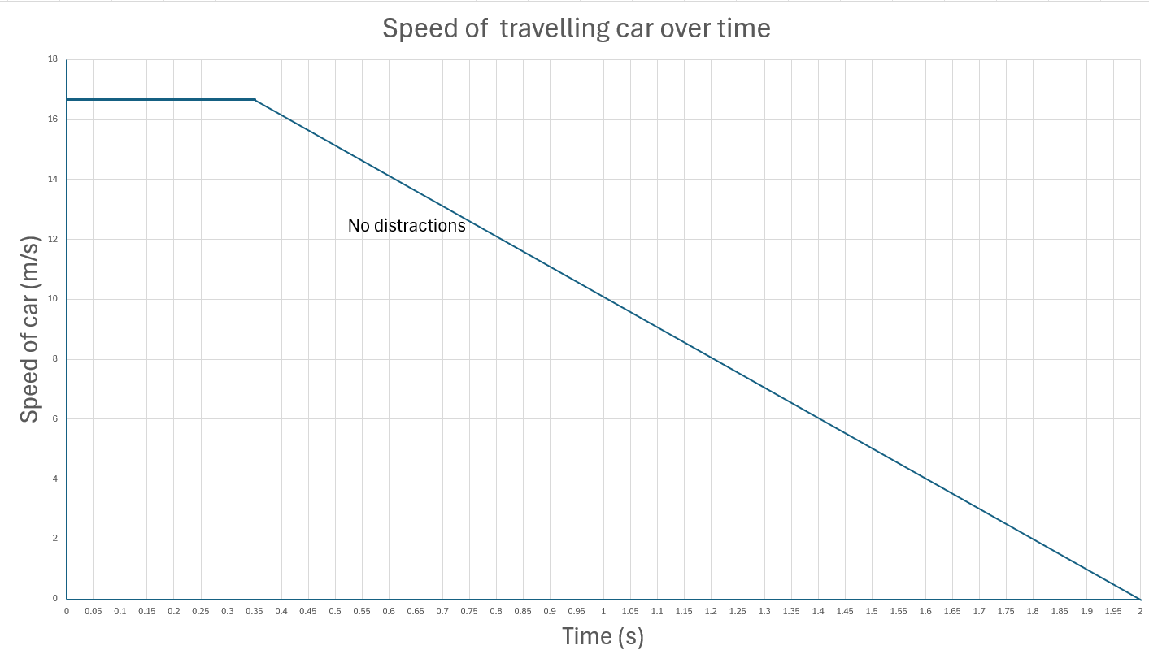

Slide 28
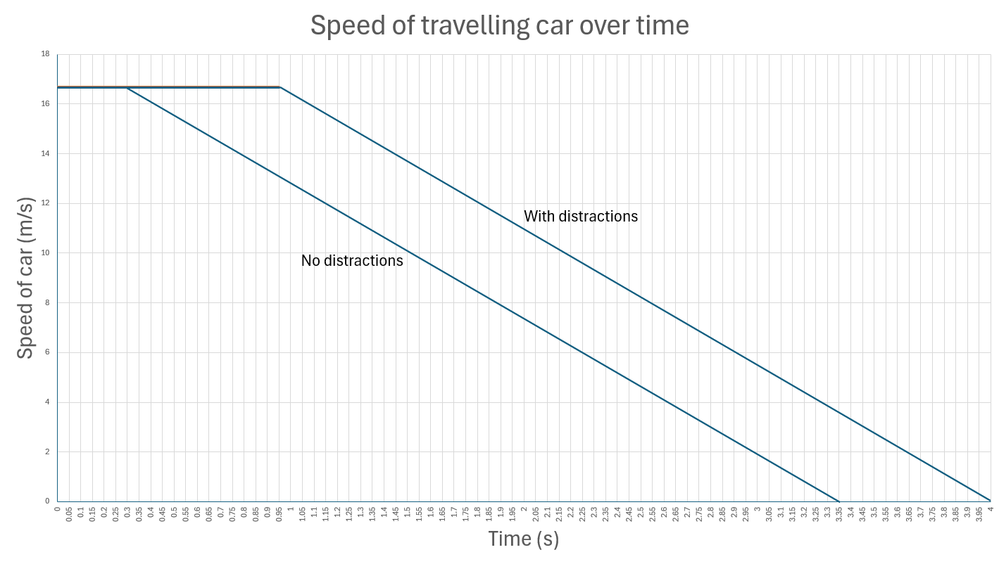

Reaction distance
= 0.95 x 16.67
= 15.87 m
Reaction distance
= 0.30 x 16.67
= 5.00 m
Stopping distance
= $\frac{1}{2}$ x base x height
= $\frac{1}{2}$ x 3.05 x 16.67
= 25.42 m

Slide 29

How far would the car travel before you start braking?
Use the formula Distance = Speed x Time
$$Distance=Speed × Time$$
$=16.67 ×Reaction time in seconds$

Slide 30
Comparing reaction times
Average human reaction time:
100 m sprinter = 0.144 seconds¹
Average person = 0.25 seconds²
Average autonomous car reaction time: 0.05 - 0.10 seconds³
Mitašík, P., Doležajová, L., & Lednický, A. (2022). INTRAINDIVIDUAL EVALUATION OF REACTION TIME AT THE MEN'S WORLD ATHLETICS CHAMPIONSHIPS 1999-2019. Acta Facultatis Educationis Physicae Universitatis Comenianae, 62(1), 72-82.
Silverman, I. W. (2010). Simple reaction time: It is not what it used to be. The American journal of psychology, 123(1), 39-50.
Betz, T., Karle, P., Werner, F., & Betz, J. (2023). An analysis of software latency for a high-speed autonomous race car—a case study in the indy autonomous challenge. SAE International Journal of Connected and Automated Vehicles, 6(12-06-03-0018), 283-296.

Slide 31
Autonomous car

Slide 32
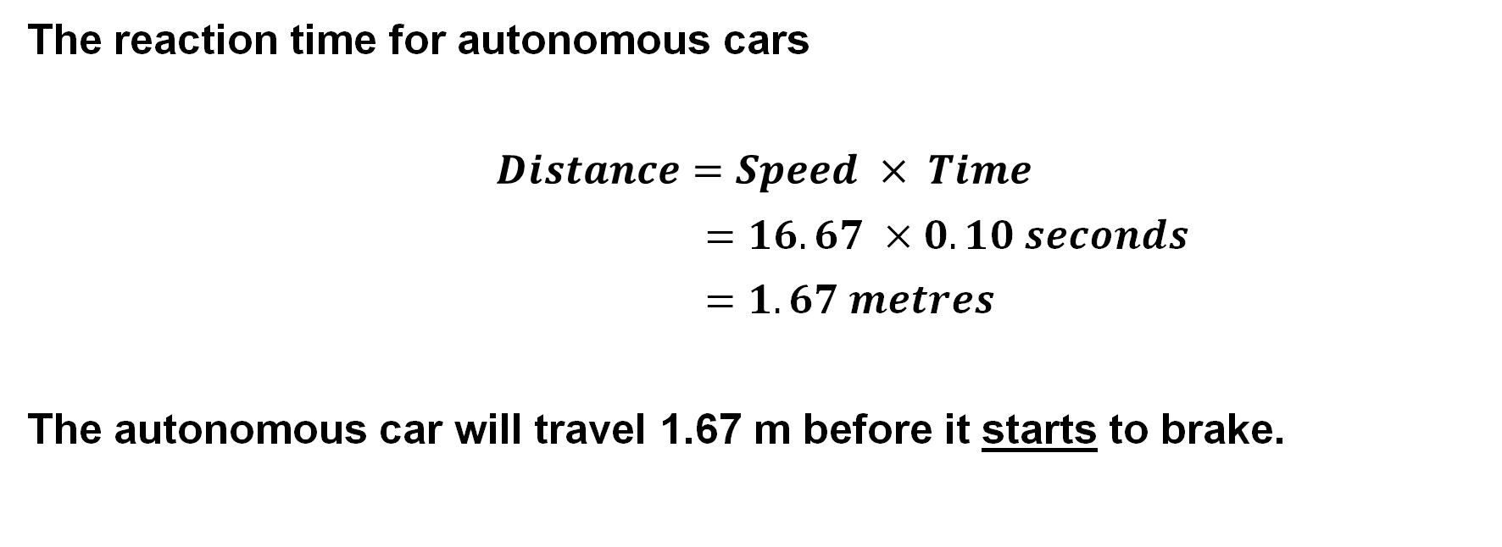
Example
The reaction time for autonomous cars
$$Distance=Speed × Time$$
$=16.67 ×0.10 seconds$
$=1.67 metres$
The autonomous car will travel 1.67 m before it starts to brake.

Slide 33
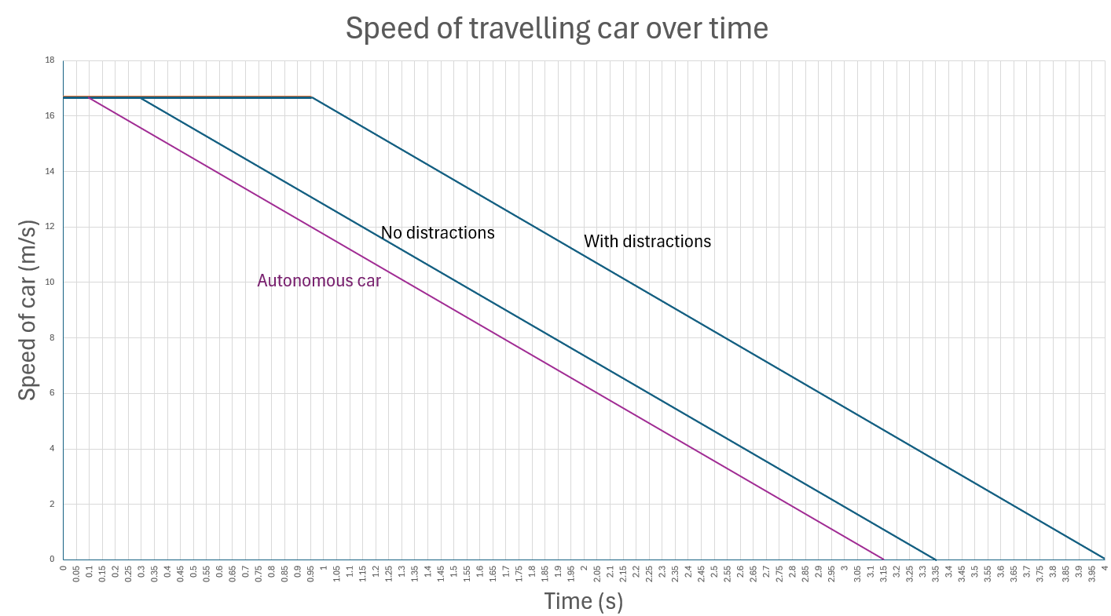

Slide 34
Argumentation
Claim:
Autonomous cars would(/would not) make it safer to walk to school.
Reasoning:
Evidence:

Slide 35
L4 Inquire
Stopping in time

Slide 36
What factors affect how quickly the brakes slow you down?

Slide 37
Measuring braking distance
1. Open up the It’s a drag website interactive.
2. Select the following conditions for the car.
3. When you start the test, a green circle will appear on the right-hand side of the “Brake” button. When this circle becomes red, select “Brake” as quickly as you can. Practice a few times to ensure that you can achieve a consistent result.
4. Complete the test three times and record your results.
5. Select different speeds as the independent variable. Complete the test three times for each speed and record your results.
Speed | Vehicle | Tyres | Road surface | Weather
20 km/h | Car | Treaded | Bitumen | Dry

Slide 38
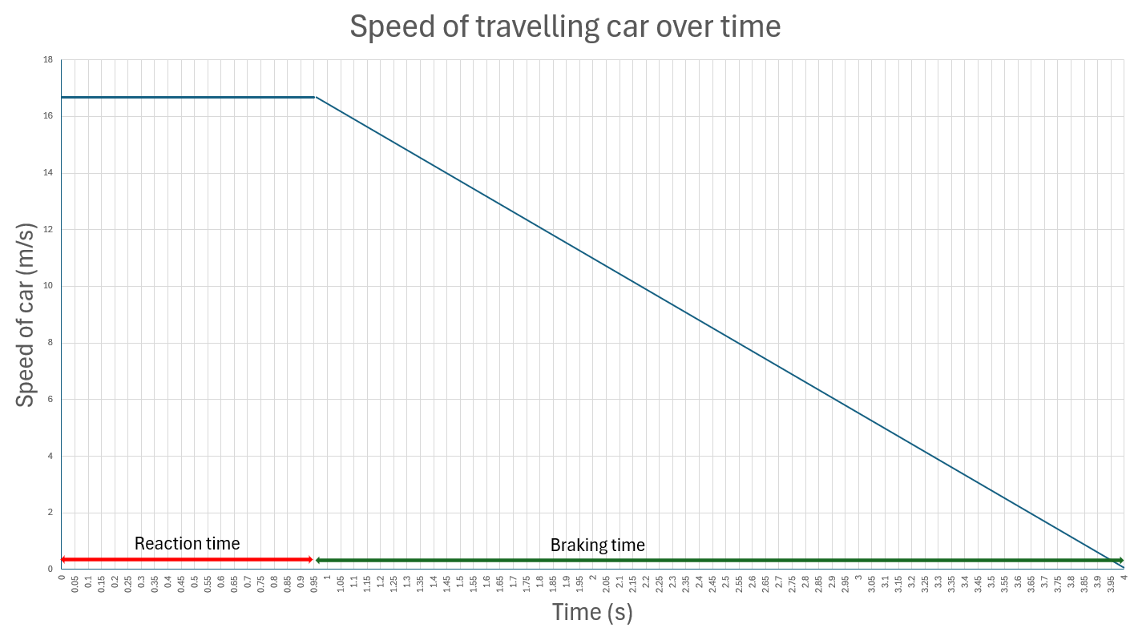

Slide 39
Discussion
What type of model are you using?
What are the limitations of this model? What doesn’t it do or show?
Why is it important to practice using the braking simulation before starting your tests?
What could happen if you didn’t understand how the program works before collecting data?
What is the difference between reaction distance and stopping distance?
Why can’t we just look at the braking distance when thinking about a car’s total stopping distance?

Slide 40
What variable will you change?
Tyre wear
Road surface
Weather

Slide 41
Discussion
Why do you change only one variable in your tests?
What is your independent/dependent variable?
Why are you only comparing the braking distance and not the reaction distance?
How do you think bald tyres/road surface/weather will affect the braking distance?
Why do you think bald tyres/road surface/weather will increase the braking distance?
How do the brakes work to stop the car?
How will the bald tyres/road surface/weather affect the friction between the road and the tyres?
How does this affect the stopping distance of the car?

Slide 42
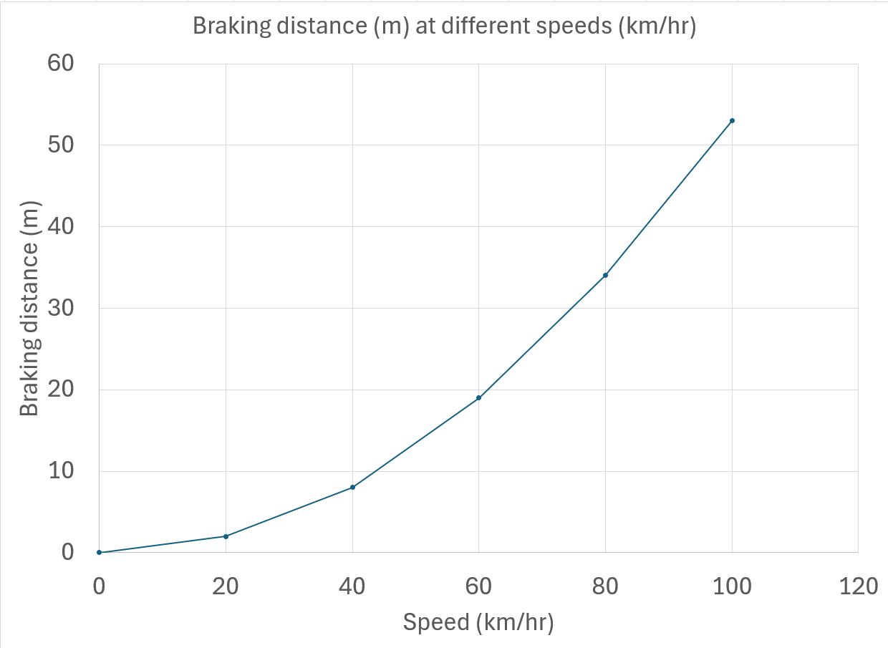
Braking distance at different speeds

Slide 43
Discussion
What trend did you notice between the car’s starting speed and the total stopping distance?
Did stopping distance increase steadily, or was the increase more dramatic at higher speeds?
What pattern did you observe between the car’s speed and braking distance when the car speed was doubled from 20 km/h and 40 km/h?
How much did the braking distance increase when the speed increased by a factor of 3 (20 km/h to 60 km/h)?
How much did the braking distance increase when the speed increased by a factor of 4 (20 km/h to 80 km/h)?
Why do you think speed limits are lower near schools?
How could your experiment results help explain the danger of speeding in school zones?

Slide 44
What is the effect of bald tyres/road surface/weather on the braking distance?

Slide 45
Acceleration = slope or gradient of the graph

Slide 46
Acceleration
The rate at which speed and direction changes.
Positive acceleration: a car is speeding up.
Negative acceleration: a car is slowing down.
Notes:
NOTE: the Australian Curriculum does not include the vectors of displacement or velocity. If your state curriculum includes vectors at this level, it is worth including extra Inquire phases to introduce this content.

Slide 47
How will autonomous cars need to modify their driving?
Claim:
Autonomous cars need to travel slower in wet conditions.
Reasoning:
Travelling slower means less distance will be travelled when braking.
Evidence:
In wet conditions, cars travel further when braking.

Slide 48
L5 Inquire
Does mass matter?

Slide 49
How closely should you follow an autonomous car?

Slide 50
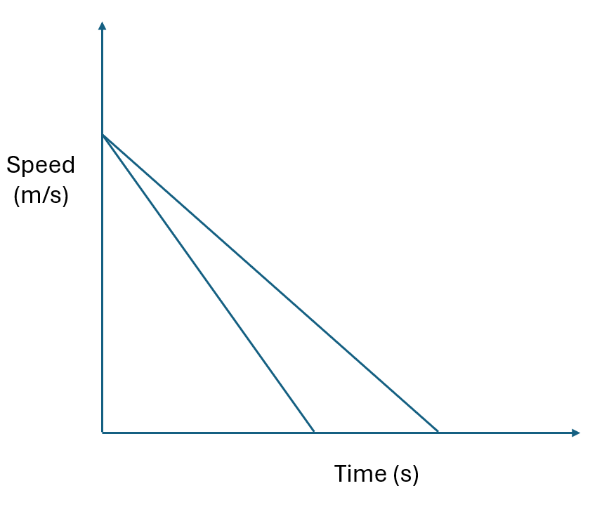
Which line represents stopping on a wet road or a dry road?

Slide 51
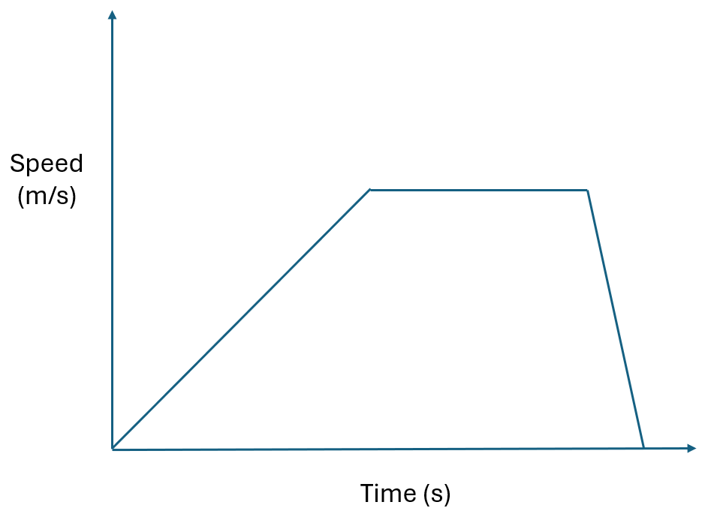
What does this graph tell you about how the car is moving?

Slide 52
Will a car’s acceleration (negative or positive) change if there are a lot of people in the car?
Does the number of people in a car affect its acceleration?

Slide 53

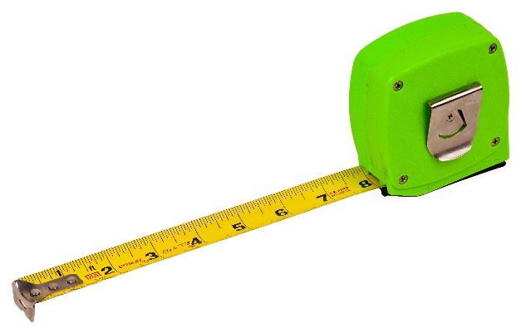
Newton’s second law
Activity 1
Tie the length of elastic to the two nails on the board.
Place the toy car in the centre of the board against the elastic.
Pull the toy car and elastic towards the end of the board. Use the ruler to measure how far the elastic has stretched. Record this measurement.
Release the car so that it rolls along the board. Use the stopwatch to measure how long it takes for the car to reach the end of the board. Record the time.
Repeat steps 2-4 another two times with the car and elastic pulled back to the same starting mark.
Use the tape to add a 50g mass on top of the car. Make sure the wheels of the car are not affected by the tape.
Repeat steps 2-4 three times with the mass on the top of the car, using the same starting mark.
Repeat steps 6-7 (the car now has 2 x 50g masses).
Activity 2
Extend the tape measure to 2 metres and lock it into place.
Tape a 50 g mass to the end of the tape measure.
Release the lock and measure the time taken for the tape measure to fully retract. Record your measurements.
Repeat steps 1-3 two further times. Determine the average time for the tape measure to retract.
Repeat steps 1-4 for 100 g.

Slide 54
Discussion
What was the force that moved the car?
How did you make sure the force was the same in both cases?
How did the car accelerate (change its speed) when the force was applied?
How did adding the mass change the acceleration of the car?
How did doubling the mass change the acceleration of the car?
How did the end of the tape measure accelerate (change its speed) as it retracted?
What provides the force for the tape measure to retract?
Was this force different for the two different masses?
If the force did not change, what did change when you increased the mass?

Slide 55
Newton’s second law
Force = mass × acceleration

Slide 56
Does the number of people in a car affect acceleration?
How fast does a car full of people accelerate compared to a car with no passengers?
Does this mean the car engine needs more or less force to accelerate at the same rate?
What about slowing down? Does a car full of people need more or less force to slow down compared to a car with no passengers?
Can you brake with more force if you have a car full of passengers?
How will the stopping distance change if you have a car full of passengers?

Slide 57
How will autonomous cars need to modify their driving?
Claim:
Autonomous cars need to change their driving programs when passengers are onboard.
Reasoning:
Evidence:

Slide 58
L6 Inquire
Seatbelt safety

Slide 59
What happens to the driver and passengers when a car stops suddenly?

Slide 60
Crash test dummies
What did you notice about the motion of the crash test dummies during and after the crash?
What stopped the car?
What stopped the crash test dummies?
Why do the dummies continue moving forward even after the car has stopped suddenly?
How does the seatbelt change the outcome for the dummies, based on what you saw?

Slide 61
Jumping on a moving trampoline
How fast were the person, the car, and the trampoline moving before they jumped?
Watching just the forward motion of the person on the trampoline, did their speed forward change? How do you know?
If you were watching from the car, would the person’s forward motion change?
What would happen to the person if the car started accelerating while they were in the air?
What if the car pulling the trampoline slowed down while the person was in the air?
How is this video similar to the previous video?

Slide 62
Throwing a ball in a moving vehicle
How could you describe the forward motion of the ball, person, and ute at the start of the video?
What happened to the ball when it was thrown in the air?
Were there any forces keeping the ball moving forward?
Why did the ball keep moving forward when it was thrown in the air?
What would happen if it was a windy day?

Slide 63
Roller blades on a trolley
What did you notice about the person’s position when the trolley started moving?
Why did the person seem to stay still while the trolley moved forward underneath them?
Have you ever stood on a bus or train when it suddenly started moving? What happened to your body?
Why do you think you feel like you’re being pushed backward when a vehicle starts moving forward?
What helps you stay in place on a moving bus or train (e.g. shoes, friction, handrails)? How is that different from wearing roller blades?
What would happen if the person on roller blades grabbed onto a handle or railing? How would their motion change?
How is this video similar to the other videos?

Slide 64
What do the crash dummies, trampoline jumper, and ball have in common?

Slide 65
What do the roller blades and paper/weight activity have in common?

Slide 66
Newton’s first law
A body in motion remains in motion until an unbalanced force acts on it.

Slide 67
L6A Inquire
What can data tell us?

Slide 68
Australian Road Deaths Database
T: Timeliness: When was the information published or updated?
R: Relevance: Is it relevant to the discussions on road safety?
A: Authority: Is the publisher of the information an expert on the information?
A: Accuracy: Can the information be verified by another source?
P: Purpose: Why was the database published?

Slide 69
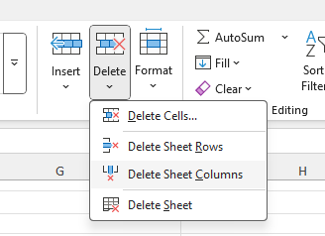
Deleting data in Excel

Slide 70
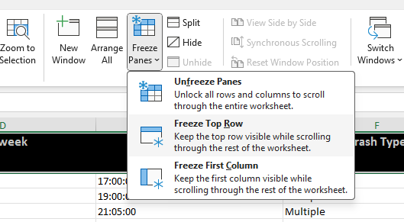
Freezing the top row (View)

Slide 71
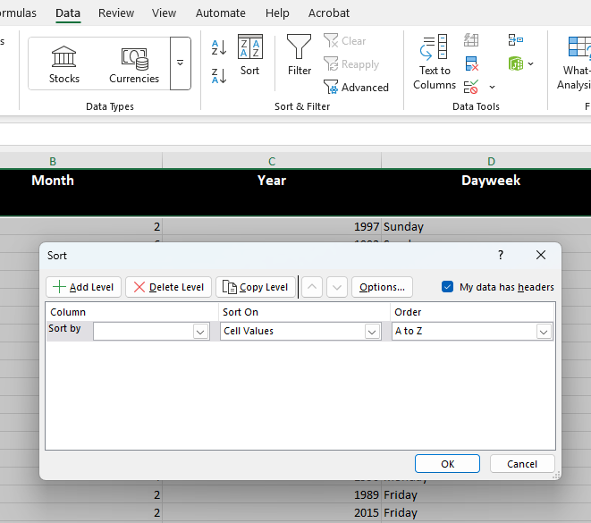
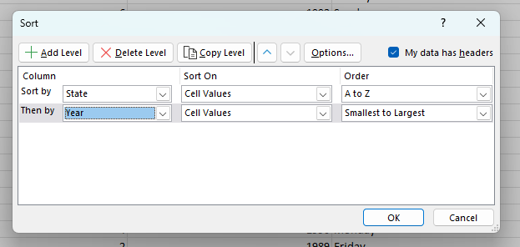
Sorting data (Data)

Slide 72
What factors could affect the number of road fatalities?
What do you notice?
What patterns can you find?
How do these variables seem to be related?
What is the relationship between...
How does ___ affect ___?
Is there a link between...?

Slide 73
Writing an investigable question
Is the data available?
Can the question be answered by analysing the data?
Is the question measurable and focused?
Is the question specific and easy to understand?
Does it avoid vague terms like "better" or "interesting"?
  Example: "How has the number of road fatalities in NSW changed from 2010 to 2020?"
  Too vague: "Why are car crashes bad?"
Does the question involve interpreting data, finding patterns or making comparisons?
Does the question require more than a yes/no answer or a single fact?
Does it relate to a real-world issue or scientific concept?

Slide 74
Clean the data
What does it mean to ‘clean’ data? What kinds of data might be removed or changed?
Why is it important to clean data before analysing it? What problems might happen if we don’t?
How did cleaning the data help you see patterns or relationships between variables more clearly?
What kind of errors or outliers were removed during the cleaning process? How did that affect your results?
Can removing ‘bad data’ make your conclusions more accurate? Why or why not?
What could happen if you accidentally remove data that was actually important?
Should we always remove outliers or strange data points? Why or why not?
How can we make sure our data cleaning choices are fair, honest, and based on good reasoning?
If two people cleaned the same dataset differently, could they come to different conclusions? What does that tell you?

Slide 75
Correlation vs causation
What does it mean if two things are correlated? Can you give an example?
What is causation? How is it different from correlation?
Why is it important not to assume that correlation means causation?
Ice cream sales and the frequency of sunburns both increase in December. Does this mean ice cream causes sunburn? Why or why not?
How can scientists test whether a relationship is actually causal?
Why are controlled experiments better for finding causation than just looking at data trends?
Why do people often jump to conclusions when they see two things happen together?
What are the risks of making decisions based on a false assumption of causation?

Slide 76
L6B Inquire
Ethical dilemmas

Slide 77
What should autonomous cars be programmed to do in an accident?

Slide 78
Ethical approaches
Consequentialism looks at the final outcome of a decision and decides if it was good or bad (the end justifies the means).
Deontology looks at the individual actions and decides if they are good or bad (were there good intentions?). The consequences do not matter.

Slide 79
Ethical concepts
Minimise harm
What will harm the least number of people?
Maximise the benefits
Who will people/society most need in the future?

Slide 80
Solve the ethical dilemma!

Slide 81
Discussion
What is your initial decision to this situation?
What action could the car have taken?
Did you use a minimise-harm approach or a maximise-benefit approach? Was there any difference to these approaches when you were making decisions?
Is anyone’s life more important than another person? Why or why not?
Who might you (as the driver) sacrifice your life for? Why?
Would your decision change if your family was in one of the groups? Why?
Is the number of lives saved more important than whose life is saved? Why?
What are the challenges of having to make these decisions years before the actual event?

Slide 82
L7 Act
Autonomous car design

Slide 83
Discussion
Do you trust the car manufacturers to make the right decisions for you (as a driver or a pedestrian) now?
When do you intend to get your driver’s license? Will this change if autonomous cars become more affordable?
How many autonomous cars are currently available? How could we find out?
What types of decisions do these cars make? How do we know? How could we find out?
What types of decisions would encourage you to buy an autonomous car? Why?

Slide 84
Design your future
Define
Outline the group of people who will want to buy the autonomous car. Consider the price range, the age and life stage (retirees, families, young sports car enthusiasts).
Ideate
Brainstorm the key features that will attract potential buyers including:
Safety features
Sensors used
The way the car responds in different situations
How the car modifies its driving in different conditions
The safety features of the car

Slide 85
Design your future
Design the prototype
Select the different features that will be used in the autonomous car. Consider where the sensors will be located and the style of the dashboard. For example, consider if the car will be fully autonomous, or if the driver will need to take control in an emergency.
Building the prototype
Prototypes can take many forms depending on the time and resources available. It may be as simple as a detailed drawing with labels and explanations, or as complex as a scaled model of the design.

